Slide 1


Scoring the Progress of Retirement Savers - How the MA
401 (k) CORE Plan Can Help Nonprofits Save for Retirement
July 24th Webinar
Presented by Massachusetts CORE Plan
Thanks for joining us! A few instructions before we begin:
You may join the audio by selecting the radio button for either “Telephone” or “Mic & Speakers.” If you are using telephone, please dial in with the conference line and audio pin provided.
If you are having any technical issues, please let us know in the chat box.
We will have time for Q&A. Please enter your questions in the chat box at any time.
This webinar is being recorded, and we will distribute the recording after the webinar.
Jenny Yuan
Operation and Membership Manager
www.massnonprofitnet.org

Slide 2
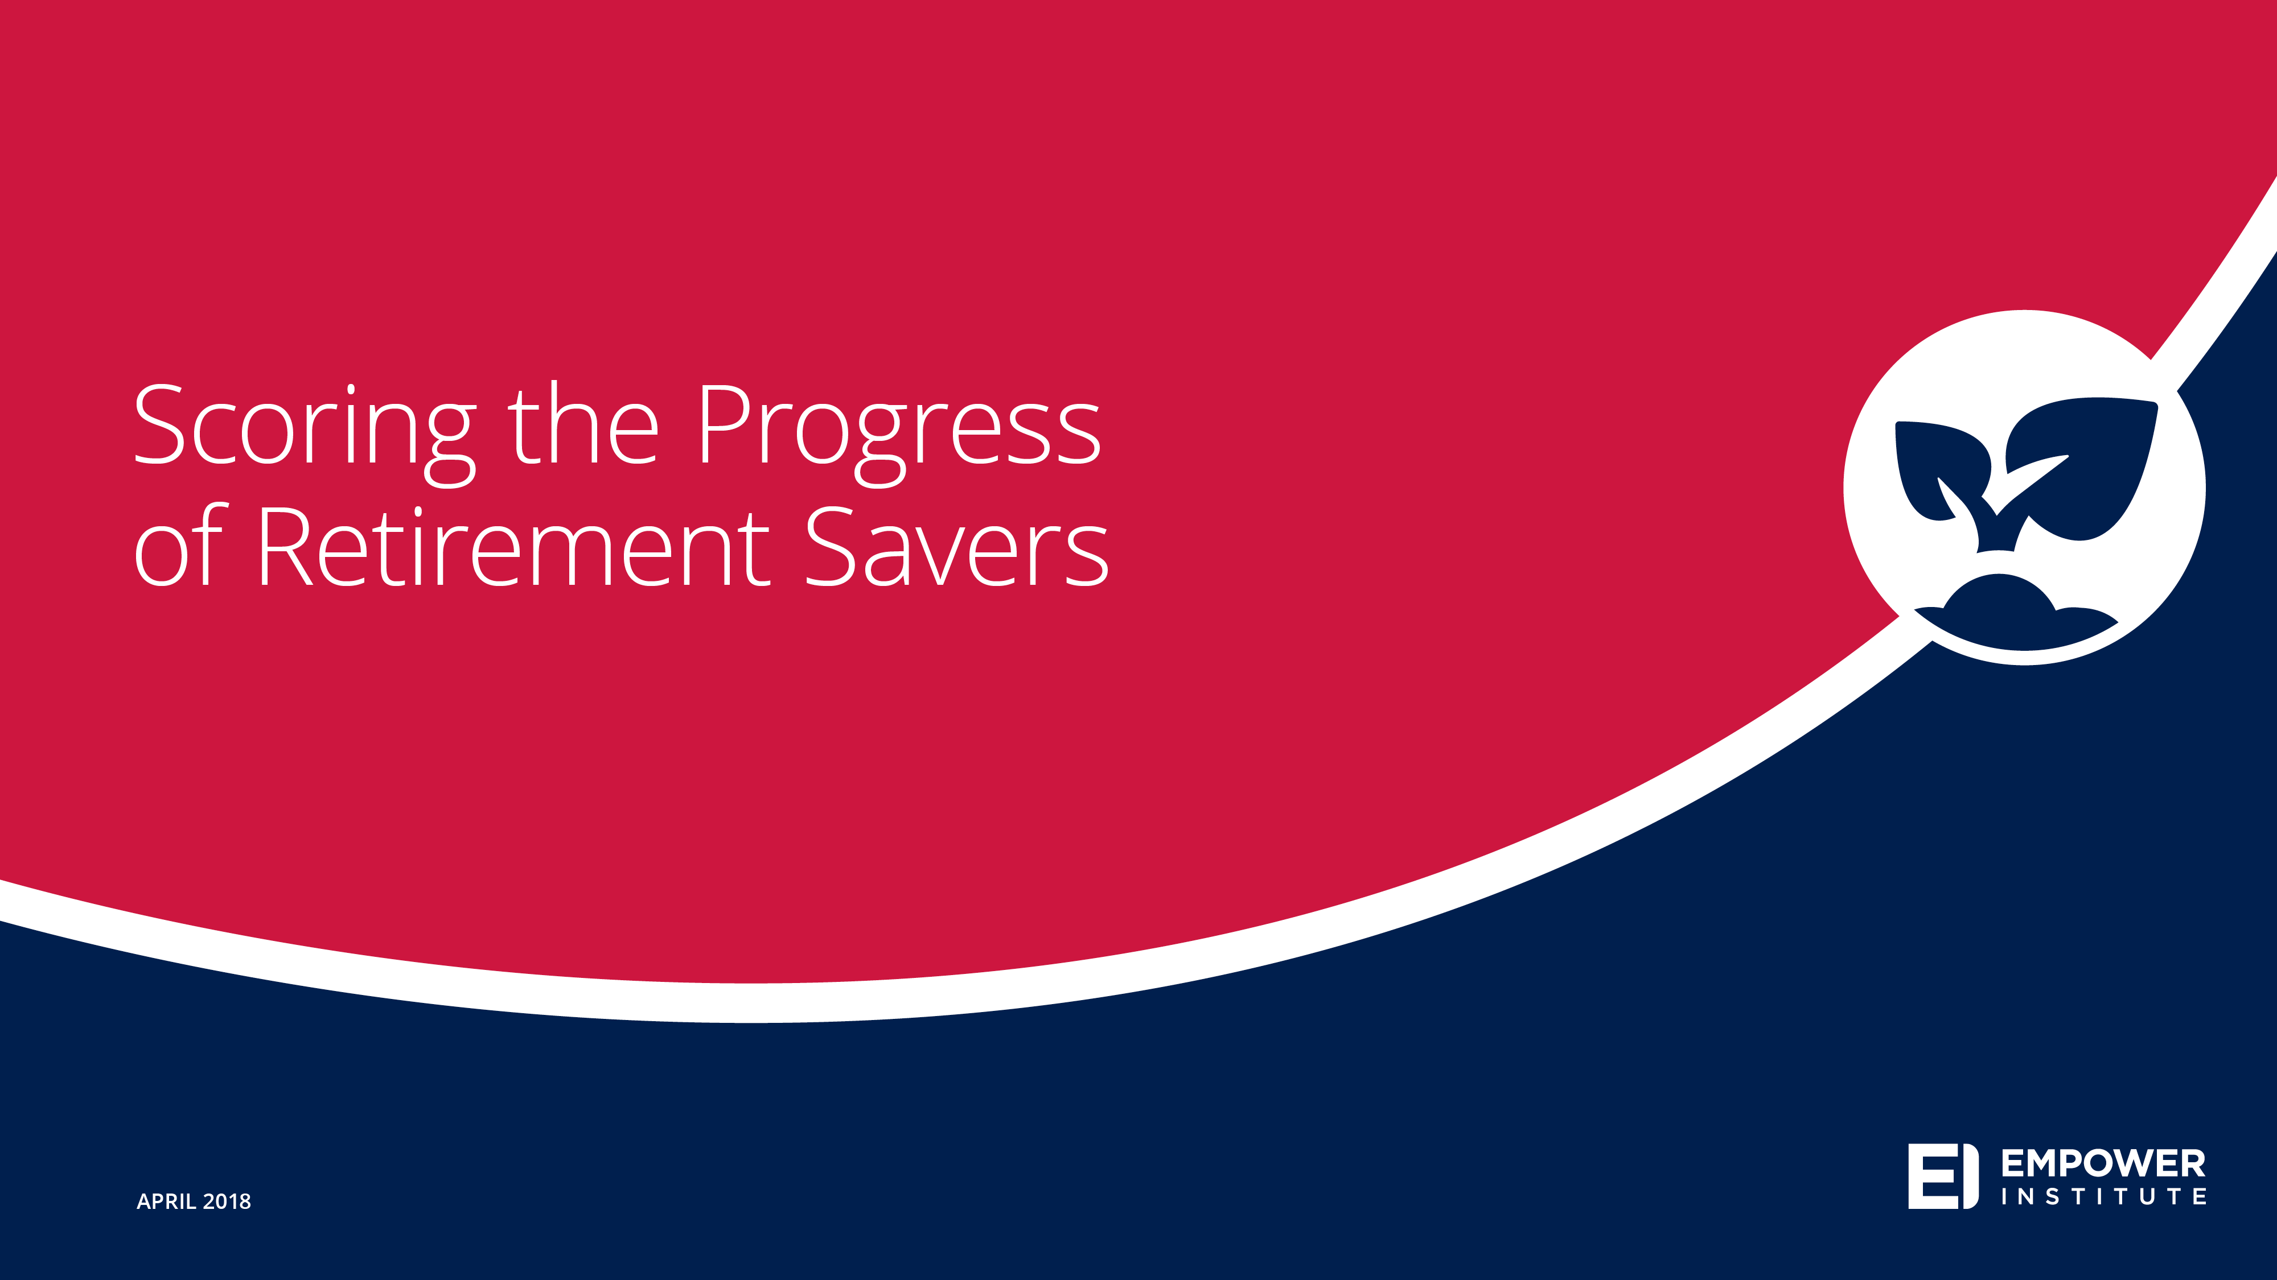
Notes:
I am here to talk to you today about Empower’s new research titled “Scoring the Progress of Retirement Savers.” We wanted to understand if American households were on track to replace their income in retirement and how habits and plan design features affect pre-retirees retirement progress score.

Slide 3
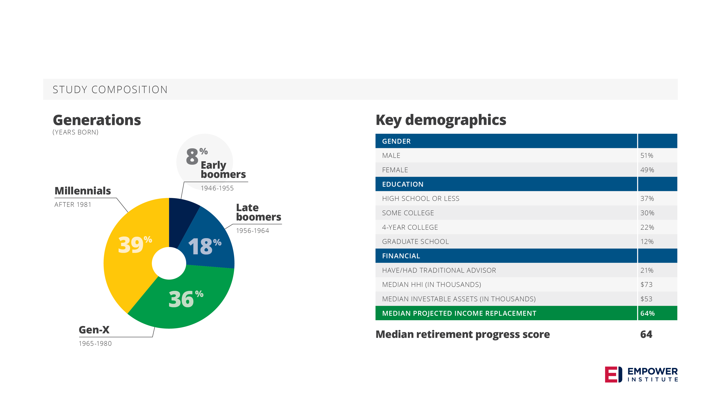
Study composition
The data for this report comes from an online survey of 4000 American households
of people between the ages of 18 to 65 and must have never been retired.
Notes:
The data for this report comes from an online survey of 4000 American households of people between the ages of 18 to 65 and must have never been retired.
On the bottom right, you can see that the median retirement progress score is 64. This means that American households are on track to replace about 64% of their income in retirement.

Slide 4

Notes:
We decided to break our finding into 3 sections:
Economics, gender, and generation
Plan design
Value of financial advice
Let’s start by taking a look at employees’ view of the current economic situation as well as any differences across generations and genders.

Slide 5
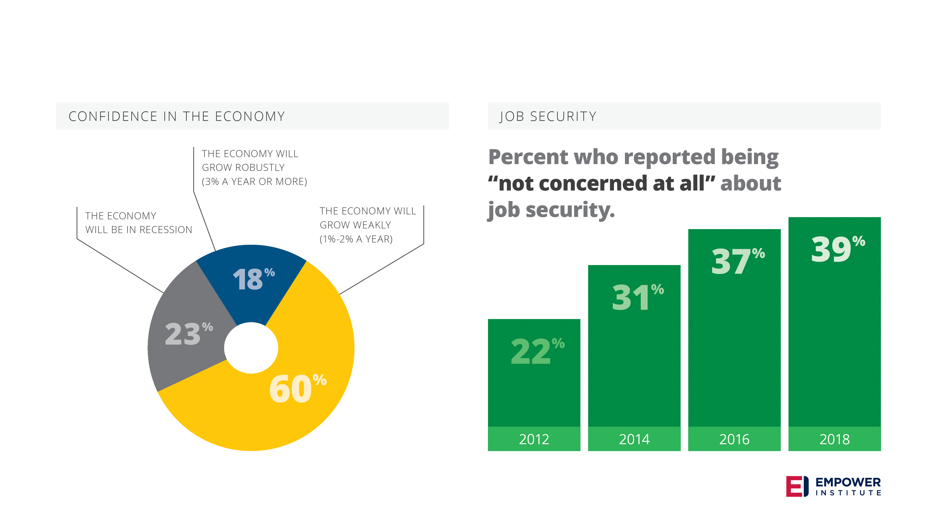
Optimistic economic expectations
Notes:
We wanted to set the tone for this research by sharing some insights on American’s view of the US economy. What we found is that American’s are optimistic about the state of the economy and what they think it will be going in the future. Two examples of this are growth expectations and feelings about job security.
The pie chart shows that over 75% of Americans expect the economy to grow over the next year.
The bar chart shows that 39% of Americans are “not concerned at all” about their job security, which is the highest it has been since we started compiling this data.

Slide 6
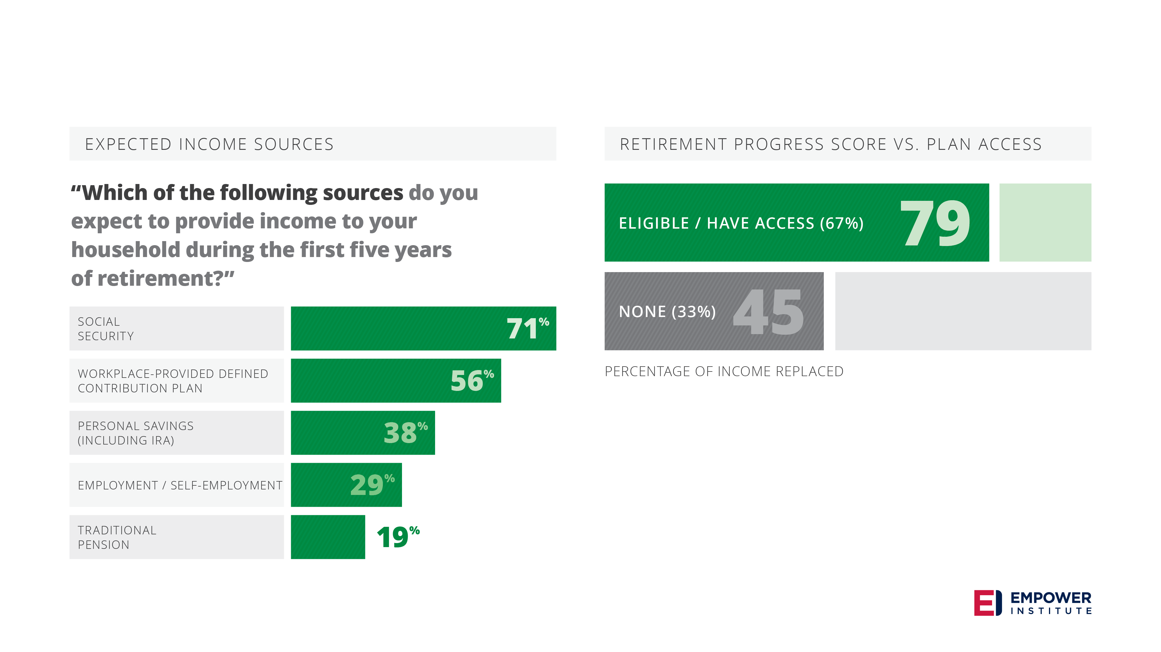
Retirement income sources
Notes:
While American’s are feeling optimistic about the economy, there are still some questions about their ability to retire with an income that they desire. This can be seen by looking at their projected sources of retirement income as well as access to plans.
56% of pre-retirees expect a workplace plan to be a source of income for retirement, second only to social security but access still remains an issue.
33% of those surveyed report that they do not have access to a workplace savings plan, and this proves detrimental to their retirement progress score. For American’s with access to a workplace savings plan, they have a score of 79 compared to a score of 45 for those that do not have access. Remember this means that for employees with access to a workplace savings plan, they are on track to replace 79% of their income in retirement compared to those with no access who are on track to replace 45% of their income in retirement.

Slide 7
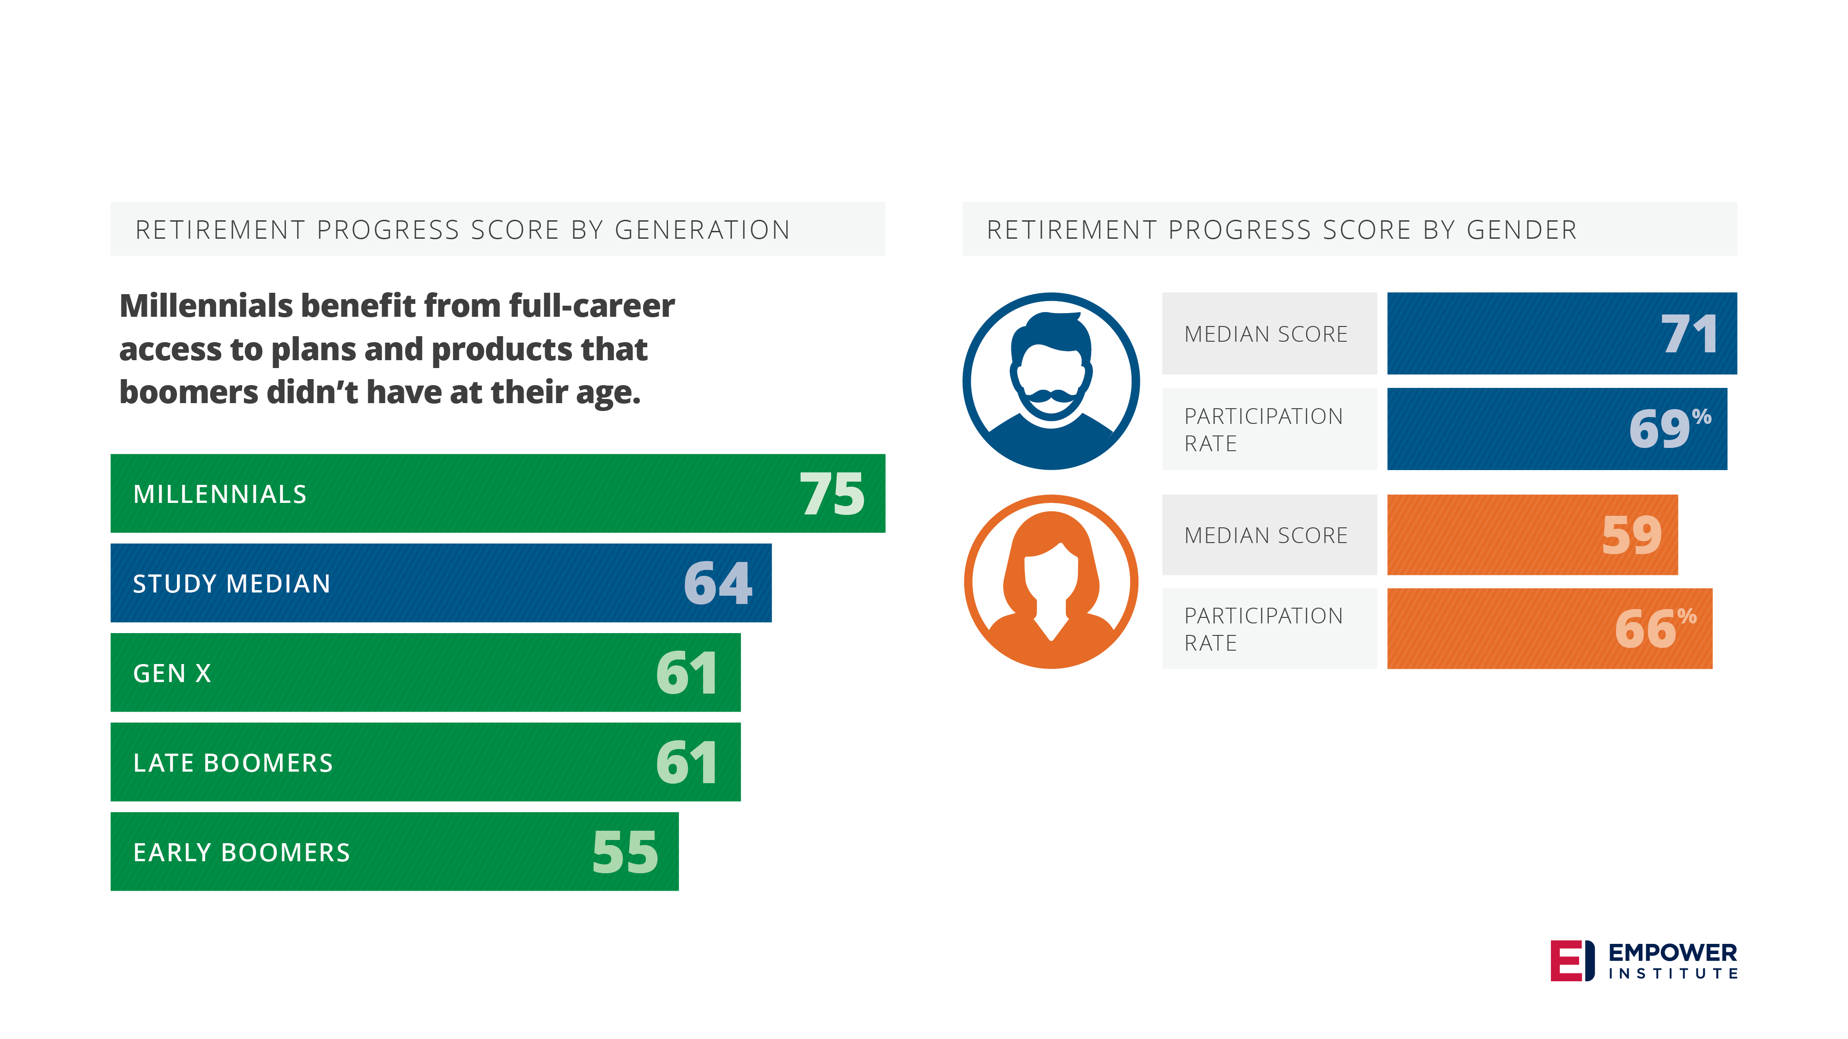
Generation and gender matter
Notes:
In addition, difference exists across generations and genders as well.
Despite getting a bad rep, millennials have a higher retirement progress score than older generations. This is likely due to when workplace savings plans were invented compared to when these generations entered the workforce.
When it comes to men and women, the difference is quite staggering. Men have a retirement progress score of about 71 compared to women at 59 even though they participate at similar rates.

Slide 8

Notes:
We’ve talked about the economics, gender, and generation. Now, let’s move to some features of plan design.

Slide 9
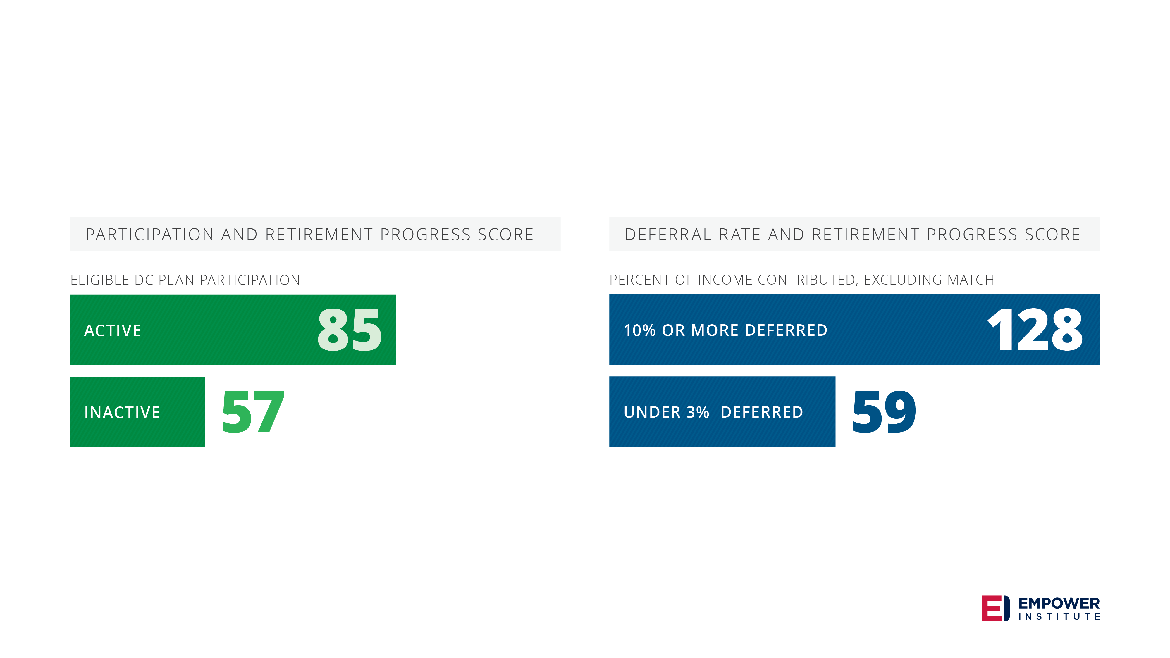
Success habits: Saving and saving enough
Notes:
When it comes to saving for retirement, it’s not enough to just have access to a workplace plan, but its also important to be active in that plan. For respondents that both have access to a plan and are active in a plan, they have a retirement progress score of 85 compared to a score of 57 for people that are not active in the plan for which they have access.
And unsurprisingly, the percent of contribution makes a big difference when it comes to who is on track to replace their income in retirement. There is a lot of talk in the industry about saving 10%, so we wanted to test just that. For households that defer 10% of their income, they are on track to replace 128% of their income in retirement. For comparison, for households contributing less than 3%, they are on track to replace 59% of their income in retirement.

Slide 10
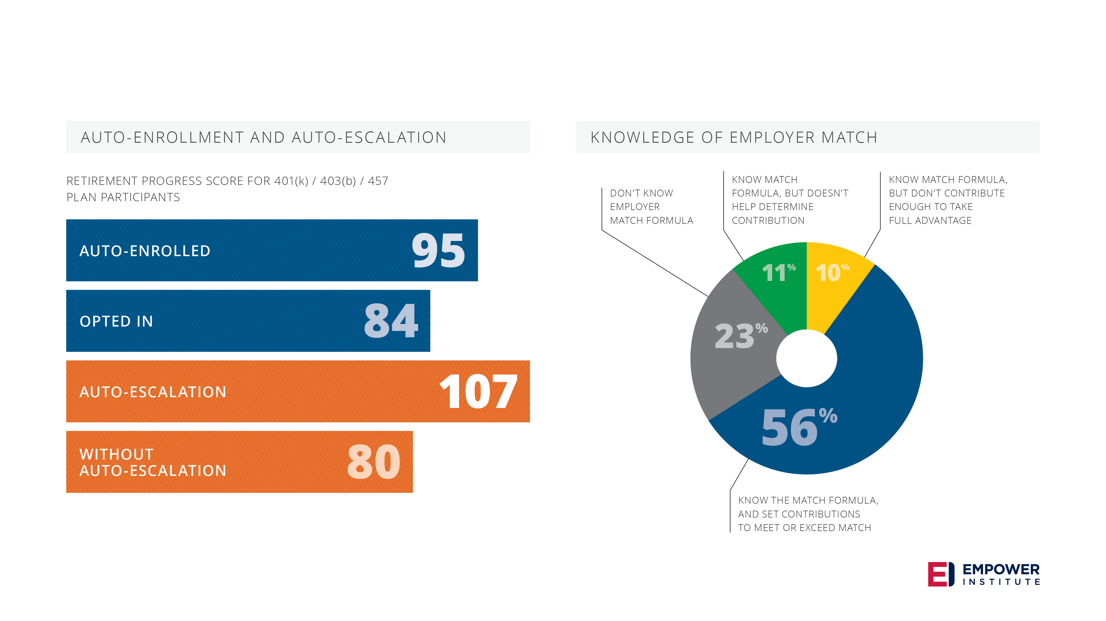
Plan design matters
Notes:
Next, let’s take a look at what plan design features help encourage higher savings rates and thus a higher retirement progress score. Two of these features are auto-enrollment and auto-escalation. Active plan participants that are auto-enrolled have a retirement progress score of 95 and those with escalation have a retirement progress score of 107.
Another plan design feature is employer match. For respondents that are active in a plan, 76% know what the match is and 76% of the amount of employees that know that match, set their match to match the match. This means that employer match plays a major role in retirement savings decisions.

Slide 11
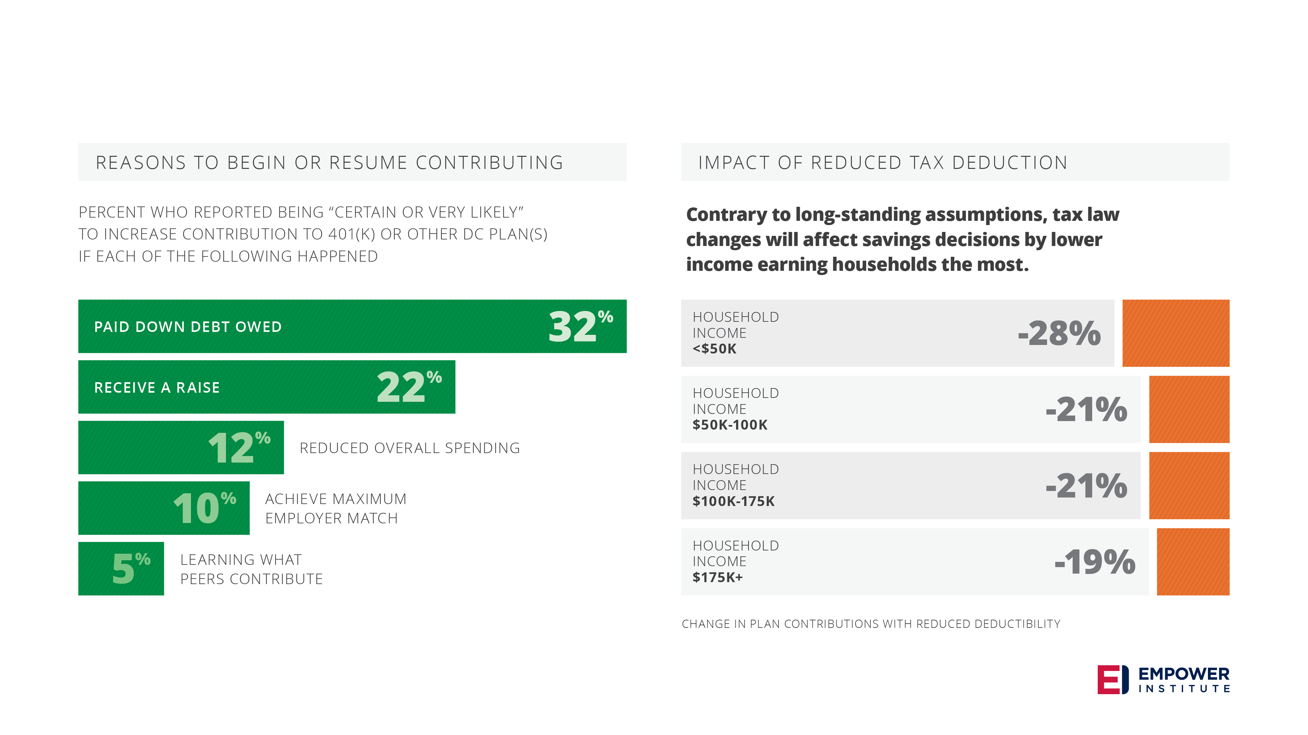
Success barriers
Notes:
Of course there are barriers to success as well. The top reason that respondents say they would certainly or very likely increase contributions is paying down debt. Rounding out the top 5 reasons cited are receiving a raise, reducing spending, to meet the match, and peer comparison. These results mean that there are some steps that can be taken that will increase saving rates such as a bill pay manager, a peer comparison tool, or increasing the match.
Another barrier to success would be if the tax treatment of contribution rates changed. We asked respondents if they would decrease contributions if the tax deduction for workplace savings plans decreased, and if so, how much. The answer was a resounding yes. This disproportionately impacts lower income households the most.

Slide 12

Notes:
We talked about the economy, gender and generation then we talked about plan design features that could increase retirement progress scores. Finally, let’s talk about the value of financial advice.

Slide 13
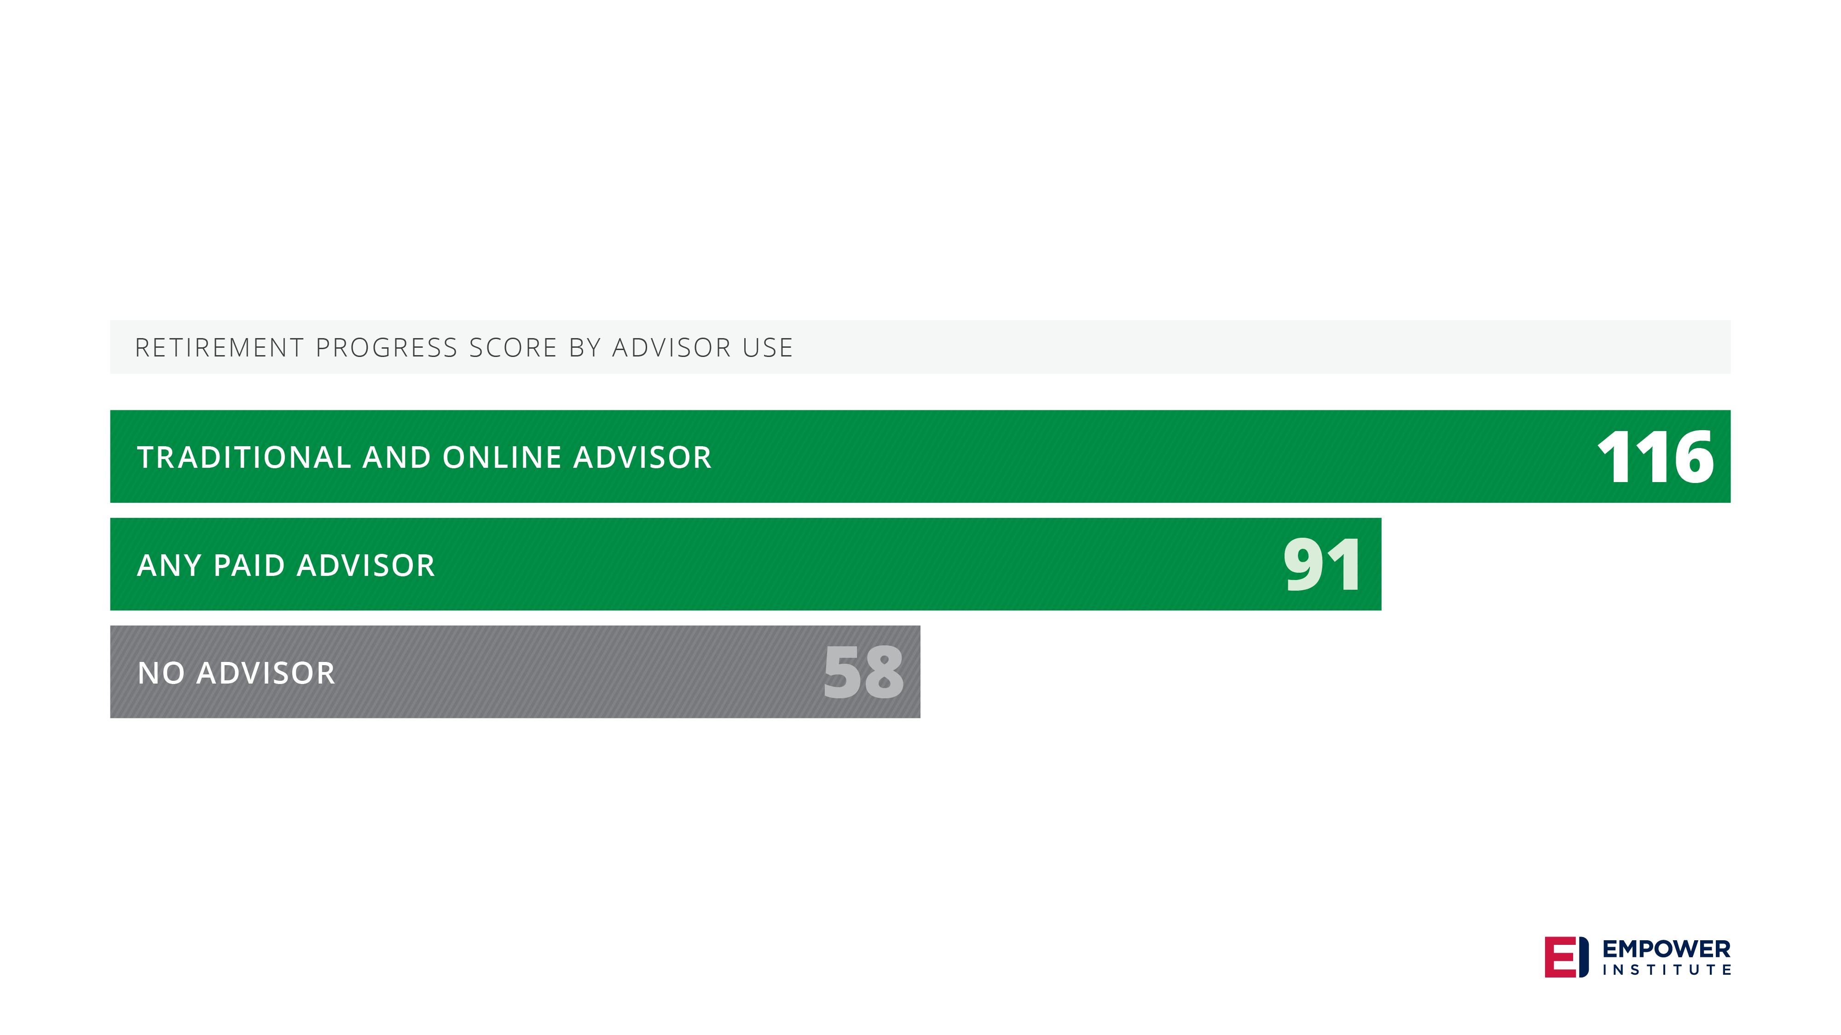
Financial advisors are making a difference
Notes:
For respondents with both a traditional and online advisor, they have a retirement progress score of 116 compared to those with no advisor at a score of 58. Those with 1 advisor – either traditional or online – they have a retirement progress score of 91. Financial advisors are making a difference when it comes to savers’ ability to be prepared for income in retirement.

Slide 14

Notes:
Let’s review a couple of our findings.

Slide 15
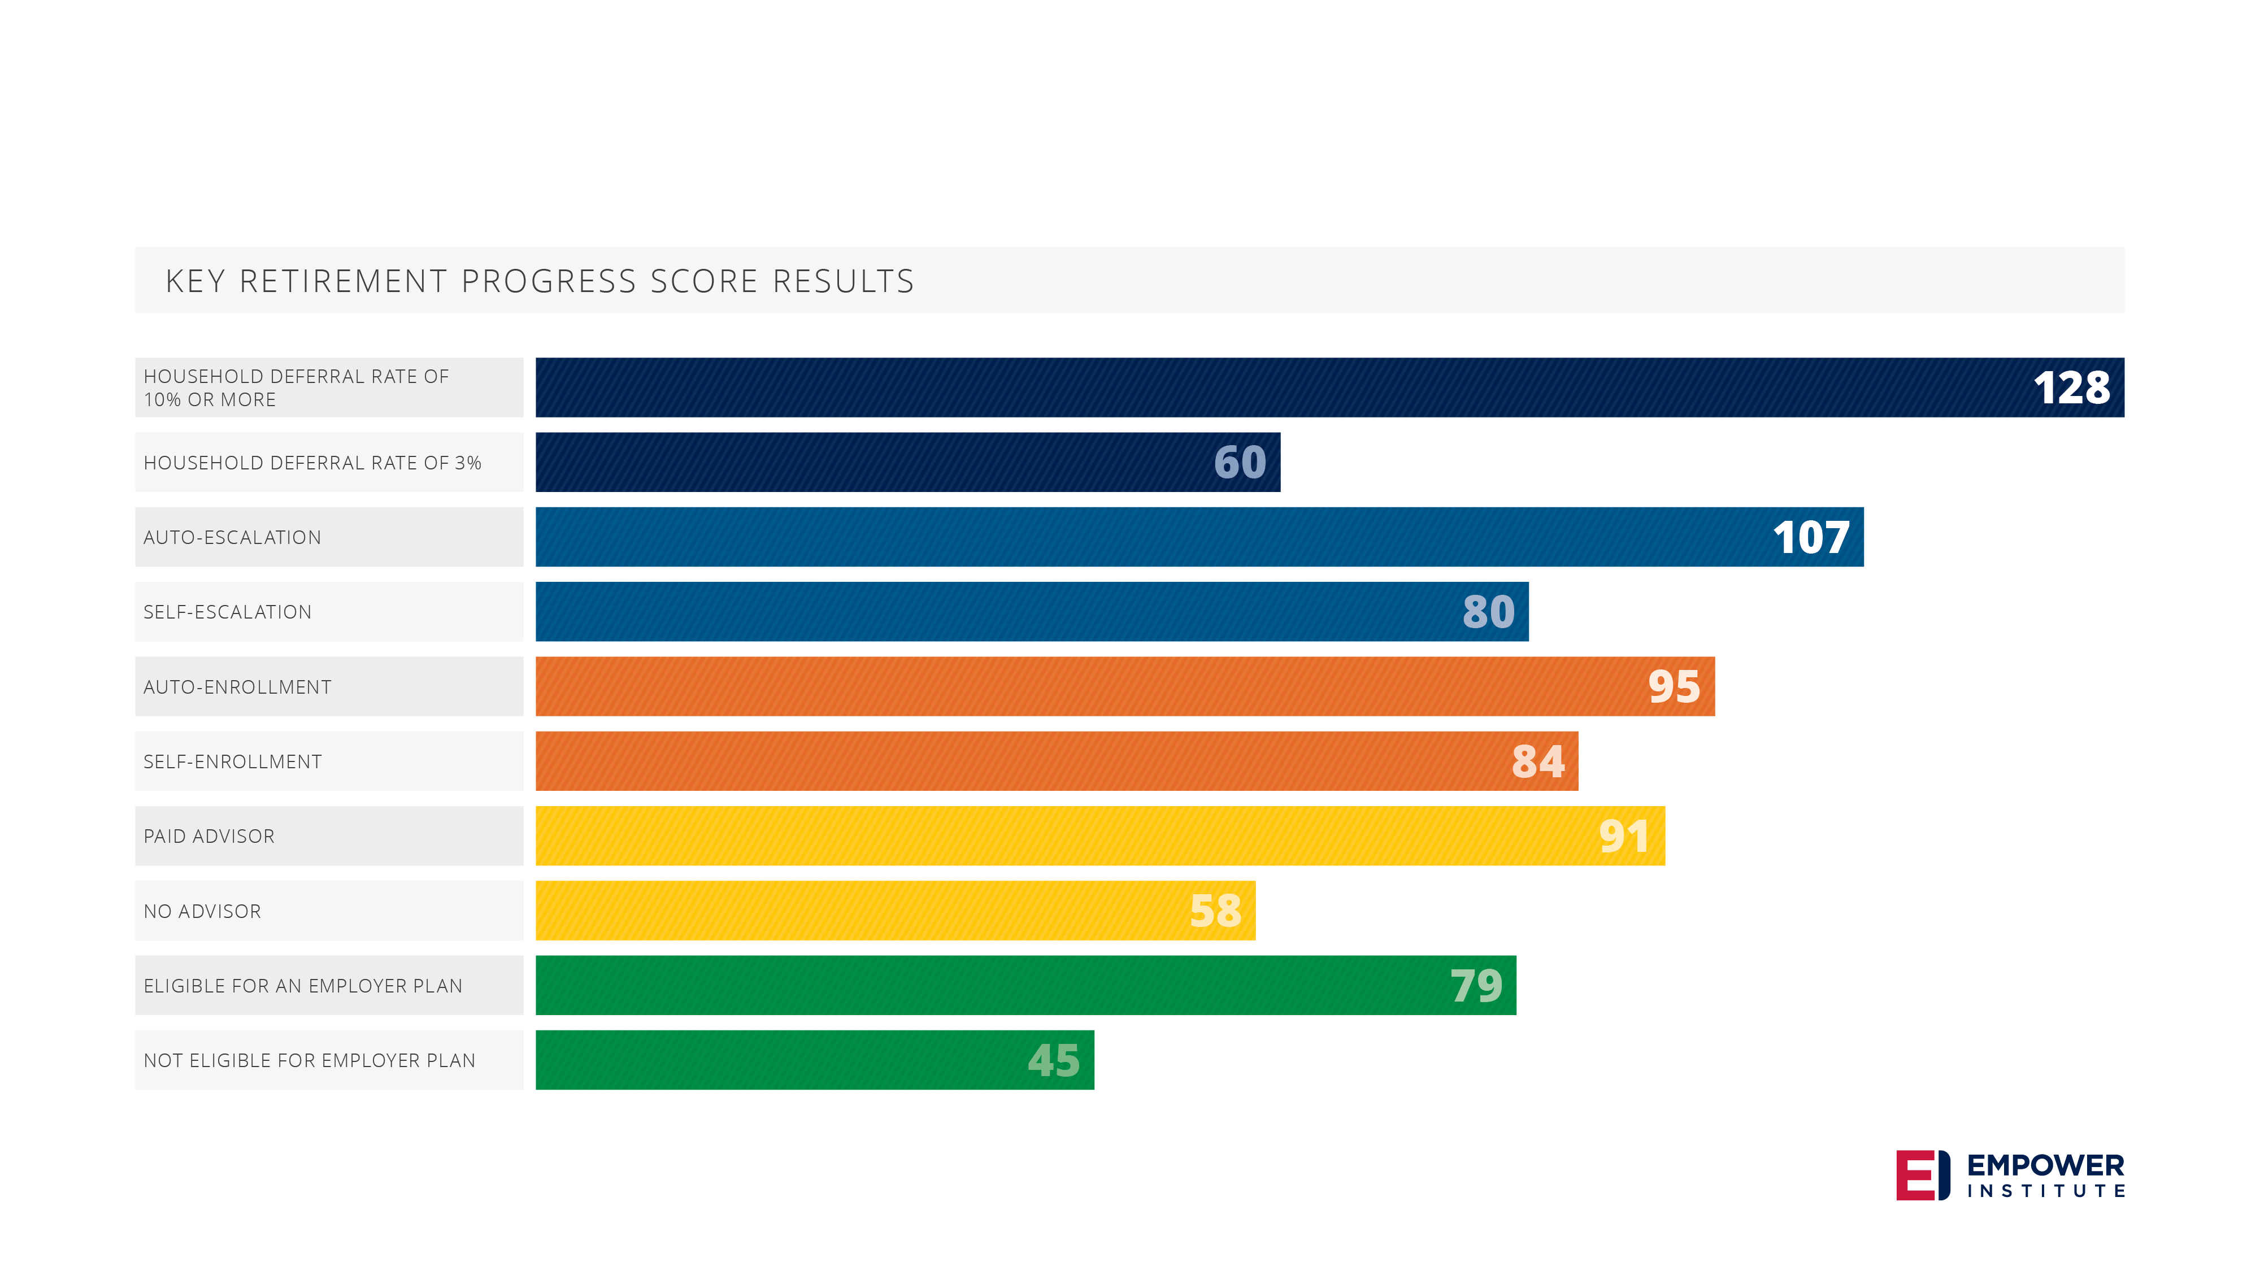
Key conclusions
Notes:
We talked about the economy, gender, and generation with some surprising results when it came to the differences across genders and generations.
Then we talked about plan design with a discussion on employer match.
Last we shared the value of financial advice and how using any type of an advisor increases a savers’ ability to replace their working income while in retirement.
These results taken together demonstrate that there are both some habits that savers can develop as well as some plan design features that can contribute to increased retirement progress scores.
[For a plan sponsor audience - I would invite you to consider Empower as your plan provider as we are focused on bringing employees a plan that will help them replace their working income in retirement. Our Plan Visualizer tool can help you compare plan design options side by side to help you figure out what may be best for your employees.]
[For an advisor audience – I would invite you to consider Empower as a plan provider as we are focused on bringing employees a plan that will help them replace their working income in retirement. Our Plan Visualizer tool can help you compare plan design options side by side with plan sponsors to help you figure out what may be best for their employees.]
[For a participant audience – As an employee with access to a plan, I would encourage you to take a look at your savings habits as well as the features offered by your plan to help ensure you are on the path to replacing your income in retirement. ]

Slide 16

MA 401(k) CORE Plan Can Help Achieve Success
Modern Plan Design Features
Flexible Contribution Options
Easy Investment Selection
Built for Small Nonprofits
Limits your Fiduciary Responsibility
Low Expense Ratios and Annual Fee

Slide 17

Contact the MA CORE Plan
Lisa Cardinal
617-510-4036
Lisa.cardinal@empower-retirement.com

Slide 18
Disclosures
The survey results are from a National Survey of 4,038
working adults (full-time, part-time, never retired)
ages 18 to 65, conducted in conjunction with NMG
Consulting. Respondents answered an online survey
between December 18, 2017 through January 21, 2018.
The Empower Institute is brought to you by Empower
Retirement and critically examines investment
theories, retirement strategies and assumptions.
It suggests theories and changes for achieving better
outcomes for employers, institutions, financial
advisors and individual investors.
Securities offered or distributed through GWFS
Equities, Inc., Member FINRA/SIPC and a subsidiary
of Great-West Life & Annuity Insurance Company.
Great-West Financial®, Empower Retirement and
Great-West Investments™ are the marketing names
of Great-West Life & Annuity Insurance Company,
Corporate Headquarters: Greenwood Village, CO;
Great-West Life & Annuity Insurance Company of
New York, Home Office: New York, NY, and their
subsidiaries and affiliates, including registered
investment advisers Advised Assets Group, LLC and
Great-West Capital Management, LLC.
The research, views and opinions contained in these
materials are intended to be educational, may not
be suitable for all investors and are not tax, legal,
accounting or investment advice. Readers are
advised to seek their own tax, legal, accounting and
investment advice from competent professionals.
Information contained herein is believed to be
accurate at the time of publication; however, it may
be impacted by changes in the tax, legal, regulatory or
investing environment.
The charts, graphs and screen prints in this
presentation are for ILLUSTRATIVE PURPOSES ONLY.
IMPORTANT: The projections, or other information
generated by this survey regarding the likelihood of
various investment outcomes, are hypothetical in
nature, do not reflect actual investment results and
are not guarantees of future results. The results may
vary with each use and over time.
The retirement progress score represents an estimate
of the percentage of current income that an individual
might need to replace from savings in order to fund
retirement expenses. This income estimate is based
on the individual’s amount of current savings as well
as future contributions to savings (as provided by
participants in the survey) and includes investments
in retirement plans, IRAs, taxable accounts, variable
annuities, cash value of life insurance and income from
defined benefit pension plans. It also includes future
wage growth from a participant’s present age to the
retirement age of 65 (1% greater than the Consumer
Price Index for Urban Wage Earners and Clerical
Workers [CPI-W]) as well an estimate for future Social
Security benefits.
The calculations also take into account mortality rates
for a variety of commonly diagnosed health conditions,
including high blood pressure, high cholesterol, type
2 diabetes, cancer of any type and cardiovascular
disease of any type apart from high blood pressure.
In addition, the model also takes into account the
consistent use of tobacco on a household basis.
The retirement progress score estimate is derived
from the present-value discounting of the future
cash flows associated with an individual’s retirement
savings and expenses. It incorporates the uncertainty
around investment returns (consistent with historical
return volatility) as well as the mortality uncertainty
that creates a retirement horizon of indeterminate
length. Specifically, the retirement progress score
procedure begins with the selection of a present value
discount rate based on the individual’s current
retirement asset allocation (stocks, bonds and cash).
Notes:
READ SLIDE

Slide 19
Disclosures continued
A rate is determined from historical returns such
that 90% of the empirical observations of the returns
associated with the asset allocation are greater than
the selected discount rate. This rate is then used for all
discounting of the survival probability-weighted cash
flows to derive a present value of a retirement plan.
Alternative spending levels in retirement are examined
in conjunction with the discounting process until
the present value of cash flows is exactly zero. The
spending level that generates a zero retirement plan
present value (i.e., an income level that is consistent
with a 90% confidence in funding retirement) is
the income estimate selected as the basis for the
retirement progress score. Such an income level is
considered to have a “sustainable” spending level
and to be an appropriate benchmark for retirement
planning. It is not a prediction, and results may be
higher or lower based on actual market returns.
Distributed by GWFS Equities, Inc.
©2018 Great-West Life & Annuity Insurance Company.
All rights reserved.
ERMKT-FBK-15903-1804 AM479434 -0418
Notes:
READ SLIDE

