Slide 1


Cybersecurity - What Every Nonprofit Needs to Know
May 8th Webinar
Presented by Tech Networks of Boston
Thanks for joining us! A few instructions before we begin:
You may join the audio by selecting the radio button for either “Telephone” or “Mic & Speakers.” If you are using telephone, please dial in with the conference line and audio pin provided.
If you are having any technical issues, please let us know in the chat box.
We will have time for Q&A. Please enter your questions in the chat box at any time.
This webinar is being recorded, and we will distribute the recording after the webinar.
Jenny Yuan
Operation and Membership Coordinator
www.massnonprofitnet.org

Slide 2
Cyber Security 102
Tech Networks of Boston | May 8, 2019

Slide 3
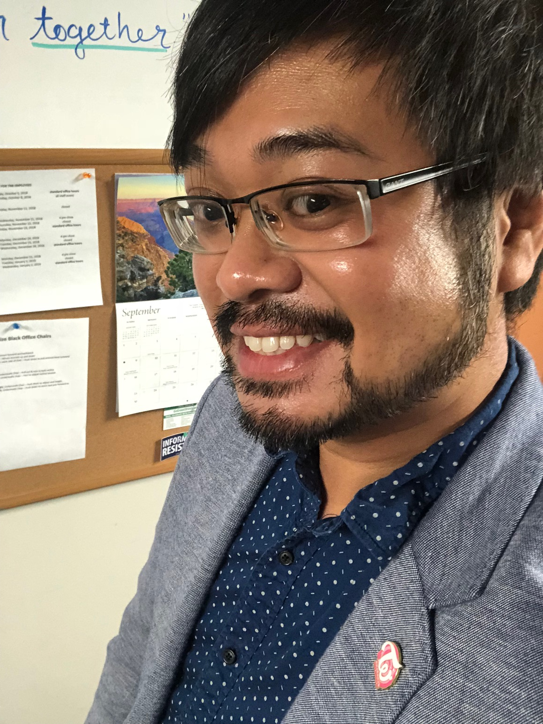
Your Presenters Today

Slide 4
Agenda
The evolution of cyber attacks
A line of defense beyond technology
Best practices and tips
Resources and Q&A
what’s in store today

Slide 5
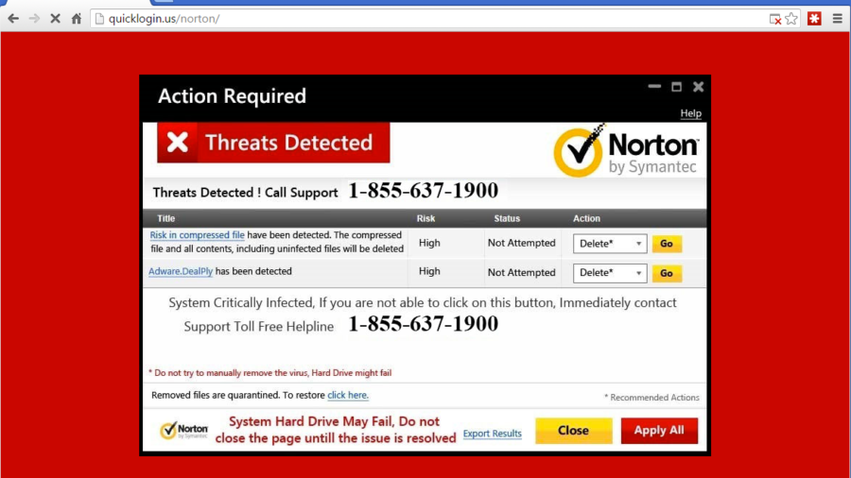
Notes:
We all know the basic attacks, especially with popups these with “required” you to call an unknown number. Then, someone remotely would log into your machine and install malware, etc and then charge you a gross amount of cash to “clean” it up.

Slide 6
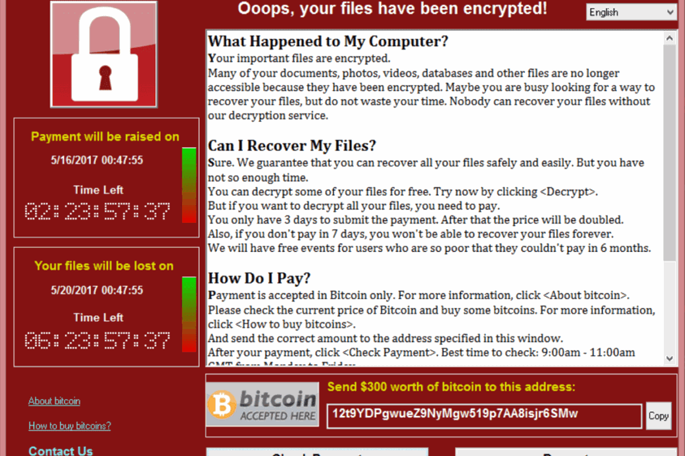
Notes:
It then progressed to this. A cryptolocker attack which encrypted all the files on your computer as well as your network.
Mostly likely than not you wouldn’t get the decryption key even if you didn’t pay.

Slide 7
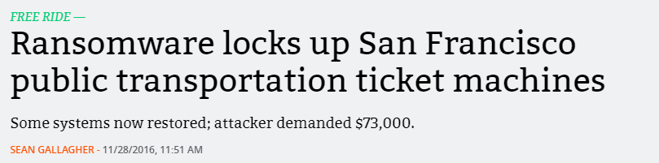
Notes:
It’s not just individuals that get attacked though. Cryptolocker can encrypt anything that has Internet access, such as fare collection machines…

Slide 8
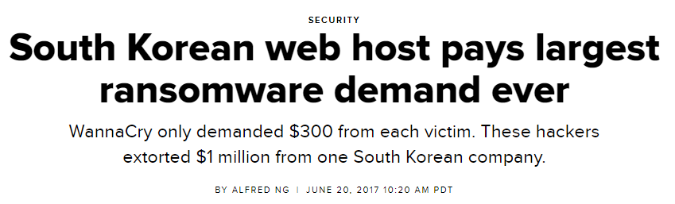
Notes:
Webhosts…

Slide 9
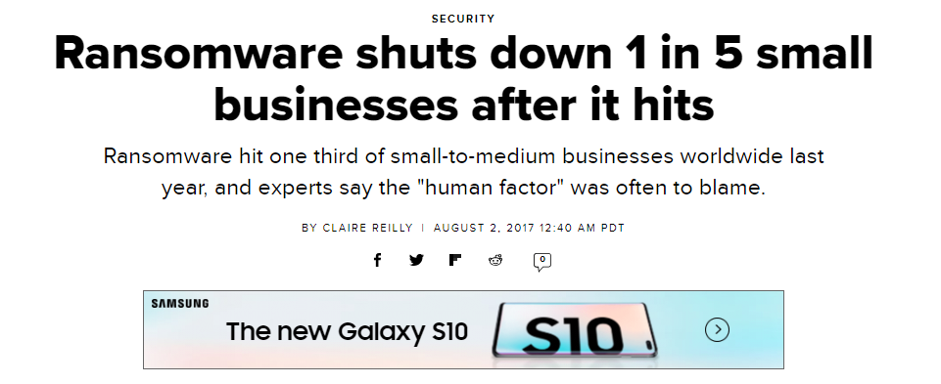
Notes:
And it has lasting affects. SMB here is 500 employees or less.

Slide 10
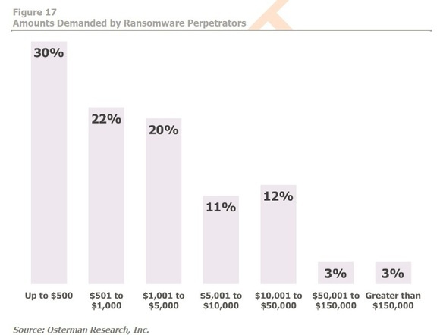
Notes:
While the majority of “ransoms” are less then $5,000, it’s the lasting recovery costs that dragged down companies. And, as I said before, you aren’t even guaranteed on receiving a decryption key if you paid.

Slide 11
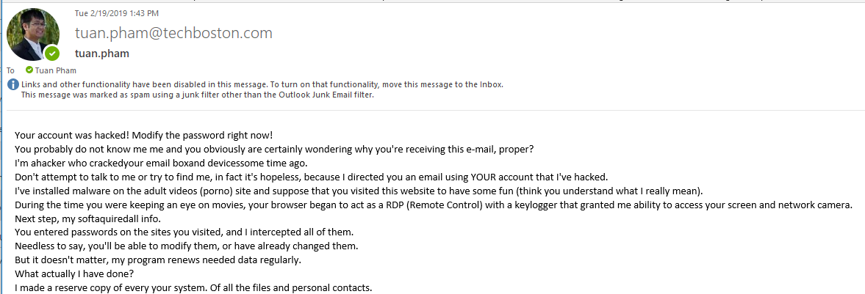
Notes:
But, in July of last year, we saw the amount of cryptolocker attacks drop dramatically. Attacks have returned to the classic blackmail, such as this one.
A variant of this attack also included passwords from a old linkedin password dump. This made the attack look more real since it included one of your old real passwords.

Slide 12
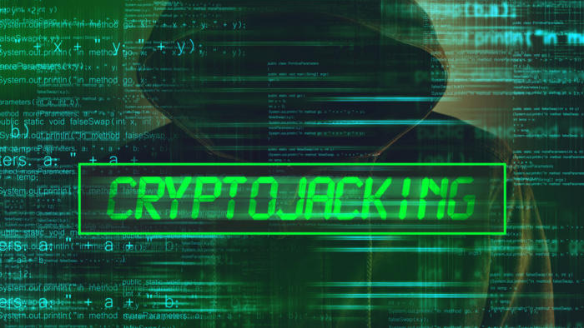
Notes:
But now, the latest attack is Cryptojacking, which downloads a script to infected workstations to mine crypto currency. Why wait for a ransom when you can just generated the money yourself?

Slide 13
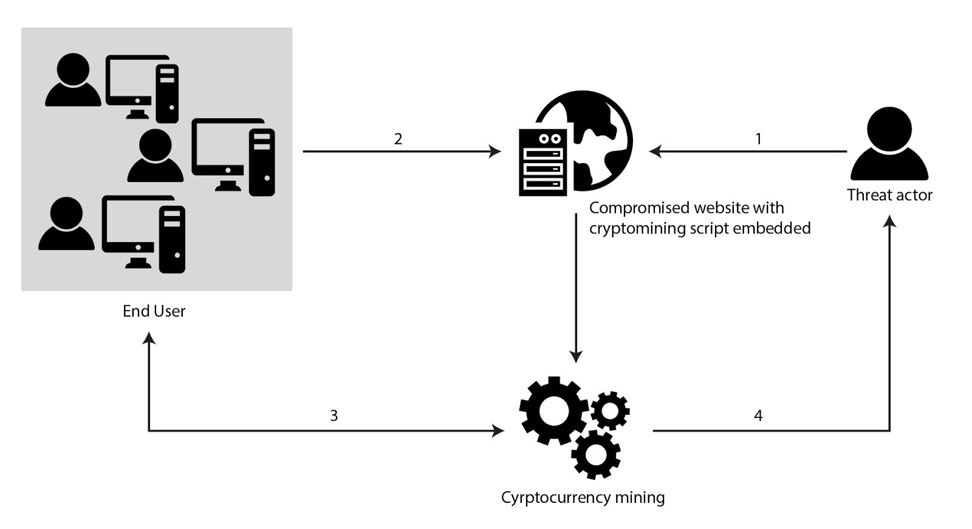
Notes:
This is the anatomy of a cryptojacking attack. A threat actor compromises a website with a cryptomining script. This is just a basic addon that can go unnoticed for ages. When your employees visit the site, the website automatically starts to run the script which generates crypto for the initial threat actor.

Slide 14
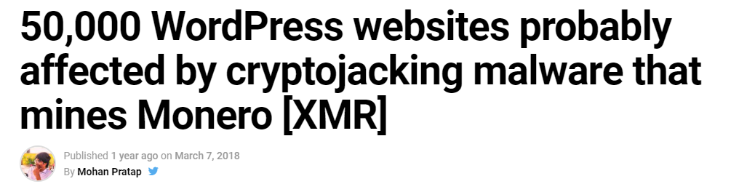
Notes:
This is the anatomy of a cryptojacking attack. A threat actor compromises a website with a cryptomining script. This is just a basic addon that can go unnoticed for ages. When your employees visit the site, the website automatically starts to run the script which generates crypto for the initial threat actor.

Slide 15
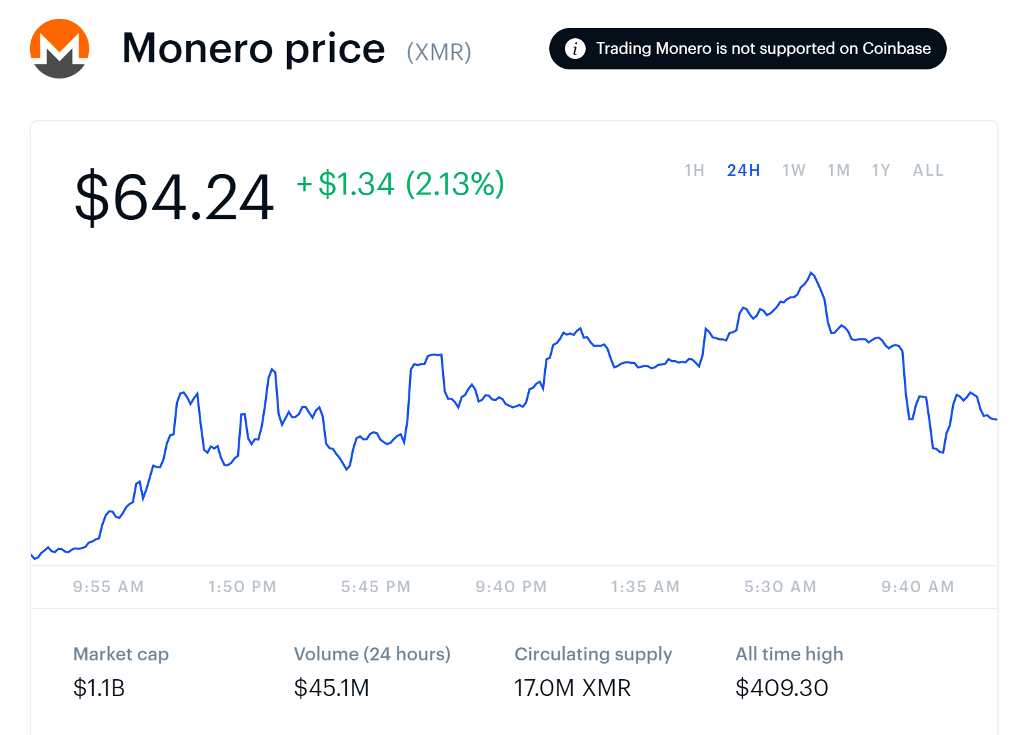
Notes:
This is the anatomy of a cryptojacking attack. A threat actor compromises a website with a cryptomining script. This is just a basic addon that can go unnoticed for ages. When your employees visit the site, the website automatically starts to run the script which generates crypto for the initial threat actor.

Slide 16

Notes:
All of these attacks have one thing in common. The weakest link is your staff. Even if you do all the wizz bang technological tools, such as firewalls, antivirus, etc., your staff is always your weakest link.

Slide 17
What are our biggest fears about cyber attacks?
Based off TNB’s own Research into the NOnPRofit Sector

Slide 18
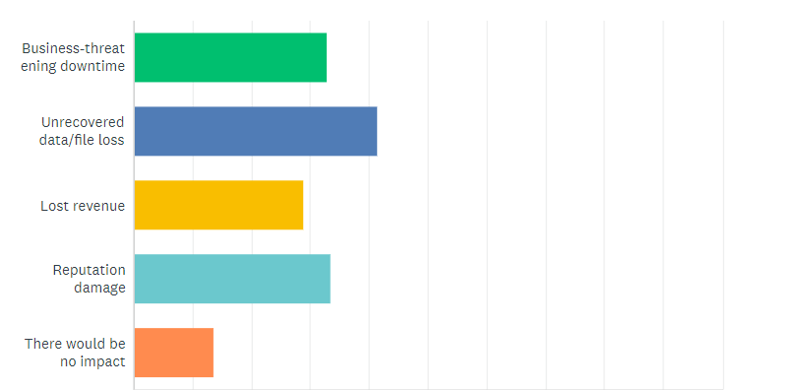

Slide 19
The easy tech stuff
But still needs to be reviewed.

Slide 20




Have a working anti virus/spam filter running at all times
Notes:
Don’t believe buzz words about “next gen” or “we’ve caught 99 percent of threats”

Slide 21
Have a working anti virus/spam filter running at all times
Notes:
Don’t believe buzz words about “next gen” or “we’ve caught 99 percent of threats”

Slide 22

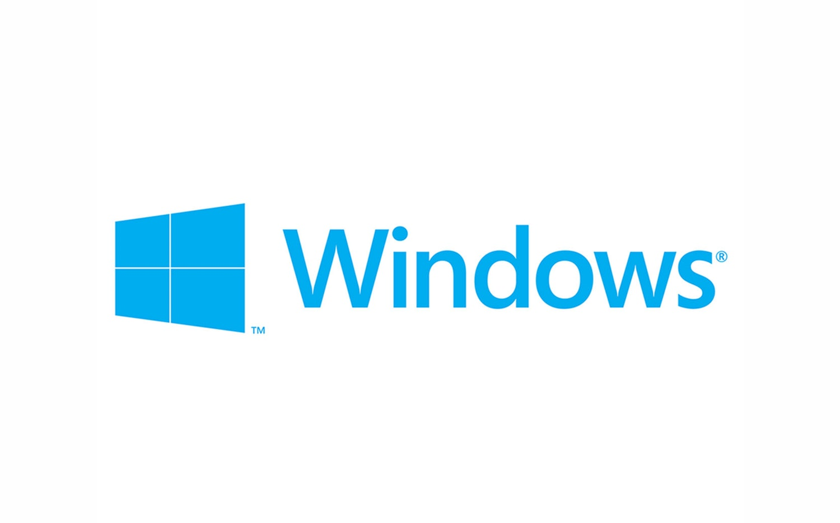
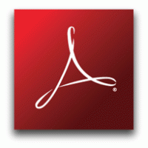

Make sure your computers and websites are patched and up-to-date
Notes:
Mention Windows 7 End of Life here! (next year, 2020, no more windows updates for Windows 7 and Server 2008!)

Slide 23
Make sure your computers are patched and up-to-date
Notes:
Don’t believe buzz words about “next gen” or “we’ve caught 99 percent of threats”

Slide 24
Make sure your data is fully backed up and restorable
Notes:
Backup are only as good as the latest file that you can recover.

Slide 25
You can’t trust backups to just happen.
Notes:
A quarter of nonprofits don’t have a backup policy. Even if you’re full cloud with everything running on Office 365 or Google Apps, you should backup your data. What will happen to your data if that cloud is inaccessible?
This is currently happening with MySpace (yes, remember that) where it just broke that any media uploaded before 2015 is no inaccessible.

Slide 26
Have a strong password policy
Notes:
Backup are only as good as the latest file that you can recover.

Slide 27
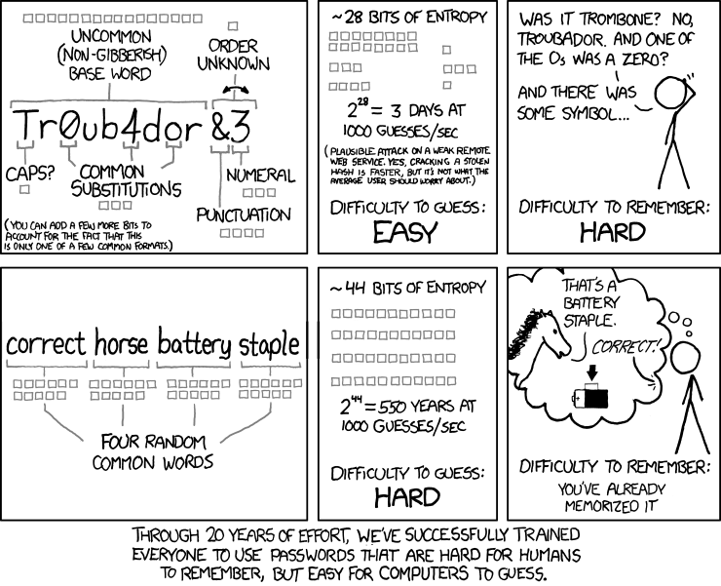

Slide 28
The not so easy stuff
Remember what your Weakest Link is

Slide 29
Have and enforce policies
WISP (Written Information Security Policy)
Massachusetts requires this to comply with CMR 17.04 which governs how Massachusetts companies and non-profits manage Personally Identifiable Information.
You are legally within your right to ask any of your vendors for their WISP.
Password Policy
This policy would apply to any person who is provided an account connected to your corporate network or systems, including: employees, guests, partners, vendors, etc.
Passwords should be complex and changed every 90 days.
Bring Your Own Device Policy
If your staff connect their personal devices (phones, computers) to your information, your organization is now liable if that device is lost and contains any protected data.

Slide 30
We like people using their own computers, but are we responsible for them?
Notes:
Don’t believe buzz words about “next gen” or “we’ve caught 99 percent of threats”

Slide 31
Regularly test and train your employees
Phishing Test
Use an automated service to send fake emails to your staff and see who leaks their user name and passwords
Annual Security Training
Massachusetts requires organizations to have an annual security training and review and sign off on a WISP.
Ongoing Security Training
Use computer-based an in-person security trainings to reinforce your policies.

Slide 32
Regularly train and test your staff
Notes:
Don’t believe buzz words about “next gen” or “we’ve caught 99 percent of threats”

Slide 33
Make security a part of your everyday
Stay
Stay educated about the latest threats out there
Follow US-CERT on Twitter to get summaries of the latest patches to applications and Windows
Address
Address security training as a part of new employee onboarding
Review any policies that you have and also go over your agency’s way of handling confidential data
Practice
Practice what you preach
Set a good example for the rest of your staff and/or reports

Slide 34
Some Resources

Slide 35
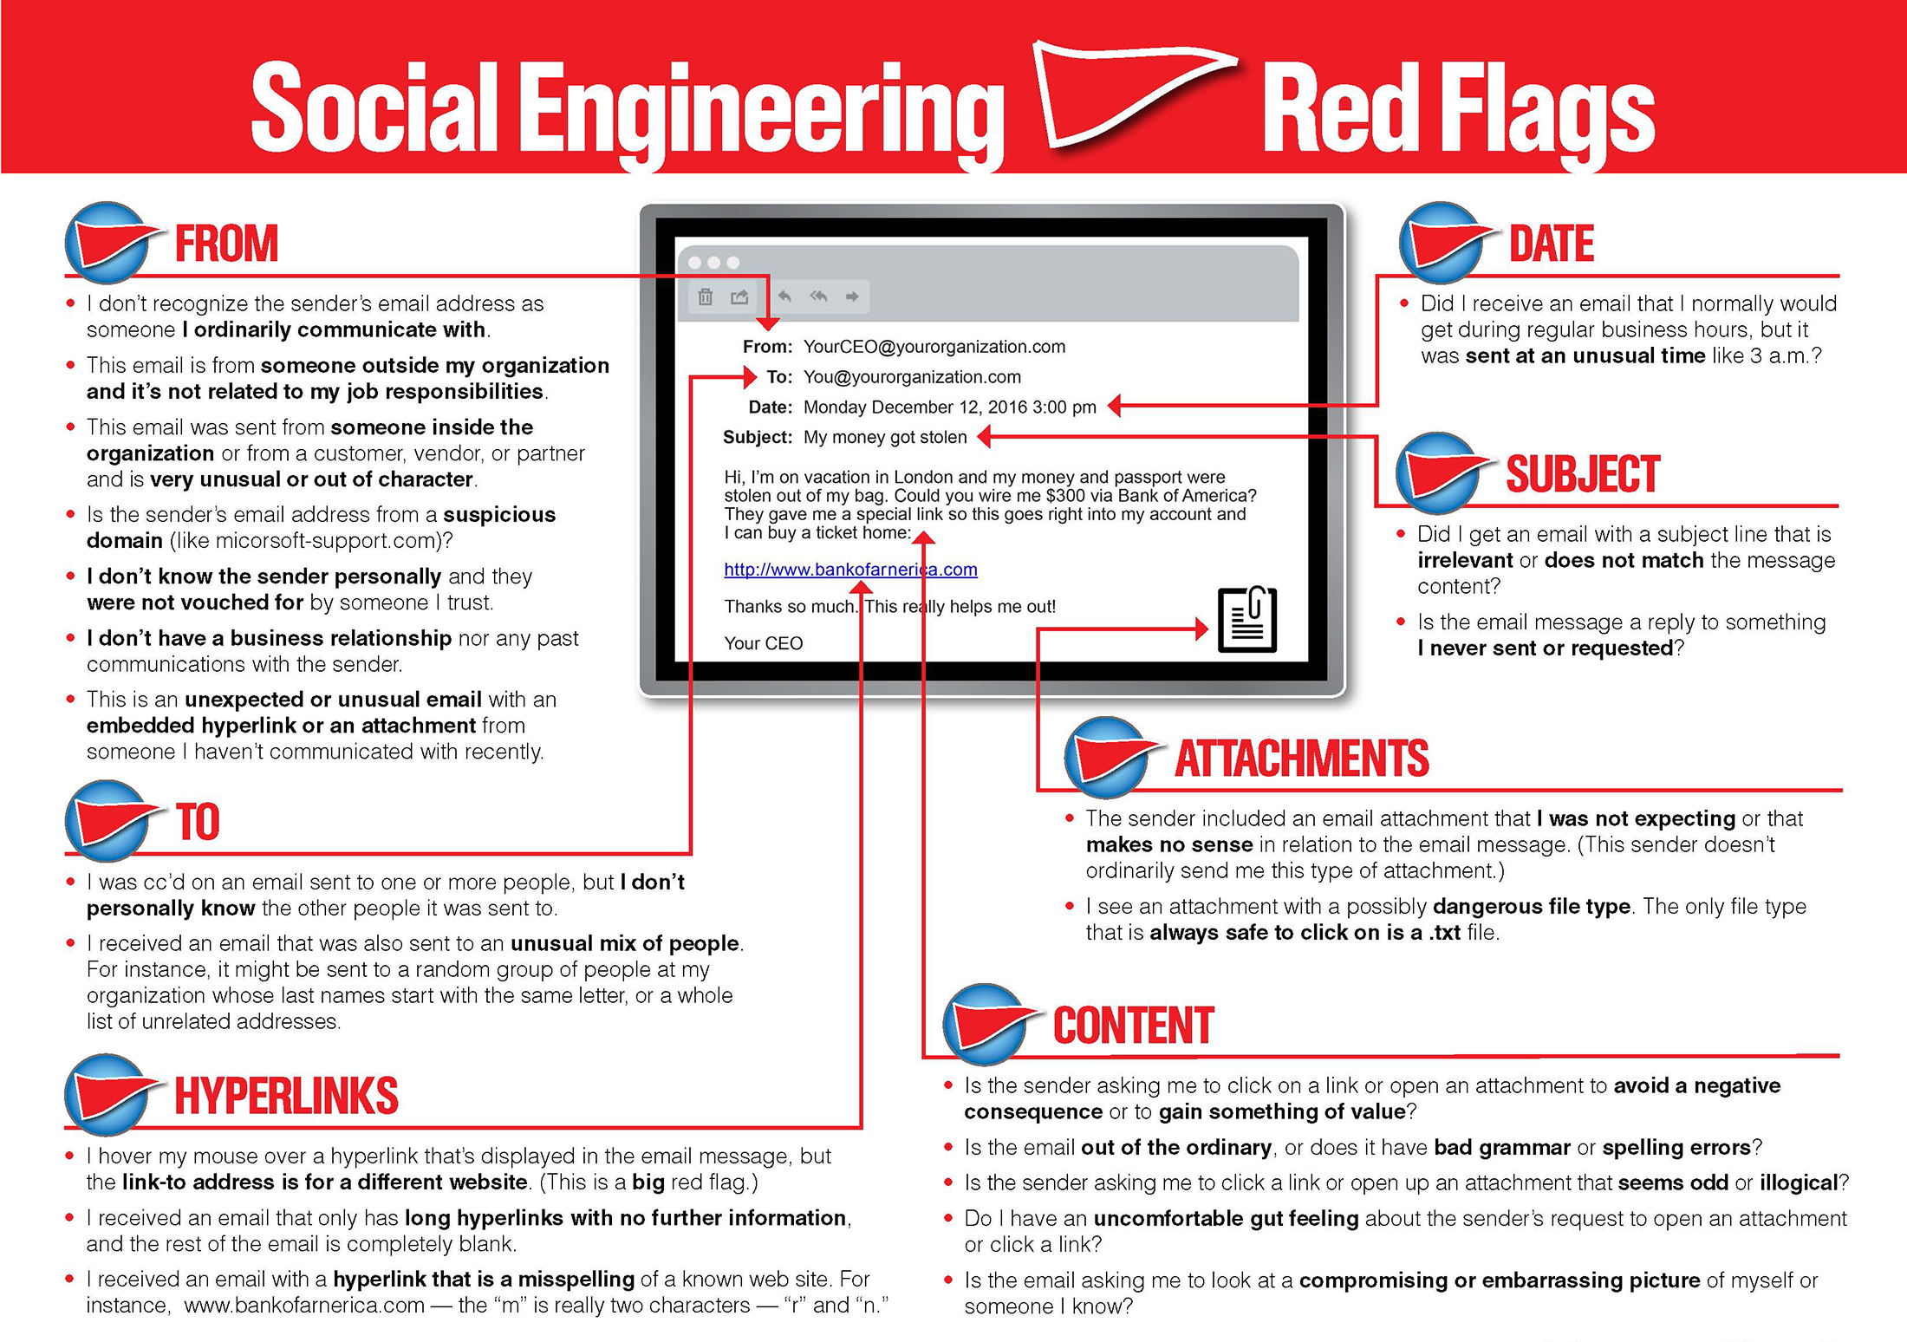
Social Engineering Red Flags
https://blog.techboston.com/social-engineering-red-flags

Slide 36
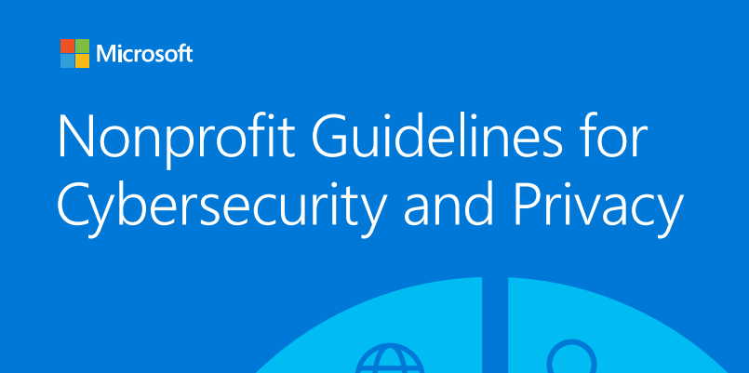

Slide 37
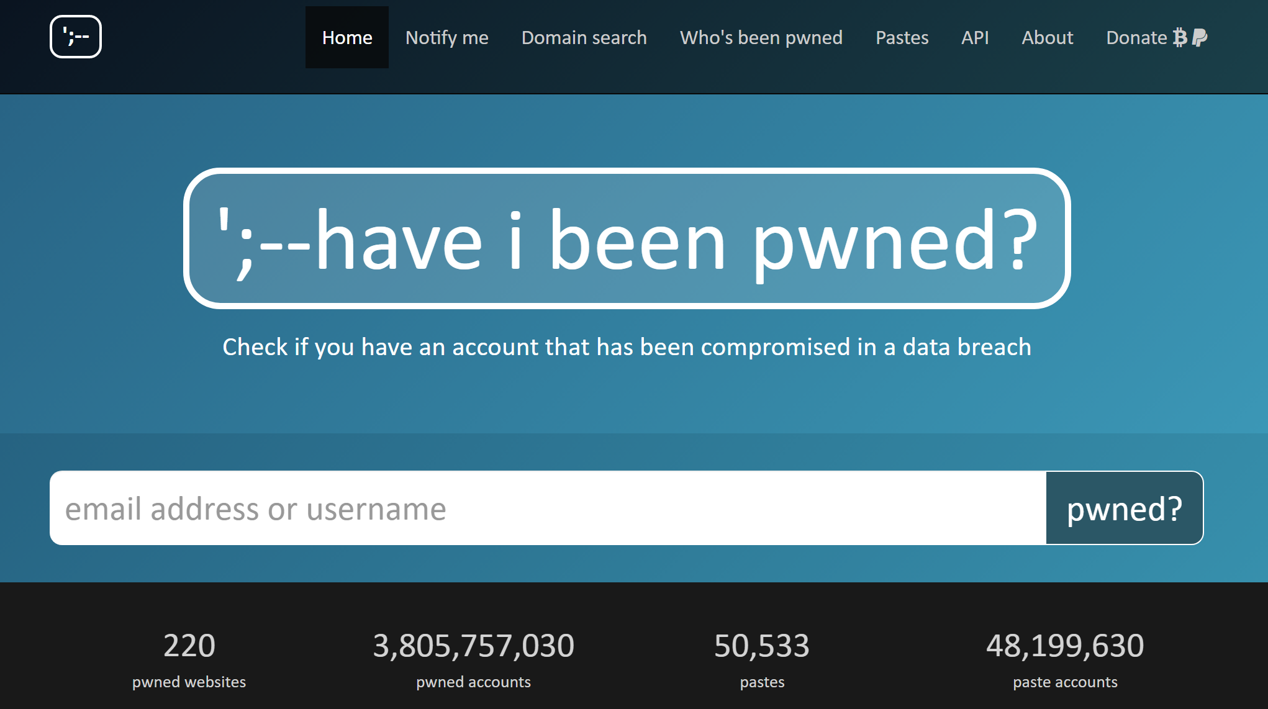

Slide 38
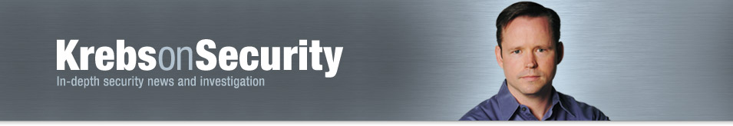

Slide 39
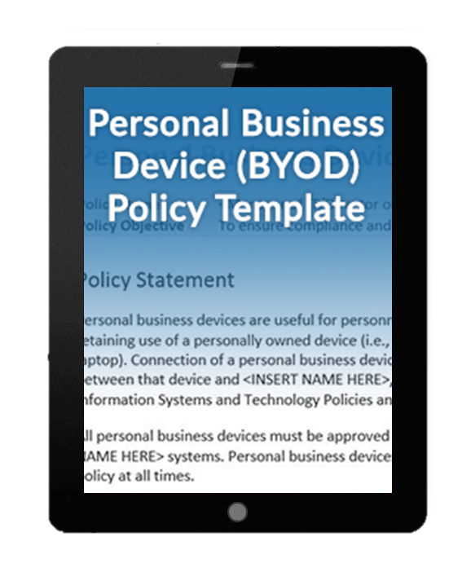
Sample BYOD Policy
https://go.techboston.com/byod-policy

Slide 40
Your To-Dos

Slide 41
After this…
Verify with your IT Resource
  Ask your IT Director or Managed Service Provider what they are doing to keep your organization’s data safe
Know that Cyber Security goes beyond software and hardware
  Review any training programs and policies that are in place at your organization.
Ensure that everyone is doing the same thing to protect your organization
  Just because you’ve trained people doesn’t mean people are following your procedures. Test and confirm!

Slide 42
Questions?
Tuan Pham
Tech Networks of Boston
617-269-0299 x303 | tuan.pham@techboston.com

