Slide 1
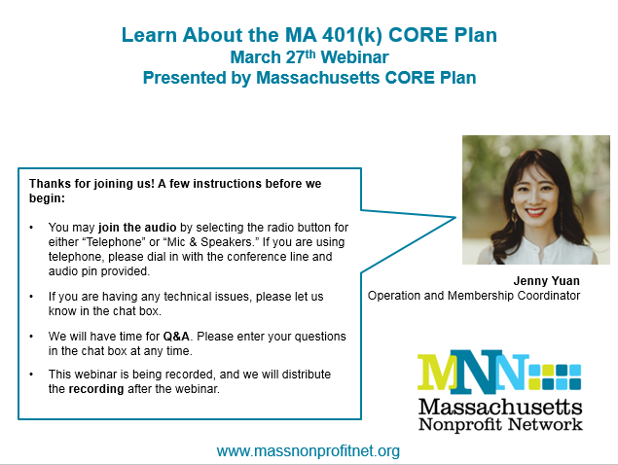

Slide 2
Connecting Organizations to Retirement
Massachusetts Defined Contribution CORE 401(k) Plan
FOR PLAN SPONSOR OR FINANCIAL PROFESSIONAL USE ONLY.
Notes:
Speaker’s notes are for INTERNAL USE ONLY. Not for use with the public.
Each slide will have notes that pertain to usage of this presentation.
There are included speakers notes to help with understanding the basics of the slides.
Also included in the presentation is Suggested talking points that will help guide the conversation while presentation the information.
Lastly, included is a script to be used if the presentation is to be recorded.
Mandatory Slide Yes
Speaker’s notes:
- Introduction slide
Suggested talking points:
Introduce yourself and Empower
Give your background and experience
Explain who Empower is and what we do
Let the audience know what they will learn today – transition to the topic slide
Script:
Hello, and welcome to this presentation on your retirement plan. If you could take a brief moment and imagine your retirement, what would you see? Can you maybe see yourself traveling to places you’ve never been? Are you pursuing a favorite hobby or past time? Or, perhaps you’re spending more time with family and friends. Whatever you’ve imagined your retirement will look like, retirement savings decisions you may make today may help you achieve your future vision of retirement. To help you connect your future vision of retirement to the savings decisions you may make today, the goal of our discussion is to help you understand how your plan works so that you may be able to use your plan to help you prepare for retirement.

Slide 3

Commonwealth of Massachusetts CORE Plan
Today’s Presentation Sections:
Overview
Key Features
Key Partners
Key Details
Contact Information
Q&A
Presenter: Lisa Cardinal

Slide 4
Overview: The Need for the CORE Plan
Commonwealth of Massachusetts created the CORE Plan
Offered exclusively to smaller nonprofit organizations in the Commonwealth of Massachusetts
Helping nonprofit employees save for retirement
Notes:
Speaker’s notes are for INTERNAL USE ONLY. Not for use with the public.
Mandatory Slide No
Speaker’s notes:
- Overview of the Plan
Suggested talking points:
Review who the CORE Plan was developed for
Script:
[Review each bullet point]
Explain the history of the plan: There are numerous nonprofits throughout the Commonwealth of Massachusetts; however, the accessibility to workplace retirement savings solutions is low for these nonprofits and their employees.
Overall, the nonprofit sector employs 455,900 – almost 17% of the state’s workforce.
According to TSNE MissionWorks, an organization that aims to strengthen the Massachusetts nonprofit sector (among other initiatives), 25% of nonprofits do not offer any retirement plans to their employees.
For many nonprofits, particularly smaller ones, in-house administration of deferred compensation plans can be cost-prohibitive given the limited budgets these organizations operate under. This leaves employees to seek out their own solutions that may not provide the advantages of pretax contributions and tax-deferred compounded growth potential, which in turn can jeopardize the employees' future retirement readiness.
The Commonwealth of Massachusetts Treasurer's Office has developed an innovative approach to providing this sizable portion of the workforce with a retirement planning solution without adding significantly to the employer's expenses. Similar to other employer-sponsored retirement plans, this plan would deduct pretax dollars from an employee's paycheck and invest them in a tax-deferred account.

Slide 5

Key Features: Eligibility
Employer Eligibility
  501(c) Organization in Massachusetts
  20 or Fewer W-2 Employees
  Outside Payroll Provider
Employee Eligibility
  All W-2 Employees

Slide 6
Key Features: CORE Benefits
Sponsored by the State Treasurer’s Office
Limits your fiduciary responsibility
Low cost investments and administration
Simplicity

Slide 7

Key Features: Contributions
Employee Contribution only
Or
Employee and Employer Contribution
Note: Additional rules apply if you have employees earning $120k+

Slide 8
Key Features: Employer Contributions
Match – 100% on first 3% of compensation, 50% on next 2%
Non-elective contribution – at least 3% of compensation
Employee % | Employer %
1 | 1
2 | 2
3 | 3
4 | 3.5
5 | 4

Slide 9

Key Features: Employee Contributions
Before tax contributions
Roth contributions
Notes:
Speaker’s notes are for INTERNAL USE ONLY. Not for use with the public.
Mandatory Slide No
Speaker’s notes:
- Slide has animation
Suggested talking points:
- Compare and contrast the differences in the paycheck when contributing on a pretax vs. Roth basis
Script:
Here we compare the Roth and Pretax paycheck. With pre-tax, your contribution is deducted before taxes are applied. Whereas with Roth, which is a type of after-tax contribution, the full gross pay is taxed, and then the 6% contribution of $150 is deducted.
Note that with both contribution types, the contribution dollar amount is calculated on the gross income, so the dollar amount contributed to the Plan will be the same, regardless of which you choose.
One question that retirement plan participants frequently ask is, “which contribution type would be better to make: Pretax or Roth?” The choice of whether to make Pre-tax contributions, Roth contributions or both, is a very personal one and should be considered in the light of your own financial situation and future retirement goals. Because of this, you may want to consider speaking with a tax professional or a financial planner prior to choosing the types of contributions you wish to make to your account.

Slide 10
Key Features: Other Plan Provisions
Immediate Eligibility
Immediate Vesting
W-2 Gross Compensation per pay period
Notes:
Speaker’s notes are for INTERNAL USE ONLY. Not for use with the public.
Mandatory Slide No
Speaker’s notes:
- Slide has animation
Suggested talking points:
- Compare and contrast the differences in the paycheck when contributing on a pretax vs. Roth basis
Script:
Here we compare the Roth and Pretax paycheck. With pre-tax, your contribution is deducted before taxes are applied. Whereas with Roth, which is a type of after-tax contribution, the full gross pay is taxed, and then the 6% contribution of $150 is deducted.
Note that with both contribution types, the contribution dollar amount is calculated on the gross income, so the dollar amount contributed to the Plan will be the same, regardless of which you choose.
One question that retirement plan participants frequently ask is, “which contribution type would be better to make: Pretax or Roth?” The choice of whether to make Pre-tax contributions, Roth contributions or both, is a very personal one and should be considered in the light of your own financial situation and future retirement goals. Because of this, you may want to consider speaking with a tax professional or a financial planner prior to choosing the types of contributions you wish to make to your account.

Slide 11
Key Features: Auto Enrollment Plan
Helps Employees Save
Makes inertia work for your employees
Employees still have complete control

Slide 12
Key Features: CORE Plan Defaults
Automatic enrollment, 6% pre-tax
Target date fund
Automatic escalation from 6%-12%
  Employer chooses the rate of either 1% or 2% per year

Slide 13

Key Features: Investments
Target Date Funds
Managed Account Service
Objective Based Funds
~ Diversification in every option ~

Slide 14
Key Features: Investments
Target Date Funds
CORE 2055 Retirement Fund
CORE 2050 Retirement Fund
CORE 2045 Retirement Fund
CORE 2040 Retirement Fund
CORE 2035 Retirement Fund
CORE 2030 Retirement Fund
CORE 2025 Retirement Fund
CORE 2020 Retirement Fund
CORE 2015 Retirement Fund
Managed Account Service
Builds a portfolio based on your specific goals and overall financial picture. And adjusts as you get closer to retirement or as you provide additional information when your financial picture changes.
Objective Based Funds
CORE Growth Fund
CORE Income Fund
CORE Inflation Fund
CORE Capital Preservation Fund

Slide 15
Key Partner: Empower Retirement
Your service provider: Empower-Retirement
  Defining success as helping people work toward replacing, for life, the income earned while working.
  Also, Empower ……
  Has a continued commitment to retirement
  Provides ongoing customer support
  Provides communication and education
  Provides quarterly statements
  Provides customer support
Notes:
Speaker’s notes are for INTERNAL USE ONLY. Not for use with the public.
Mandatory Slide No
Speaker’s notes:
- Empower overview slide
Suggested talking points:
Let the audience know our goal is to help them replace for life – the income they earned while working
Discuss our roles and responsibilities
Script:
Empower Retirement provides retirement plan record keeping services for Businesses, Governments and non-profit organizations. With the many combined years of experience that Empower employees have, our focus remains on you, the individual participant, and how we can support both you and your employer with your retirement plan. To help and support you along your journey to retirement, we provide services such as receiving and tracking your payroll contributions and account balance, sending you statements, providing communication and financial education both in person and electronically, having representatives that are available to answer any of your questions about your savings plan and many more day to day responsibilities.

Slide 16
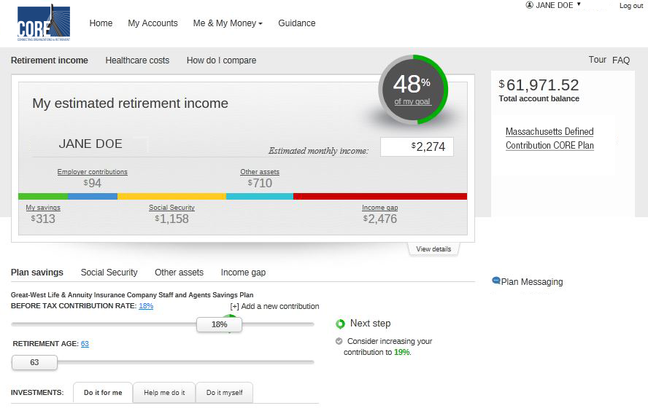
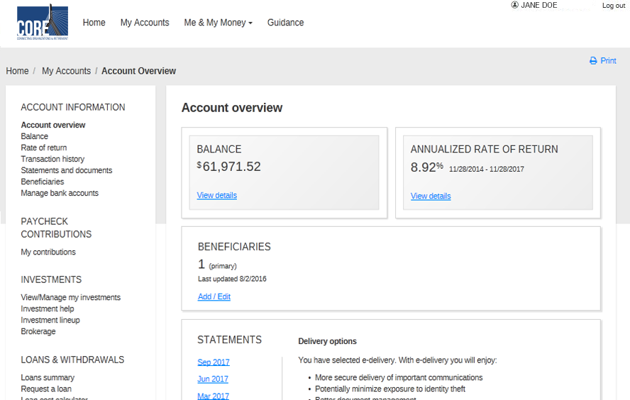
Key Partner: Website – My Account
https://empower.wistia.com/medias/4jbg8twq9k
FOR ILLUSTRATIVE PURPOSES ONLY.
Notes:
Speaker’s notes are for INTERNAL USE ONLY. Not for use with the public.
Mandatory Slide: No
Speaker’s notes:
Reiterate the key features of post-login by pointing out sections in red boxes:
sliders, navigation, online account maintenance.

Slide 17
Remittance Process
Your payroll provider calculates the contribution amounts and you (the employer) then enter those dollar amounts in Empower’s Plan Sponsor website Center (PSC) as noted in Step 4 and 5.
The full process is outlined below:
Step 1
Step 2
Step 3
Step 4
Step 5
Employee contacts Empower to request contribution amount
Empower sends Employer a report a few days before each payroll date showing employees who requested a contribution change and referencing their newly requested election
Employer enters the newly requested contribution election into payroll system (others’ existing elections should already be there)
Payroll Company calculates Employer and Employee contributions for all participants and produces report showing dollar amounts and money type per employee
Employer, referring to Payroll Company’s report, enters dollar amounts and money types into Empower’s website, hits enter, which uploads data per person, and authorizes Empower to debit organization’s bank account

Slide 18
Key Details: Plan Pricing
Employer Fee
Start up fee: | $2,500
Annual fee: | $350 if you provide an Employer Contribution Or $950 if you do not provide an Employer Contribution
 | This is reduced by $200 in Year 1.
Employee Fee
Annual fee: | $65 annually, paid quarterly
 | Deducted from employee account balance. Or, the employer can cover this fee if desired.

Slide 19
Key Details: Expense Ratios¹ on Investments
Target Date Funds | Estimated Gross Expense Ratio
CORE 2055 Retirement Fund | 0.16%
CORE 2050 Retirement Fund | 0.16%
CORE 2045 Retirement Fund | 0.16%
CORE 2040 Retirement Fund | 0.16%
CORE 2035 Retirement Fund | 0.16%
CORE 2030 Retirement Fund | 0.15%
CORE 2025 Retirement Fund | 0.15%
CORE 2020 Retirement Fund | 0.15%
CORE 2015 Retirement Fund | 0.15%
CORE 2010 Retirement Fund | 0.15%
CORE Retirement Allocation Fund | 0.15%
Objective- Based Funds | Estimated Gross Expense Ratio
CORE Growth Fund | 0.19%
CORE Income Fund | 0.14%
CORE Inflation Fund | 0.14%
CORE Capital Preservation Fund | 0.47%
1Gross expense ratios are the funds’ total annual costs, including the investment manager and operating expenses, a 1 basis point accrual for trust services and a 10 basis point accrual for 3(38) investment consultant services, expressed as a percentage of the funds’ average net assets over a given time period. They are gross of any fee waivers or expense reimbursements and are subject to change. Please see the fund’s fact sheet for additional information.

Slide 20
In Summary
The CORE Plan is designed with small MA nonprofits in mind
Best-in-Plan design features streamline administration and make good retirement outcomes easier to achieve
Flexible options help employers pick what’s best for their employees and their organization
All while limiting the fiduciary liability of your nonprofit
Thank you for taking time to learn more about the CORE Plan.
Questions?

Slide 21
Contact the CORE Plan
Lisa Cardinal, Local CORE Plan Representative
  617-510-4036
  Lisa.Cardinal@empower-retirement.com
www.ma-employer-core.com
Empower Participant Web Guided Tour
Notes:
Speaker’s notes are for INTERNAL USE ONLY. Not for use with the public.
Mandatory Slide Yes
Speaker’s notes:
- Read slide

Slide 22
DISCLOSURES
  Carefully consider the investment objectives, risks, fees and expenses of the annuity and/or the investment options. Contact us for a prospectus, a summary prospectus and disclosure document, as available, containing this information. Read them carefully before investing.
  Securities offered or distributed through GWFS Equities, Inc., Member FINRA/SIPC and a subsidiary of Great-West Life & Annuity Insurance Company.
  GWFS Equities, Inc., or one or more of its affiliates, may receive a fee from the investment option provider for providing certain recordkeeping, distribution and administrative services.
  Asset allocation and diversification do not ensure a profit and do not protect against loss in declining markets. Asset allocation and balanced investment options and models are subject to the risks of the underlying investments, which can be a mix of stocks/stock funds and bonds/bond funds.
  The charts, graphs and screen prints in this presentation are for ILLUSTRATIVE PURPOSES ONLY.
  Great-West Financial®, Empower Retirement and Great-West InvestmentsTM are the marketing names of Great-West Life & Annuity Insurance Company, Corporate Headquarters: Greenwood Village, CO; Great-West Life & Annuity Insurance Company of New York, Home Office: New York, NY, and their subsidiaries and affiliates, including registered investment advisers Advised Assets Group, LLC and Great-West Capital Management, LLC. GWFS Equities, Inc. registered representatives may also be investment adviser representatives of GWFS affiliate, Advised Assets Group, LLC. Representatives do not offer or provide investment, fiduciary, financial, legal or tax advice or act in a fiduciary capacity for any client unless explicitly described in writing. All rights reserved. ©2018 Great-West Life & Annuity Insurance Company. All rights reserved. ERPC-3453-1712-Enroll AM455234-0318
22
FOR PLAN SPONSOR OR FINANCIAL PROFESSIONAL USE ONLY.
Notes:
Speaker’s notes are for INTERNAL USE ONLY. Not for use with the public.
Mandatory Slide Yes
Script:
Please consider the investment objectives, risks, fees and expenses carefully before investing. The prospectus contains this and other information about the investment options. Depending on the investment options offered in your plan, your registered representative can provide you with prospectuses for any mutual funds; any applicable annuity contracts and the annuity’s underlying funds; and/or disclosure documents for investment options exempt from SEC registration. Please read them carefully before investing.

