Slide 1
Leveraging Technology to Improve Your Back Office
February 13th Webinar
Presented by Kevin P. Martin & Associates
Thanks for joining us! A few instructions before we begin:
You may join the audio by selecting the radio button for either “Telephone” or “Mic & Speakers.” If you are using telephone, please dial in with the conference line and audio pin provided.
If you are having any technical issues, please let us know in the chat box.
We will have time for Q&A. Please enter your questions in the chat box at any time.
This webinar is being recorded, and we will distribute the recording after the webinar.
Marta Hodgkins-Sumner
Director of Membership and Programs
www.massnonprofitnet.org

Slide 2
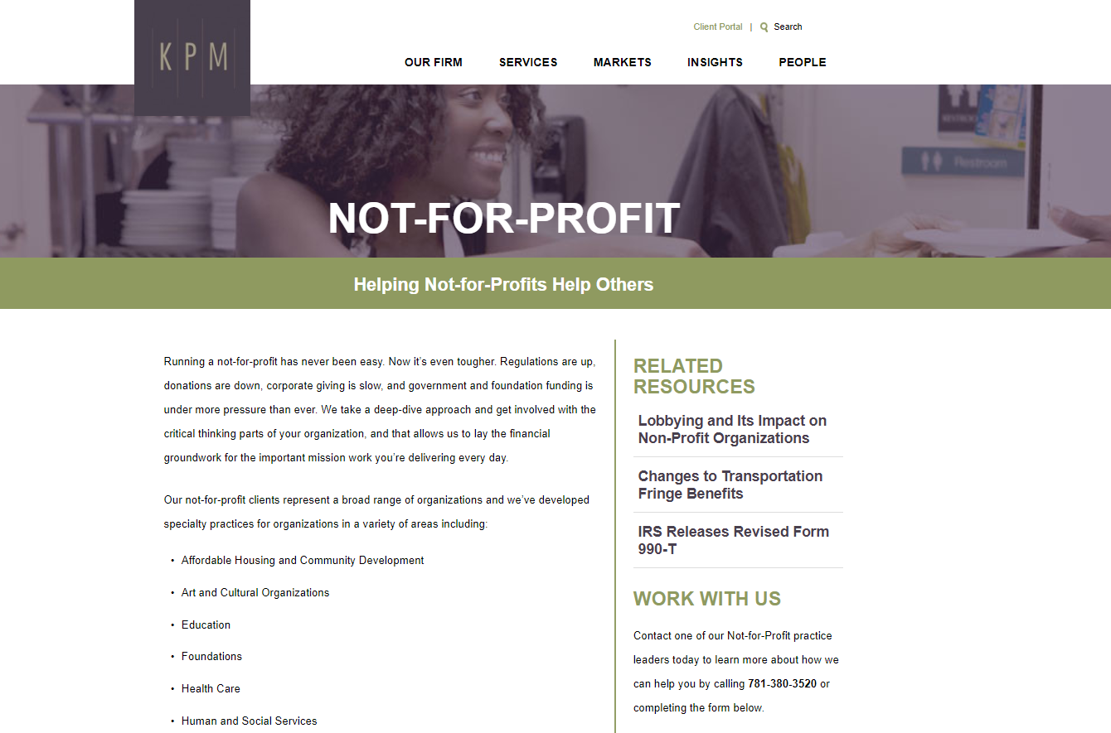
www.kpm-us.com

Slide 3
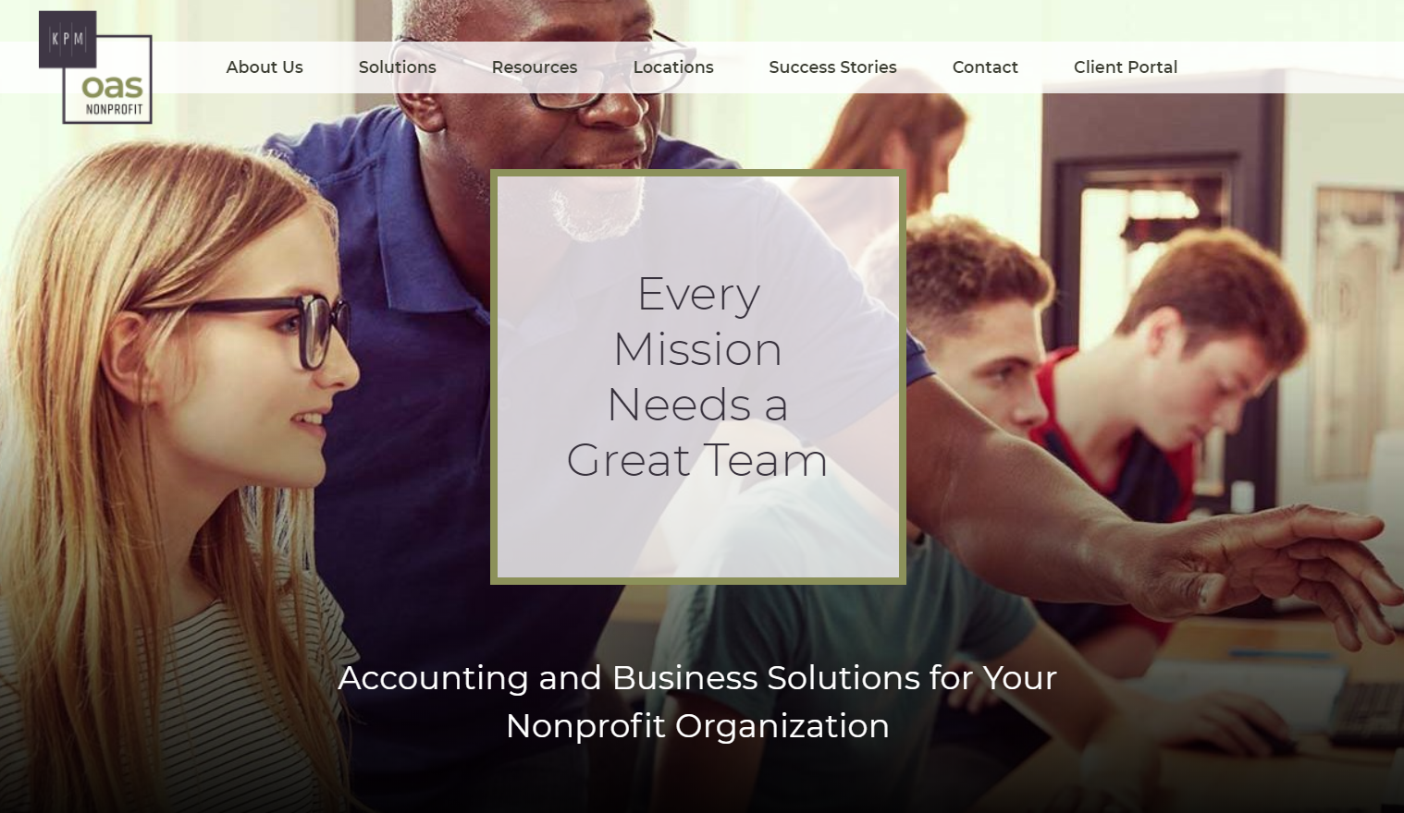
www.KPMnonprofitOAS.com

Slide 4
Our Agenda
Documenting your process
Technology you can leverage
The process of change

Slide 5
Documenting Your Process
Donations and invoicing
Cash collections
Vendor bills
Cash payments
Payroll
Discovering two things

Slide 6
Technology You Can Leverage
Processing vendor bills
Expense reporting
Vendor payments
Data integration
Accounting software

Slide 7
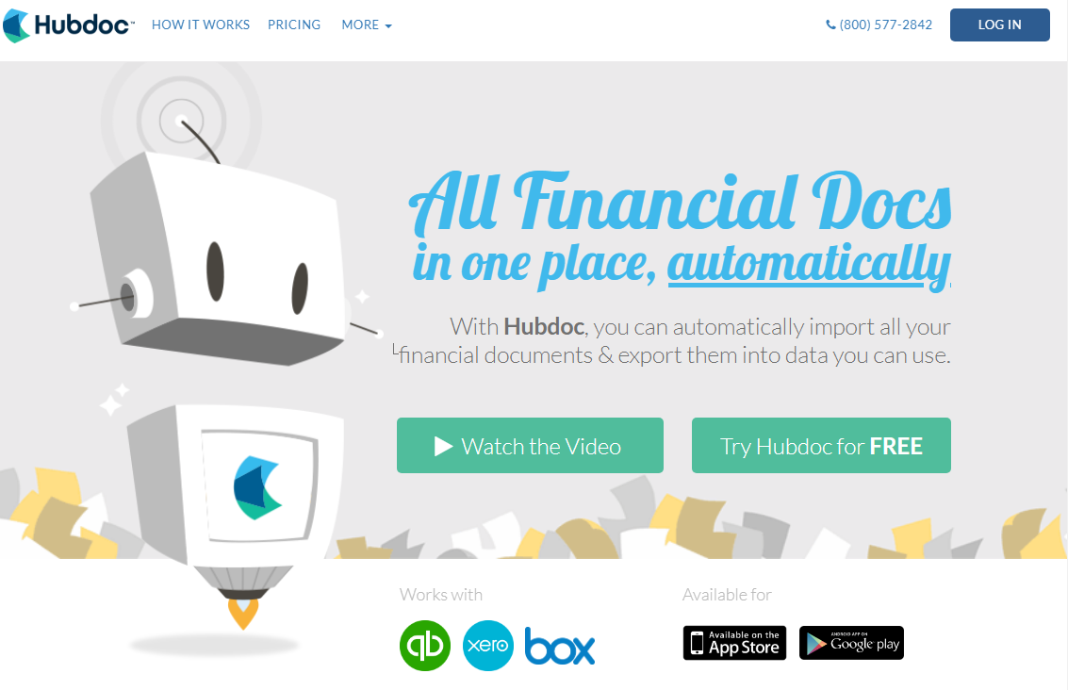
Processing Vendor Bills

Slide 8
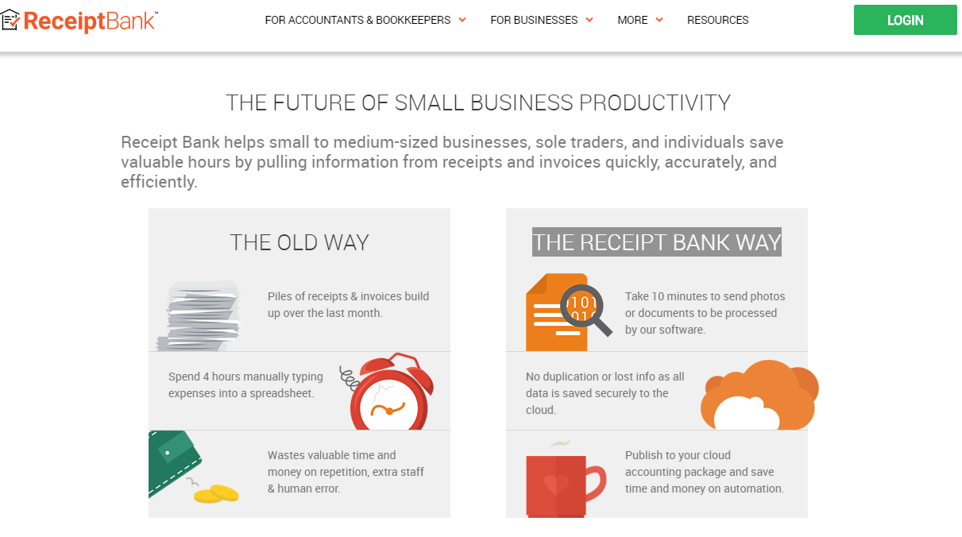
Processing Vendor Bills

Slide 9
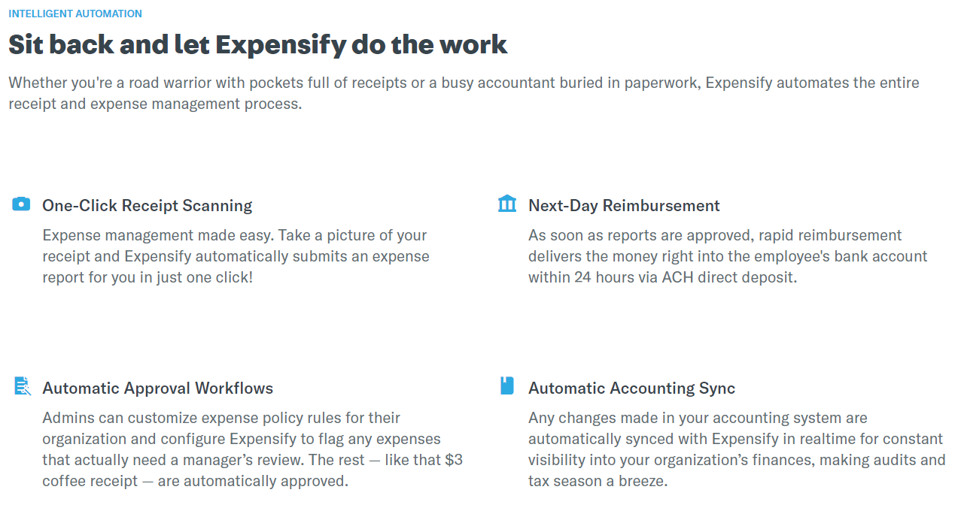
Expense Reporting

Slide 10
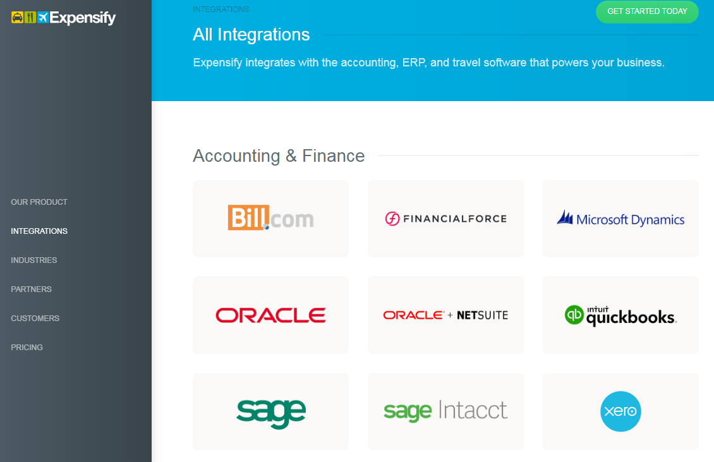
Expense Reporting

Slide 11
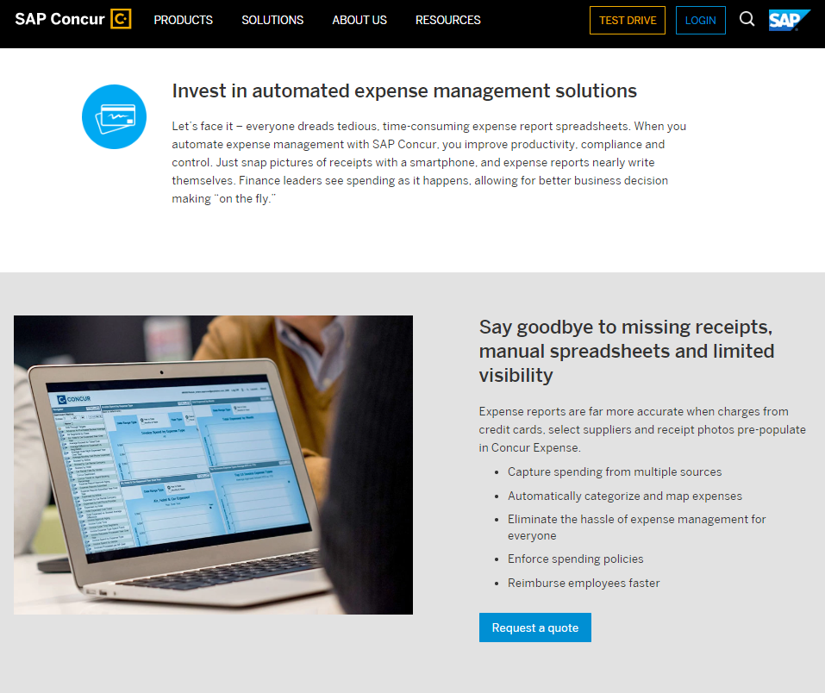
Expense Reporting

Slide 12
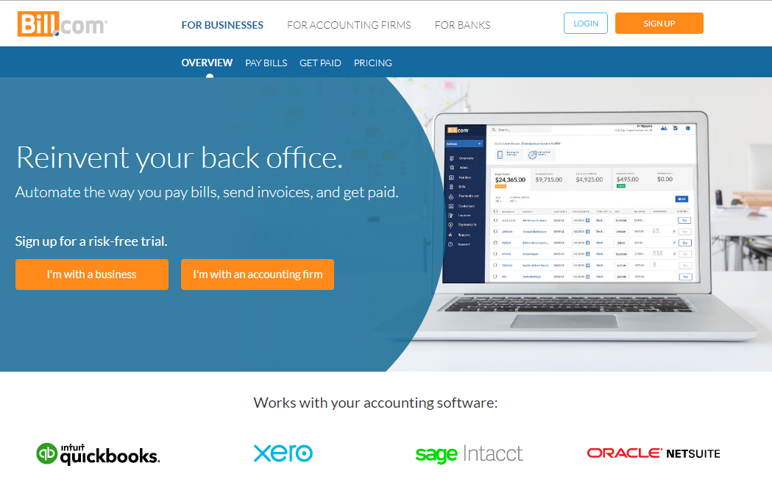
Vendor Payments

Slide 13
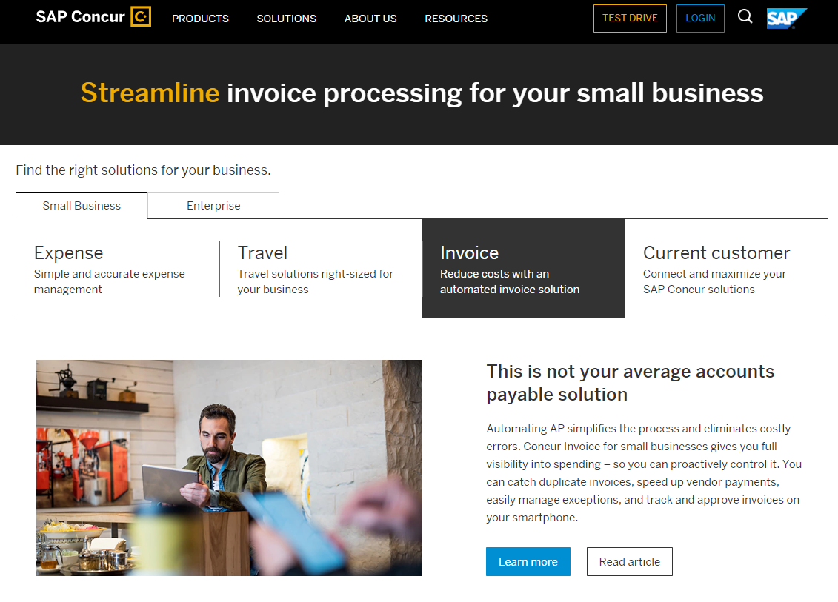
Vendor Payments

Slide 14
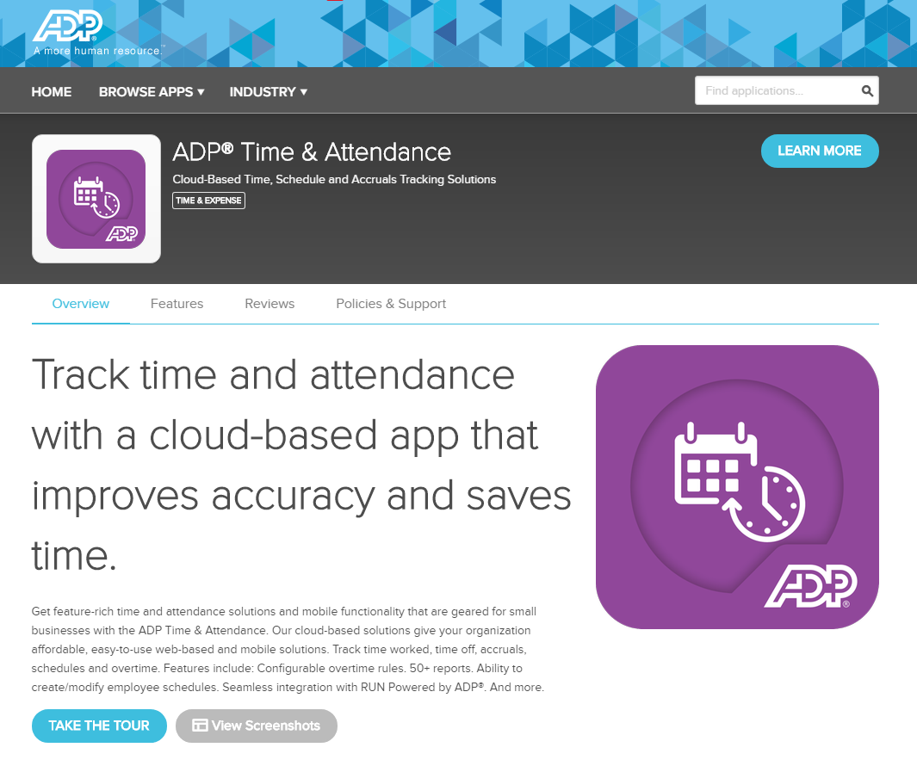
Data Integration

Slide 15
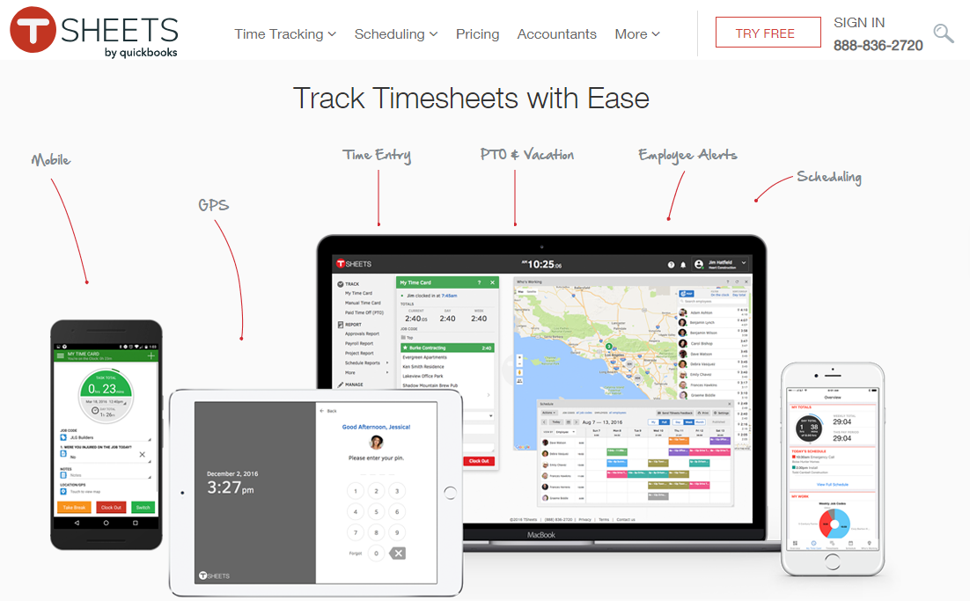
Data Integration

Slide 16
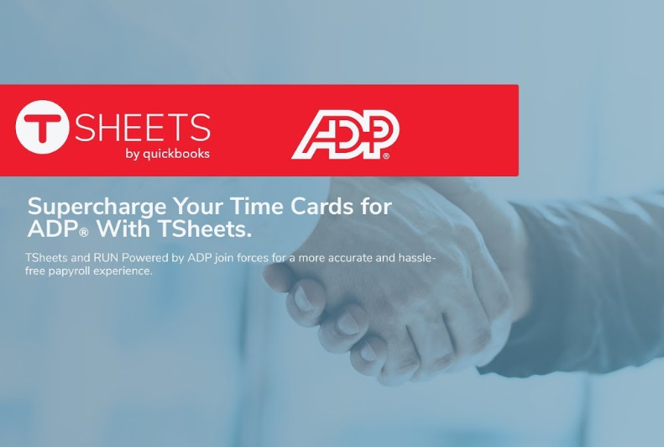
Data Integration

Slide 17
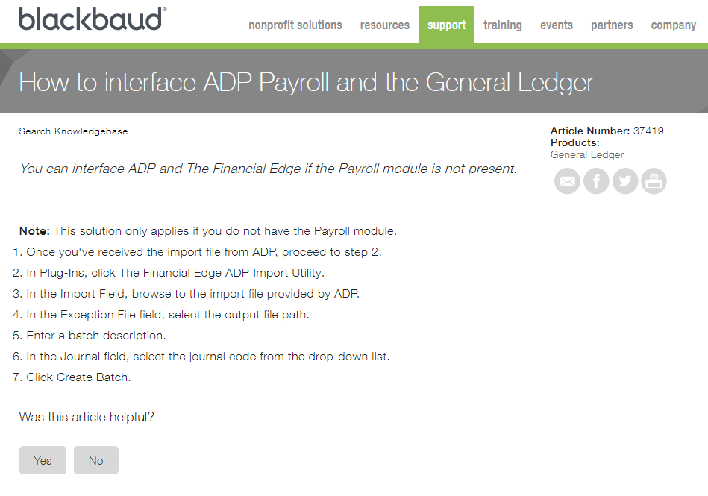
Data Integration

Slide 18
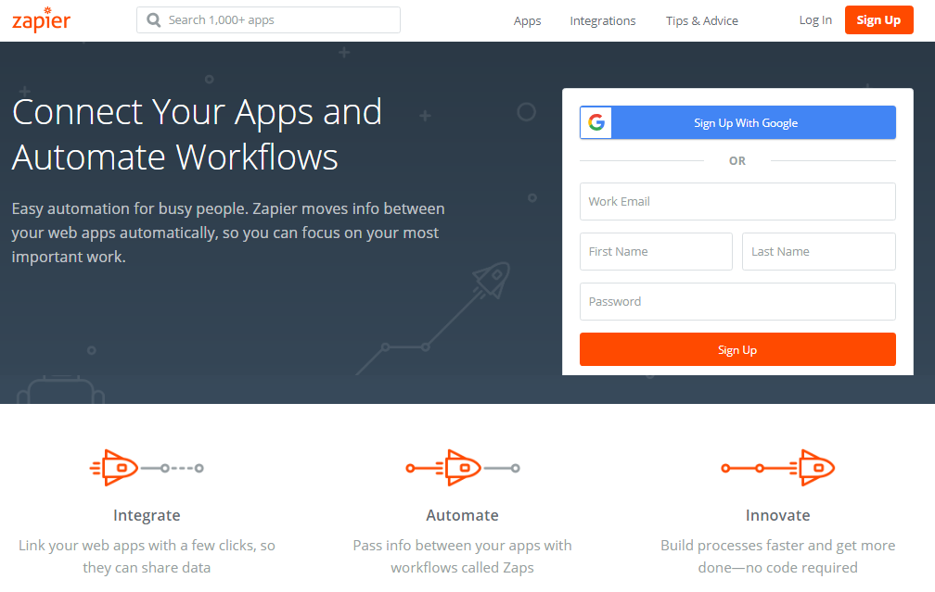
Data Integration

Slide 19
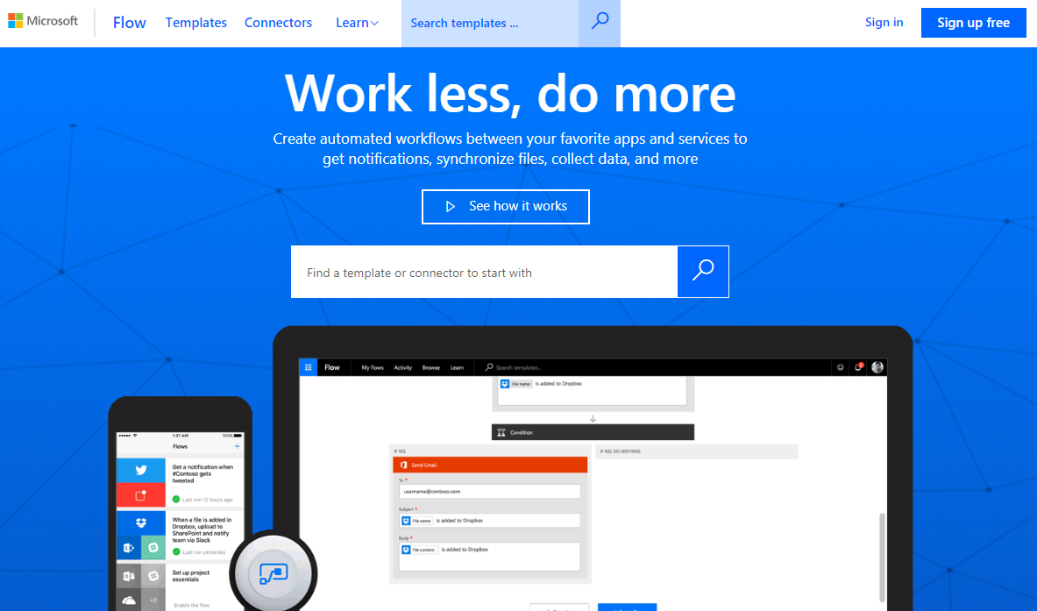
Data Integration

Slide 20
Accounting Software
Online or on-premise
Written for nonprofits
All inclusive or only accounting
Third party apps

Slide 21
The Process Of Change
Map your process
Determine your “that’s not changing” list
Identify where you rekey data
Focus on needs not features
Plan for disruption
Do your homework

Slide 22
Contact Information
Barry MacQuarrie, CPA
bmacquarrie@kpm-us.com
James Matzdorff, CPA
jmatzdorff@kpm-us.com

