Slide 1
Growing Pains: Dealing with High Expectations and Resistance in DEI Culture Change in Your Organization
Guimel DeCarvalho, LICSW, SHRM-CP
Director of People & Culture and Chief Diversity Officer
Wayside Youth & Family Support Network
Guimel_decarvalho@waysideyouth.org

Slide 2
The Key Takeaways
You may see drops in satisfaction scores and hear anecdotal stories of “more conflict” among staff.
Focus on objective measures like turnover, retention, and diversity in management levels.
Go slow, but be consistent in messaging and clear in purpose.
Bonus Takeaway: Download all the presentations from the conference!!

Slide 3

Wayside: A Case Study
Children’s Mental Health Agency
450+ employees spread out over 17 locations in Massachusetts
21 – 76 years old
75% Female
36% staff of color
Mix of educational background from no degree to MD

Slide 4

Inciting Incident

Slide 5
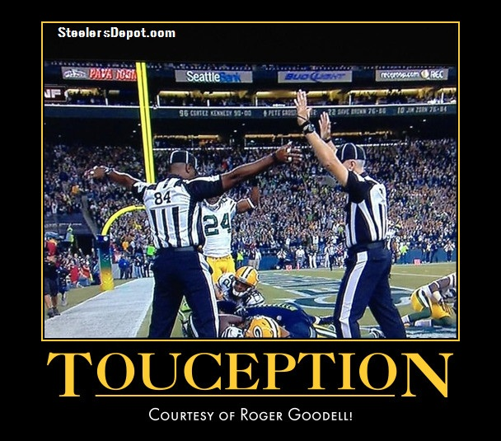
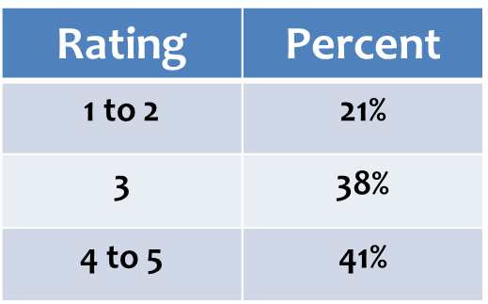
White Privilege Training

Slide 6

Diversity & Inclusion Committee Feedback
Basic Level information
Many in Admin (majority White staff) did not attend
Logistics Issues
Held in a church
Poor trainer

Slide 7

Regrouped

Slide 8
Equity Continuum
The Equity Continuum is an evidenced based framework that is being developed by Monisha Kapila, CEO of ProInspire. It outlines three phases of DEI through an organizational focus, leadership, and strategies, as follows:
• 101: Diversity - when leaders are awake to the importance of diversity, and the organization starts building a diverse workforce by focusing on recruitment and retention.
• 201: Inclusion - when leaders become woke about social issues and injustices, and the organization focuses on creating an inclusive culture by viewing and managing cultural change.
• 301: Equity - when leaders are doing the work to become anti-racist/anti-oppression, and the organization is driving equity inside and outside the organization by addressing structural and institutional oppression.

Slide 9
We Developed Our Guiding Principles
Wayside will do the work to become an anti-racist, social justice, and advocacy organization that provides mental health services to children and families.
http://www.waysideyouth.org/WorkWithUs/EmployeeIntranet/DiversityInclusion.aspx
We will accomplish this through the attainment of 5 goals:
1) Create trust.
2) Have courageous conversations.
3) Increase social capital.
4) Apply an equity lens.
5) Measure data & hold ourselves accountable.

Slide 10

Then We Measured

Slide 11
Establishing a Baseline

Slide 12
Establishing a Baseline
 | Dec 2015 | Dec 2014
# Requests Sent to Staff | 420 | 400
Responders | 135 | 88
Response Rate | 32% | 22%
Wayside Commitment to Diversity (Yes) | 99% | 87%
Observed Stated or unstated Bias (Yes) | 21% | 43%
Witnessed Bias (Yes) | 17% | N/A
Experienced Bias (Yes) | 24% | N/A
Policies & Actions Supportive of Staff & Clients, reflecting Wayside commitment to diversity & inclusion | 76% | 72%
All measures demonstrated staff overwhelmingly agreed that the Agency was “committed to diversity”
Incidents of bias were decreasing.
Staff witnessed bias at a similar rate of those who experienced it.

Slide 13




What we did (so far)
21 Different Action Items!!

Slide 14

Mid-Year Check In

Slide 15
Diversity Survey Results
Overall, 98% of staff agreed that Wayside is committed to diversity and inclusion and 94% agreed that their program is committed to diversity and inclusion.
61% of staff were interested in joining an affinity group. On a scale of 1 to 10, 73% of staff felt more prepared than not (5+ rating) to engage in Courageous Conversations. 17.6% of staff felt extremely unprepared (0 rating).
Within the Wayside work environment, 9.5% of staff experienced mistreatment based on racial or group identity and 9.9% felt isolated due to racial or group identity. 31% of staff have observed intentional or unintentional acts of bias (3 times more than those who experienced it firsthand).

Slide 16

Let me say this another way
 | Dec 2015 | June 2017
Agency Commitment | 99% | 98%
Experienced Bias | 24% | 9.5%
Felt Isolated | NA | 9.9%
Witnessed Bias | 17% to 21% | 31%
Ratio | .79 | 3.26

Slide 17
Group Differences
There were limited differences between White staff and staff of Color.
  10.5% of staff of Color rated Wayside as “no, not much” on Wayside as a safe place for People of Color compared to 4.4% of White staff.
  15% fewer staff of Color rated Wayside as “yes, very much” on Wayside is committed to diversity and inclusion.
  13% of staff of Color experienced mistreatment based on racial or group identity and 12% felt isolated due to racial or group identity compared to 6% of White staff respectively.
  The largest differences were across Programs with three programs showing the most areas for improvement.

Slide 18

Staff Satisfaction Diversity Questions: Program Differences
From 8 to 40 point drops in percentile
Dramatic differences by Program

Slide 19
Areas for Pride: Staff Feel Valued
*Areas in yellow have over 90% of staff agreeing or strongly agreeing.

Slide 20

Diversity Turnover: They are staying
Turnover of staff of color dropped from 36% to 26.5%.
Slightly lower than the total agency turnover rate of 27%.
Of the 41 staff of color hired in FY2017 only 7 left the agency, which is an 83% first year retention rate compared to a 73% first year retention rate for the agency as a whole. The second year retention rate of staff of color is 73% which is the same as the second year retention rate for the agency as a whole.

Slide 21
Direction from Diversity Survey
Comments | Number | Percent
Need to increase number of managers/supervisors of color | 38 | 21%
Need to increase trainings | 69 | 38%
Need to increase Courageous Conversations | 38 | 21%
*Fragility Comment | 17 | 9%
*Difference of Opinion is not valued | 9 | 5%
* Comments were only counted for this category if they were explicit fragility statements.

Slide 22
What we kept doing (so far)
31 Different Action Items!!

Slide 23

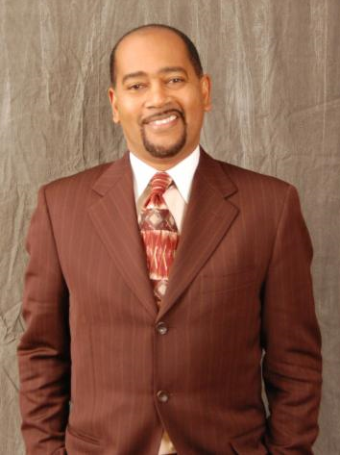
Changing Institutions & Culture
https://vimeo.com/47025981

Slide 24
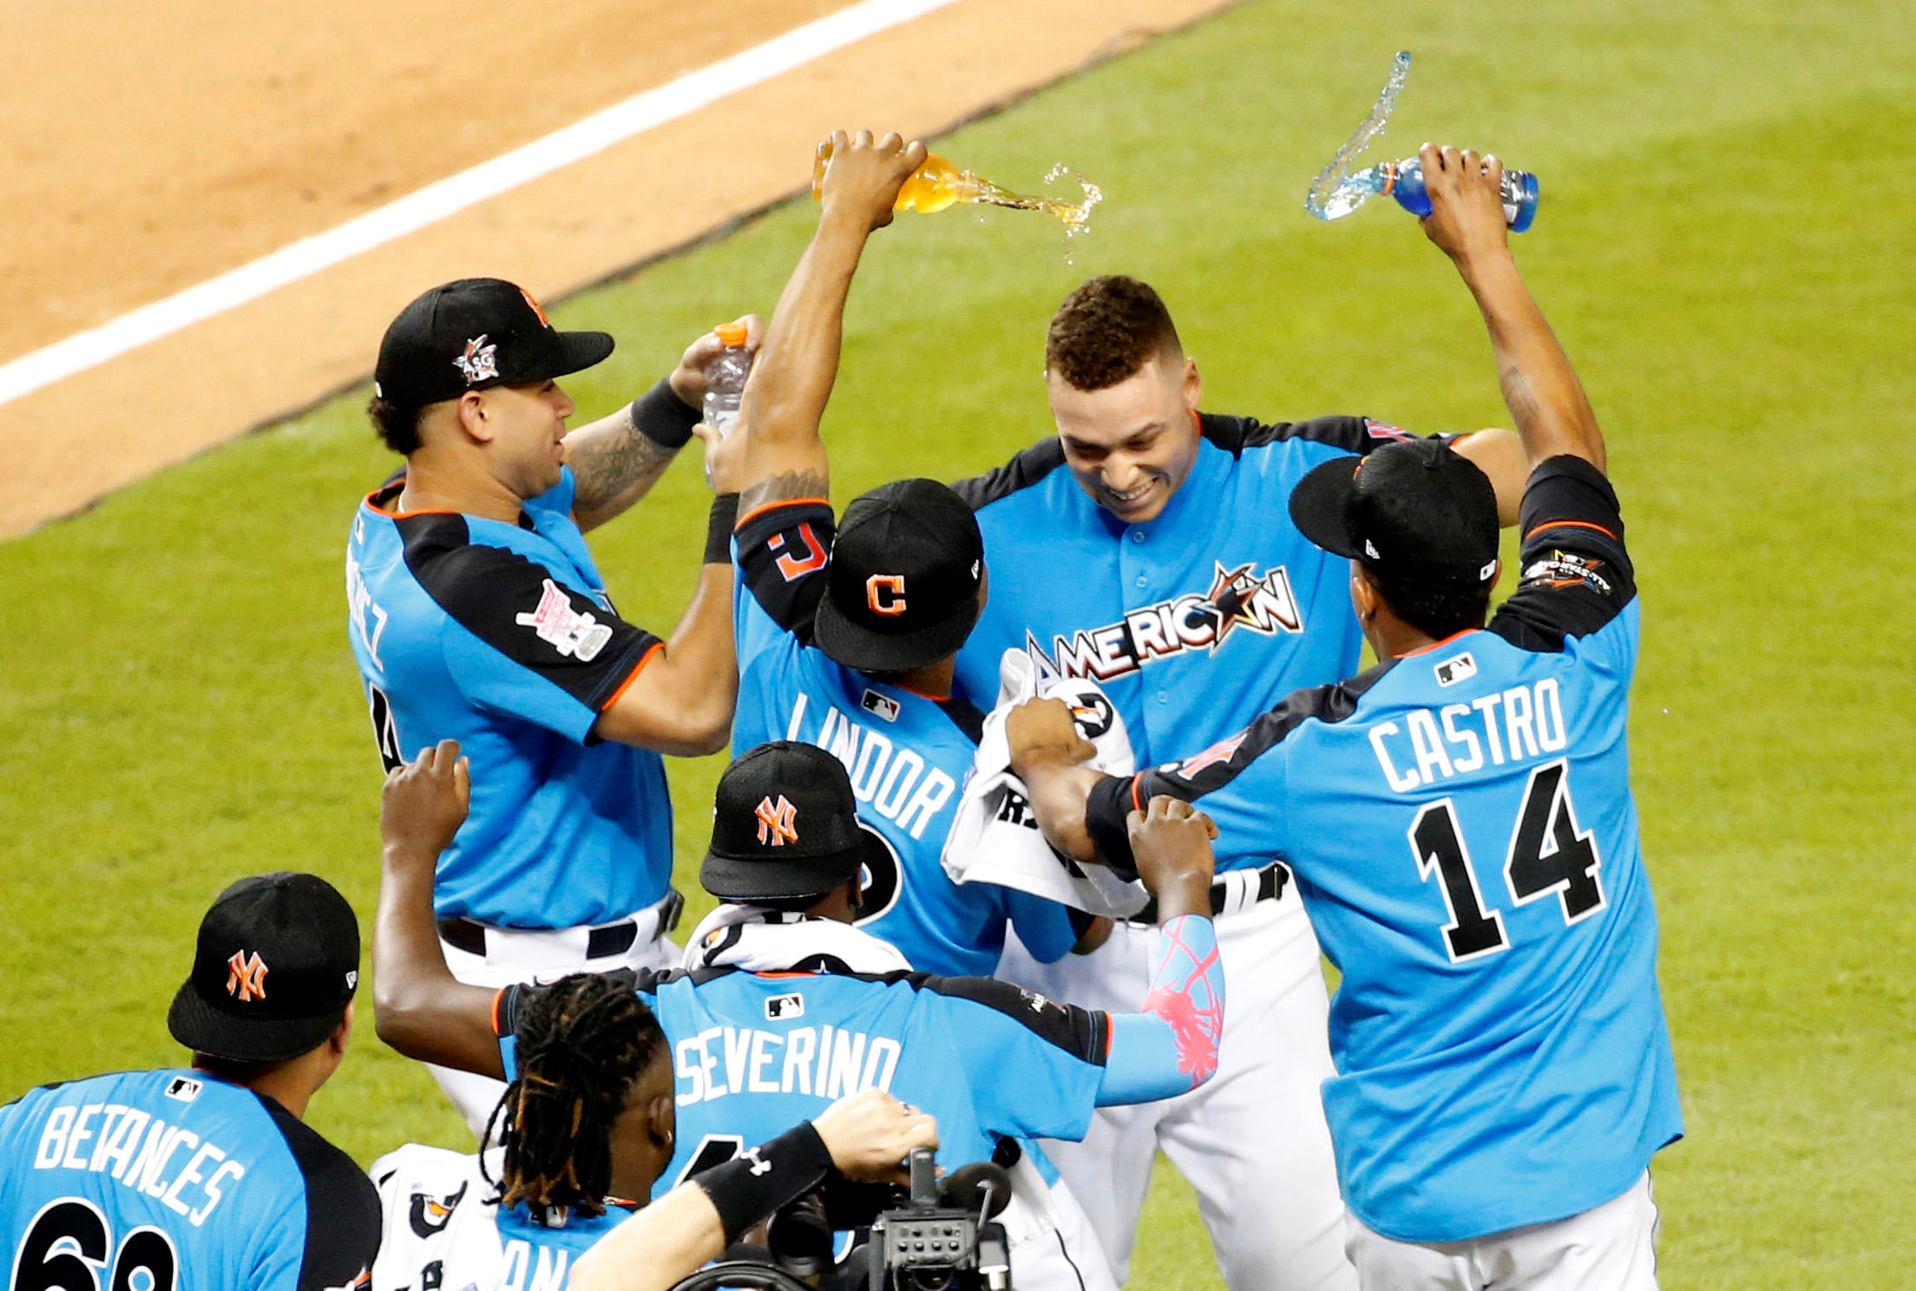

Validate, Challenge, Request Training
Rating | Percent
1 to 2 | 1%
3 | 5%
4 to 5 | 94%
240 Staff Attended
All Senior Managers Participated

Slide 25
Starting to Reach the Goal!!
Future Efforts:
Keep Increasing Managers of Color
Create program specific strategies on DEI
 | FY2015 | Dec. 2016 | FY2017 | FY2018
Senior Manager | 20% | 22% | 22% (2 of 9) | 14% (1 of 7)
Program Director | 16% | 16% | 16% (5 of 31) | 19% (7 of 37)
Supervisor | 34% | 42% | 46% (36 of 78) | 47% (30 of 64)
Overall | 27% | 31% | 37% (43 of 118) | 35% (38 of 108)

Slide 26
Starting to Reach the Goal!!
 | Dec 2015 | FY 2017 | FY2018
Agency Commitment to Diversity | 99% | 98% | 99.9%
Experienced Bias | 24% | 9.5% | 6%
Witnessed Bias | 17% to 21% | 31% | 29%
Ratio | .79 | 3.26 | 4.83
Increased Diversity | FY2017 | FY2018
Staff of Color | 36% | 41%
Bilingual Clinicians | 27% | 31%
LGBTQ+ | 11% | 15%
Mental/Emotional Disability | 4% | 13%
Immigrant | 7% | 9%

Slide 27
Starting to Reach the Goal!!
Turnover | FY2017 | FY2018
Overall Turnover | 27% | 30%
Staff of Color Turnover | 26.5% | 28%
Courageous Conversations | FY2017 | FY2018
5+ rating on prepared | 73% | 85%
Avg. Rating | 61 | 72
Pct. Rating 0 | 17.6% | 1.4%

Slide 28

Good News!
Increased staff diversity!
Continued lower turnover of staff of color compared to agency turnover!
Increased preparedness to have Courageous Conversations!
Of the 29% of staff who witnessed some form of bias, 38% did something to intervene!

Slide 29
List of Wayside’s DEI related efforts and accomplishments of 2017 - 2018
Named the Director of People and Culture, as our Chief Diversity Officer
Named the Director of Talent Acquisition, as Director of Recruitment and Inclusion
UNITY Day Event as part of the MetroWest Human Service Advocacy Council
Lowered turnover rate of staff of color
Increased supervisors of color increased from 34% to 47% and Program Directors of color increased from 16% to 19%
Completed four Leadership Academy sessions with 46% of participants being staff of color
All Wayside training in February on the fundamentals of White Privilege – 4 hours; nearly 200 participants
Held 20 on-site sessions of Learning How to Have Courageous Conversations led by EDCO consultants at 20 programs – 1.5 hours

Slide 30
List of Wayside’s DEI related efforts and accomplishments of 2017 - 2018
Two All Wayside trainings in November by Dr. Ken Hardy on the Validate, Challenge, Request model of confronting challenging conversations around race/bigotry – 3 hours; 240 participants
Created the Wayside Virtual Open Door – an online suggestions/complaints box for staff to submit concerns, incidents, etc. which can be done anonymously
Created Wayside Affinity Groups (WAGs) to allow space for staff to meet to connect over common interests
Completed the 3rd annual Diversity Survey and have a 2018-2019 Diversity Action Plan as a result
Program trainings on Best Practices in documentation of transgender clients
Listing preferred pronouns in applications, on-boarding emails, and on name tents during Pre-Service
Created Gender Inclusivity Statement and mechanism for staff to self-identify their preferred pronouns in email with a link to this statement

Slide 31
List of Wayside’s DEI related efforts and accomplishments of 2017 - 2018
Changed time of Diversity & Inclusion Committee when held on Campus to allow more residential staff to attend
Cultural Competency Online Training is now conducted at start date – 1.25 hours
Diversity and Inclusion section of Pre-Service Orientation where new hires receive an overview of the Agency’s efforts on DEI
Distribution of Rainbow Peace Flags and non-discrimination statement
Organized a customized LCSW/LICSW licensing course specifically designed for bilingual staff and staff of color who traditionally have had difficulty passing the exam
Created VCR Champions - An internal workgroup of staff with areas of expertise that can train across sites
Completed translation of Intake Documents
Assessment of new Electronic Health Records system for gender and race/ethnicity language and data collection of clients

Slide 32
List of Wayside’s DEI related efforts and accomplishments of 2017 - 2018
Developed an online resource/training guide that serves as a support for the VCR technique in collaboration
Created a DEI Training plan for staff at all stages of employment
Assisting in the development and implementation of a Mentoring Program.
Development of a Career Map and Career Consults
Working with Director of Recruitment & Inclusion on recruiting sources of diverse candidate pools.
On-boarding – online trainings, onboarding module, pre-service to help create a trusting culture
Program Specific Onboarding to help create a trusting culture
Lastly, we have provided important support and resources for staff during times of national crisis around DEI issues (Orlando, Charleston, the election, the 1st Muslim ban, Charlottesville, etc.)

Slide 33

What can you do?
5 Key Steps
CEO Buy-In & Full Support
Measure & Accountability
  Self-Assessment Survey
Consider Outside Consultant
Make a Comprehensive Plan
Be resilient in the face of resistance from those that think this is all too much and/or frustration of those who think you’re going too slow

Slide 34
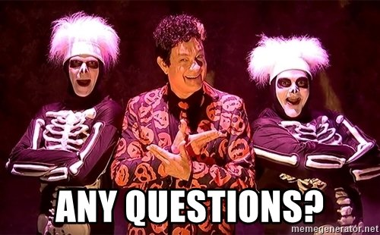
Thank you

