Slide 1
2017 EMPLOYMENT LAW REVIEW
Practical Compliance and Risk Management in a Brave New World

Slide 2
Presented by Angela Snyder, Esq. & Lynne Ahearn
angela@foleylawpractice.com
495 Palmer Avenue, Suite 3
Falmouth, MA 02540
508-548-4888 (office)
774-255-3065 (mobile)
lahearn@hayscompanies.com
133 Federal Street, 6th Floor | Boston | MA | 02110
(617) 778-5075 (office)
(617) 699-8232 (mobile)

Slide 3
Federal Law in 2017
Updated I-9’s
New Rules for Employer Wellness Programs
Minor changes to ACA…or MAJOR changes
July 1, 2017: OSHA Electronic Reporting of Injury Logs for employers with 250 or more employees, and certain high risk industries with 20-249 employees.
Revised EEO-1 Reporting
The fate of the revised FLSA overtime rules.

Slide 4
Updated I-9’s
The I-9 was updated again in July of 2017. All employers should now be using new I-9 forms, which expires on 8/31/19. New I-9’s can be filled out online.
I-9 is used to verify the identity and employment authorization of individuals hired for employment in the U.S. All employees and employers are required to fill out the form.

Slide 5
New Rules for Employer Wellness Programs
Key Takeaways:
Do not discriminate.
Make it voluntary.
Give notice of information collected.
Reasonable accommodation rules apply.
Confidentiality.
Incentive limits.
New ADA and GINA apply to both participatory and health contingent wellness programs, and limit use of incentive or penalty to 30% of the cost of self-only coverage. In August, Federal Court found that the 30% threshold was arbitrary and remanded the EEOC rules without vacating them.

Slide 6
New OSHA Reporting Rules
Anti-Retaliation Rules took effect December 1. Rules apply to all employers.
New electronic reporting rules took effect January 1, 2017, reporting starts on December 1, 2017 and lawsuits are ongoing. These rules apply to employers with 250 employees and those with 20 or more employees in high risk industries.
Administration could roll back rules before reporting starts on December 1.

Slide 7
Sample of industries that must submit (Form 300A) data to OSHA electronically
NAICS | Industry
6219 | Other ambulatory health care services
6221 | General medical and surgical hospitals
6222 | Psychiatric and substance abuse hospitals
6223 | Specialty (except psychiatric and substance abuse) hospitals
6231 | Nursing care facilities
6232 | Residential mental retardation, mental health and substance abuse facilities
6233 | Community care facilities for the elderly
6239 | Other residential care facilities
6242 | Community food and housing, and emergency and other relief services
6243 | Vocational rehabilitation services
7111 | Performing arts companies
7112 | Spectator sports
7121 | Museums, historical sites, and similar institutions

Slide 8
EEO-1 Pay Data Reporting
Final rules revising the EEO-1 report to add W-2 earnings and work hours reporting were scheduled to go into effect in early 2018. Revised EEO-1 would have gone into effect on March 31, 2018, and would have required employers with more than 100 employees to report w-2 wage information and total hours worked.
In August the White House suspended pay-data reporting on the revised EEO-1 form while keeping the new EEO-1 reporting deadline.

Slide 9
Affordable Care Act
It is still the law.
In fact, the IRS issued a letter in June reminding employers that the legislative provisions of the ACA are still in force and taxpayers are required to follow the law. This includes the Employer Shared Responsibility rules, or “play or pay” mandate for employers.
Until the ACA's employer coverage and reporting obligations are changed through legislative actions or reforms, businesses with 50 or more full-time employees or equivalents (Applicable Large Employers, or ALEs) must provide ACA-compliant health coverage to employees who work at least 30 hours per week, or 130 or more hours monthly. They must also track and report all employee hours to the IRS and follow other administrative requirements.

Slide 10
Fate of the New FLSA Overtime Rules
A court issued final order invalidating the rules.
The DOL has issued a “request for information” (RFI) asking for public input in the creation of new rules.
With the exception of increasing salaries, the course of actions employers should have taken in anticipation of new rules should be continued.

Slide 11
2017: Massachusetts
Pay Equity
Update to CORI law
An Act Regulating Employer Contributions to Healthcare
Legal Marijuana

Slide 12
Pay Equity Law
The law was designed to close the wage gap between men and women. The Act provides greater clarity on what constitutes unlawful pay discrimination and imposes new rules and restrictions on employers.
The law goes into effect January 1, 2018
The Act establishes an affirmative defense for employers who have audited their pay practices within the prior three years. Specifically, employers who voluntarily review their pay practices and “demonstrate that reasonable progress has been made towards eliminating compensation differentials based on gender for comparable work,” have an affirmative defense to pay discrimination claims.

Slide 13
What to do about salary history?
As of January 1, 2018, Massachusetts employers must remove the salary history question from applications.
Other states and cities around the country also have new salary history bans. In fact, in 2016 nearly half of all states reviewed legislation that would ban the salary history questions.
There is now data indicating that the salary history question does negatively impact women, which means employers have a pay equity problem as of day 1.
If women are hired at a lower number, a pay equity problem will exist later even if the employer has no discriminatory practices in place.
To reduce risk, consider a Pay Equity Audit combined with exploring new means of establishing starting pay.
When conducting a pay equity audit, consider using outside counsel to shield findings with attorney client privilege.

Slide 14
An Act Further Regulating Employer Contributions to Health Care
The new law is part of an initiative designed to respond to a growing trend of employees shifting from commercial insurance to publicly sponsored coverage because of premium increases. The Act is expected to raise $200 million in employers’ fees to fund MassHealth in two ways.
1. The law will increase the existing Employer Medical Assistance Contribution (“EMAC”) from an annual maximum fee of $51 per employee to $71 per employee. EMAC funds are used to subsidize health care for low-income Massachusetts residents.
2. The law will penalize employers with a fine of up to a maximum of $750 for each non-disabled worker who receives health insurance coverage through MassHealth or subsidized coverage instead of through their employer-sponsored health insurance plan. Prior to the passage of the Act, employers were not directly fined if their workers received coverage through MassHealth or the Massachusetts Health Connector instead of through their employer-sponsored plan.

Slide 15
How to Comply
Account for the impact that this temporary assessment will have on operating costs.
Review current EMAC and unemployment insurance liabilities to best evaluate the additional impact these tiered assessments represent
Review health insurance offerings and employee communications pertaining to those offerings to ensure that that employees are informed of any applicable employer-sponsored benefits to maximize employees on the plan.

Slide 16
Updated CORI Policy and Administration
Massachusetts issued final revised regulations to the Criminal Offender Record Information database, more commonly known as CORI. CORI includes records from Massachusetts’ criminal justice agencies. In order for background checks to include Massachusetts criminal records, a CORI check must be run.
The updated regulations require employers to update policies, record keeping and documents destruction practices and adverse action notices to potential employees.

Slide 17
Alright, Alright, Alright. Let’s Talk Marijuana…and Emerging Trends for Addressing Drug Use in the Workplace
Marijuana legalization passed by more than 1.7 million votes in November. It is now legal for individuals over the age of 21 to possess, use and grow marijuana at home. It permits stores to sell marijuana beginning January 1, 2018.
A clearly communicated and enforced policy prohibiting the use and possession of marijuana and other controlled substances while at work is still enforceable.
However, the Massachusetts Supreme Judicial Court has held that medicinal marijuana use may be a reasonable accommodation under the ADA.

Slide 18
“In looking for people to hire, you look for 3 qualities:
Time magazine named Warren Buffet one of the most influential people in the world.
Integrity
Intelligence
Energy
and if they don’t have the first, the other two will kill you.”
-Warren Buffet
All. Together. Certain.
18

Slide 19
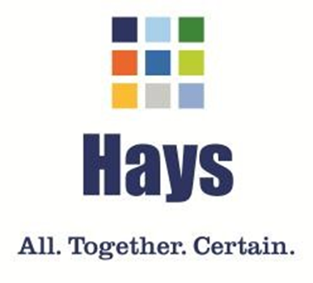
Who you are hiring and how?
Traditional screening methods such as background checks and drug testing, can be expensive and typically occur late in the hiring process. This can lead to many adverse effects on the workplace.
Integrity Testing – Pre-employment screenings analyze the likelihood that employees will engage in counterproductive work behavior. Such testing administered in the initial phases of the hiring process can help identify applicants who are at high risk for theft, substance abuse, hostility towards others and dishonesty. This approach has proven to be EEOC compliant and non-discriminatory.
All. Together. Certain.
19
Notes:
Next Slide Christiensen Return from Farms Video

Slide 20
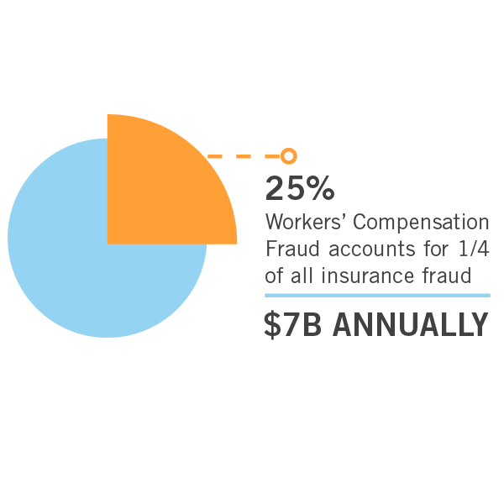
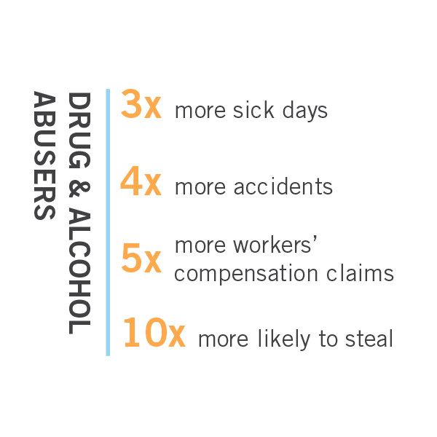
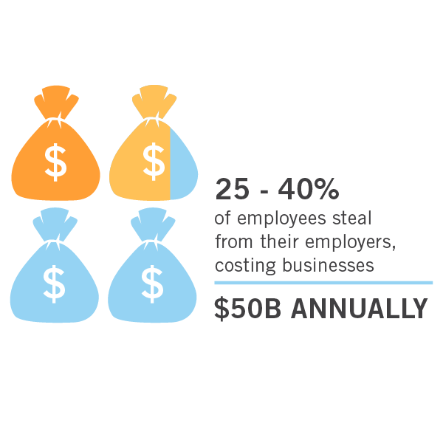
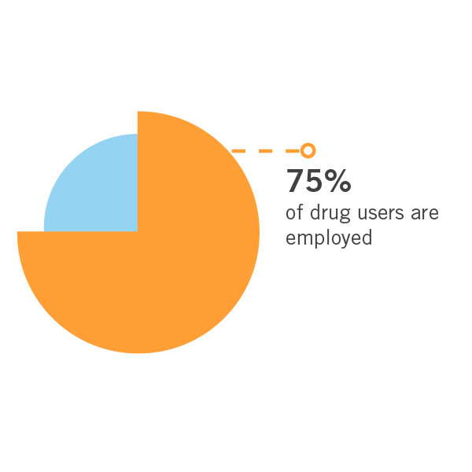
Hiring the Right People
All. Together. Certain.
20

Slide 21
Hiring the Right People
Drug & Alcohol Abuse Increased WC Claims and Costs
Continuous
Turnover
Employee
Theft
All. Together. Certain.
21

Slide 22
Cognitive Dissonance
Rationalize ‘risky’ behavior as normal to justify their behaviors when their life styles are in conflict with their values
Drug Use
Hostility
Theft
Covert
(Personality)
Lying
VS.
Overt
(Self Admitting)
All. Together. Certain.
22
Notes:
Suggested VO: Now most people at this point are thinking, why would a anyone answer a direct question honestly about stealing? It’s a psychological principal known as cognitive dissonance. Simply put, cognitive dissonance is the human behavior when individuals who are involved in ongoing, “risky” behaviors will over time begin to rationalize their behavior as normal. As a result, they have no issue with answering direct questions about their current or recent abnormal “risky” behavior. (MIT hostility, drug use, theft and lying(faking). Understanding the psychology of questioning for cognitive dissonance has lead us to an overt integrity test that has been tested on millions of applicants with some powerful results.

Slide 23
Drug & Alcohol Use
All. Together. Certain.
23

Slide 24
Theft Behaviors
All. Together. Certain.
24

Slide 25
Results
Less workplace violence/bullying
Reduced employee theft/shrinkage
Instant results - accelerates the hiring process
Reduced absenteeism
Fewer negligent hiring suits
Identification of applicants with an “entitlement mentality”
Reduction in non-occupational disability losses
All. Together. Certain.
25
Notes:
Suggested VO: No ones should be concerned about the costs associated with a new health care system or skyrocketing worker compensation costs or increasing turnover rates in their businesses right?
This is where I want to start today by showing you where we are headed in this presentation. It’s kind of like looking at a fantastic results before you start the process of getting the results. You’re not quite certain how your going to get there, but having a picture to start with gives you a great idea of where you want to go.
What we are doing is sharing with you a similar picture of where you want to go. A sweet spot, if you will for employee costs and trends that many of our Integrity Test clients enjoy

Slide 26
Approach Compliance the Way You Approach Achieving Your Nonprofits Mission: Strategically.
Develop effective trending. Trending is the theory that we can predict errors by trending low level mistakes that didn’t have big consequences. The near misses are the mistakes that were caught before they resulted in a loss, or the injury that almost happened. These are the “we got lucky” scenarios. These offer incredible insight into areas of exposure for any company. Each near miss is an opportunity to proactively evaluate high risk areas of liability.
Identify your barriers.
Update your policies and practices, including integrity testing and handbooks to address near misses and barriers. This will ensure employees, managers, HR and executive leadership all understand compliance to the level needed to mitigate risk at every level of the organization.
An effective risk management assessment presents an organization with an opportunity to correct a problem before it becomes a consequential incident. Near miss identification of “we got lucky” scenarios represent an opportunity for growth.

Slide 27
Questions?
The attorneys at Foley & Foley, PC are available to assist with:
Handbooks and Handbook Updates
Policies
Employment Law Audits
Workplace Compliance Assistance
Training
Workplace Investigations
(508) 548-4888
info@foleylawpractice.com
http://www.foleylawpractice.com/
WE BLOG! https://workplacelawhelp.com/
The advisors at Hays Companies are available to assist with:
Health Plan Analytics & Reporting
Underwriting/Risk Pool Management
Population Health Management
Enterprise Cost Containment
Specialty Resources/Services
International Benefits
(617)778-5075
lahearn@hayscompanies.com
http://www.hayscompanies.com
https://vimeo.com/hayscompanies

