Slide 1
Greater Institutional Abundance
Through Effective Relationship Building
Andrea B. Wasserman, President, Social Profit Ventures
abw@socialprofitventures.com
www.socialprofitventures.com
202-271-2469
Notes:
Build out a 70 minutes session..
Part One
Opening: Slides 1 – 3 with in a word ice breaker – 7 minutes
RESOURCE BOOK
30 MINUTE FREE CONSULTATION
Part Two: Inspiration: Slides 4 – 7 - 7 minutes
Part Three: Bolster 45 minutes
Part Four : 2 min close

Slide 2
Agenda Inspire*Bolster*Empower
Inspire campaigners to approach this sacred work with renewed energy, greater resourcefulness, and expertise
Bolster both new and veteran campaigners in their efforts to enhance their major donor relationship methodology
Empower campaigners to activate and achieve even greater fundraising success in FY2018 and beyond
Notes:
Part One:

Slide 3
Exercise One (PN 4): In a Word…
As you think about the aspirational vision of your nonprofit, please consider and share in a word, what the term Institutional Abundance represents to you?
Notes:
Part One

Slide 4
foundation of your practice
Part Two: Inspire
Notes:
Part Two:

Slide 5
Exercise Two (PN 5): Passion, Mission, Impact, Need
Articulation of your deep passion for the vitality of your nonprofit that is anchored in an understanding of the mission, impact, and financial needs of the organization
Notes:
Part Two:

Slide 6
Knowing Your Donor’s/Prospect’s Story
WHAT IS IMPORTANT TO THE INVESTOR/DONOR? AND WHY?
WHAT ARE EXAMPLES OF COMMUNAL IMPACT?
WHAT IS YOUR ORGANIZATION DOING THAT NO ONE ELSE IS DOING?
Notes:
Part Two:
SESSION TETHERED TO YOUR REALITY WHEN HAVE IN MIND SEVERAL DONORS AND PROSPECTS AS CASE STUDIES
YOUR STORY PACKAGED IN A COMPELLING WAY THAT SPEAKS TO YOUR DONOR… NOT WHAT YOU WANT TO TELL YOUR DONOR, WHAT YOUR DONOR WANTS TO HEAR

Slide 7
Inspired Donor: Synthesis of These Elements
Articulation of Compelling Needs and Desired Impact
Your Connection To Compelling Needs
Donor’s Values, Interests, etc....
Inspired Donor: Synthesis of These Elements into Powerful Story
Notes:
Part Two:

Slide 8
Your Methodology
Part Three: Bolster
Notes:
Part Three: How do we get into relationships with right people and nurture these relationships

Slide 9
Fortification of your methodology
Articulation of your deep passion for the vitality of your nonprofit that is anchored in an understanding of the mission, impact, and financial needs of the organization
Notes:
Part Three:

Slide 10
The Journey: Development Relationship Cycle
Identification
Cultivation
Solicitation
Stewardship
Discovery
Notes:
Part Three
Sprint through the relationship journey with pit stops along the way

Slide 11
Identification
Identifying potential donors who
may have the capacity to
make gifts of $X,XXX or more.
Notes:
Part Three
How do you find donors?
WORTHWHILE ARTICLE IN RESOURCE BOOK ON ABCS OF PROSPECTING – ABC’s donor prospecting; Finding donors in plain sight

Slide 12
ABCs of Identifying Prospects
Access: People we already know or with whom we share a solid connection.
Belief: People who share similar interests or already believe in our mission.
Capacity: People with the ability to move up the giving pyramid.
“The ABCs of Donor Prospecting,” by Iris Sutcliffe, March 27, 2015
www.networkforgood.com
Notes:
Part Three
Strategic in our prospecting efforts and not on a wild goose chase…
Best methods for sourcing for donors?

Slide 13
Fruitful Place to Source
Mid Tier Donors
General Fund
General Fund
Major Donors
Major Donors
Notes:
Part Three

Slide 14
Exercise Four (PN 10): Collective Wisdom
Where are your best major donor prospects likely to come from?
Notes:
Part Three

Slide 15
Discovery
The “Discovery Process” is understood to be the collection of the activities and actions—electronic research, peer screening research, phone calls, letters, emails, and visits—taken to initially qualify a prospect as a potential major prospect.
—Gonser Gerber
Notes:
Part Three
PROSPECT RESEARCH AT FINGERTIPS

Slide 16
Moves Management
As David Dunlop, creator of the system, described it, “The moves concept focuses major gift fundraising on changing people's attitudes so they want to give. To do this, we take a series of initiatives or moves to develop each prospect's awareness of, knowledge of, interest in, involvement with, and commitment to the institution and its mission.”
Notes:
Part Three:
Focus on the DONOR NOT THE GIFT

Slide 17
Components of Moves Management Program
Select 10-25 best prospects
Gather research on each prospect
Identify volunteer/board member and staff for each (this person will be
responsible for cultivation and solicitation)
Consult volunteer/board member/staff about prospect
Develop strategy for each prospect with gift amounts and gift opportunities
Plan next 5-10 moves
Implement moves
Review status every quarter months
Review at end of year and move new prospects in or old prospects out
Track
Prospect | Type | Last Gift | Potential Gift | Stage | Interest Area | Strategy | Next Step

Slide 18
Cultivation
Cultivating prospects through personal outreach and donor-centered strategies that involve appropriate staff and volunteers and incorporate what you have learned about a prospect.
Notes:
Part Three

Slide 19
Exercise Four (PN 14): Cultivation Strategies That Inspire
Please think about a prospect or two that have been activated.
Drawing upon what we learned thus far, what tools/resources do you have to not only educate, but also inspire your prospects, according to their interests?
Notes:
Part Three:

Slide 20
Your prospect has been identified, research done, interests determined, and a cultivation process has led you to the moment of fundraising truth.
It’s time to ask for the gift.
Notes:
Part Three
According to the Public Management Institute (Conrad, 1978) not asking the single biggest mistake made in fundraising. An Independent Sector poll conducted from May to July, 2001 (p. 26, Nov 8, 2001, The Chronicle of Philanthropy) 56 percent of households say that they have been asked to give by at least one nonprofit; of these, 95 percent made a donation to at least one nonprofit compared to 79 percent of the households that did not receive a solicitation. Again, the best form, most effective way, of asking for a gift is personal solicitation.

Slide 21
Moment of Fundraising Truth
So what’s your next move?
Notes:
Part Three

Slide 22
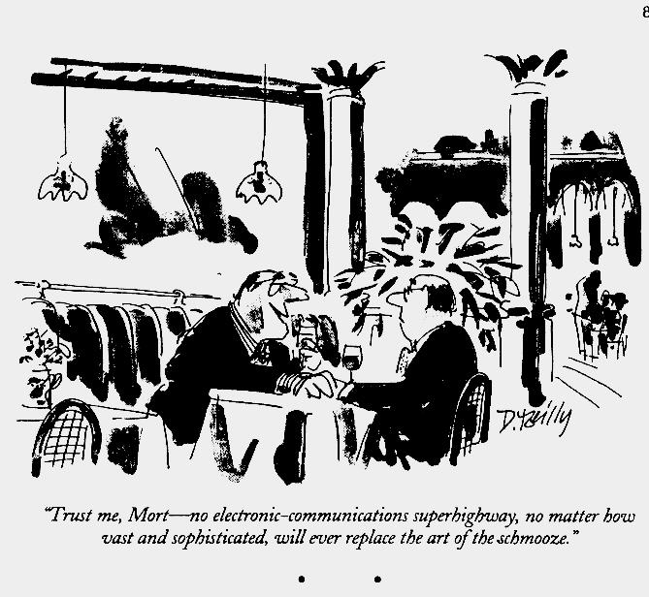
Notes:
Part Three

Slide 23
Solicitation: Wisdom from Colleagues
Prep
The Negotiation
The Close
Land the meeting
Opening
The Case
The Ask
Post Meeting
Soliciting gifts for specific amounts that reflect the cultivation strategy and represent personally significant or stretch commitments.
Notes:
Part Three
MAP OF THE PROCESS AS WAY OF ANCHORING OUR PRACTICE.
RECOGNIZE NEVER TIES UP THIS NEATLY
Prep
Landing the Meeting
Opening
Case
Ask
Close
Post Meeting

Slide 24
Exercise Six (PN 15-16): Personalize Solicitation Pop Quiz
Prep
Who should be invited to the meeting?
Land the Meeting
What is the best locale for the meeting?
Opening
What are the best ways for you to establish a rapport and prime this conversation for success?
The Case
Engage first, then educate prospect about organization from his/her perspective
Translate this into real action
Notes:
Part hree

Slide 25
Exercise Six (PN 15-16): Personalize Solicitation Pop Quiz
The Ask
Define the amount that you are asking for
After you ask your prospect to consider a gift of $x,000, what is your next move?
The Negotiation
How would you respond to resistance – “I’m not ready to make a commitment now?”
The Close
When is the right time to close the conversation?
Post Meeting
You have secured the gift, now what?
Notes:
Part hree

Slide 26
Stewardship
“The ongoing relationship with a donor based on mutual respect for both the source and impact of the gift.”
—Beyond Fund Raising, Grace, 1997; Beyond Fundraising, Second Edition, 2005
Notes:
Part Three

Slide 27
Practice
Part Three: Empower
Notes:
Part four: Wrap Up 5 minutes

Slide 28
Practice
Fortification of your methodology
Articulation of your deep passion for the vitality of your nonprofit that is anchored in an understanding of the mission, impact, and financial needs of the organization
Notes:
Part Three:

Slide 29
Exercise Six (PN 17): Practice the Ask Over Lunch or Coffee
Prepare
Think about your donor’s motivations and interests and how you can help him/her to succeed at philanthropy
How will you talk to you donor about the mission? Where would he/she see greatest value proposition?
Be prepared for objections. Imagine the issues the donor might raise and come up with appropriate answers
Give your partner the profile of the donor or prospect you have chosen
Employ your methodology and role play with your partner
Freeze; give feedback. Switch; repeat

Slide 30
As fundraising guru Jerold Panas says,
“You don’t have to be great to start but you have to start to be great.”
Notes:
Part 5:

Slide 31
With deep gratitude!
Andrea B. Wasserman, President, Social Profit Ventures
abw@socialprofitventures.com
www.socialprofitventures.com
202-271-2469
Edited by Zach

