Slide 1
Bridge for Resilient Youth in Transition (BRYT)
July, 2015

Slide 2
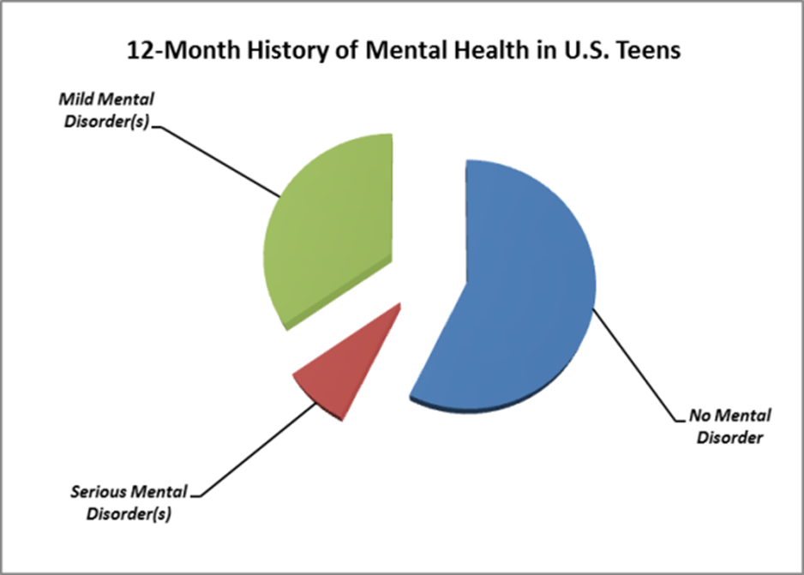
8% of teens have serious emotional disorders
from Kessle et al, Arch Gen Psych 69 (NO. 4), APR 2012

Slide 3
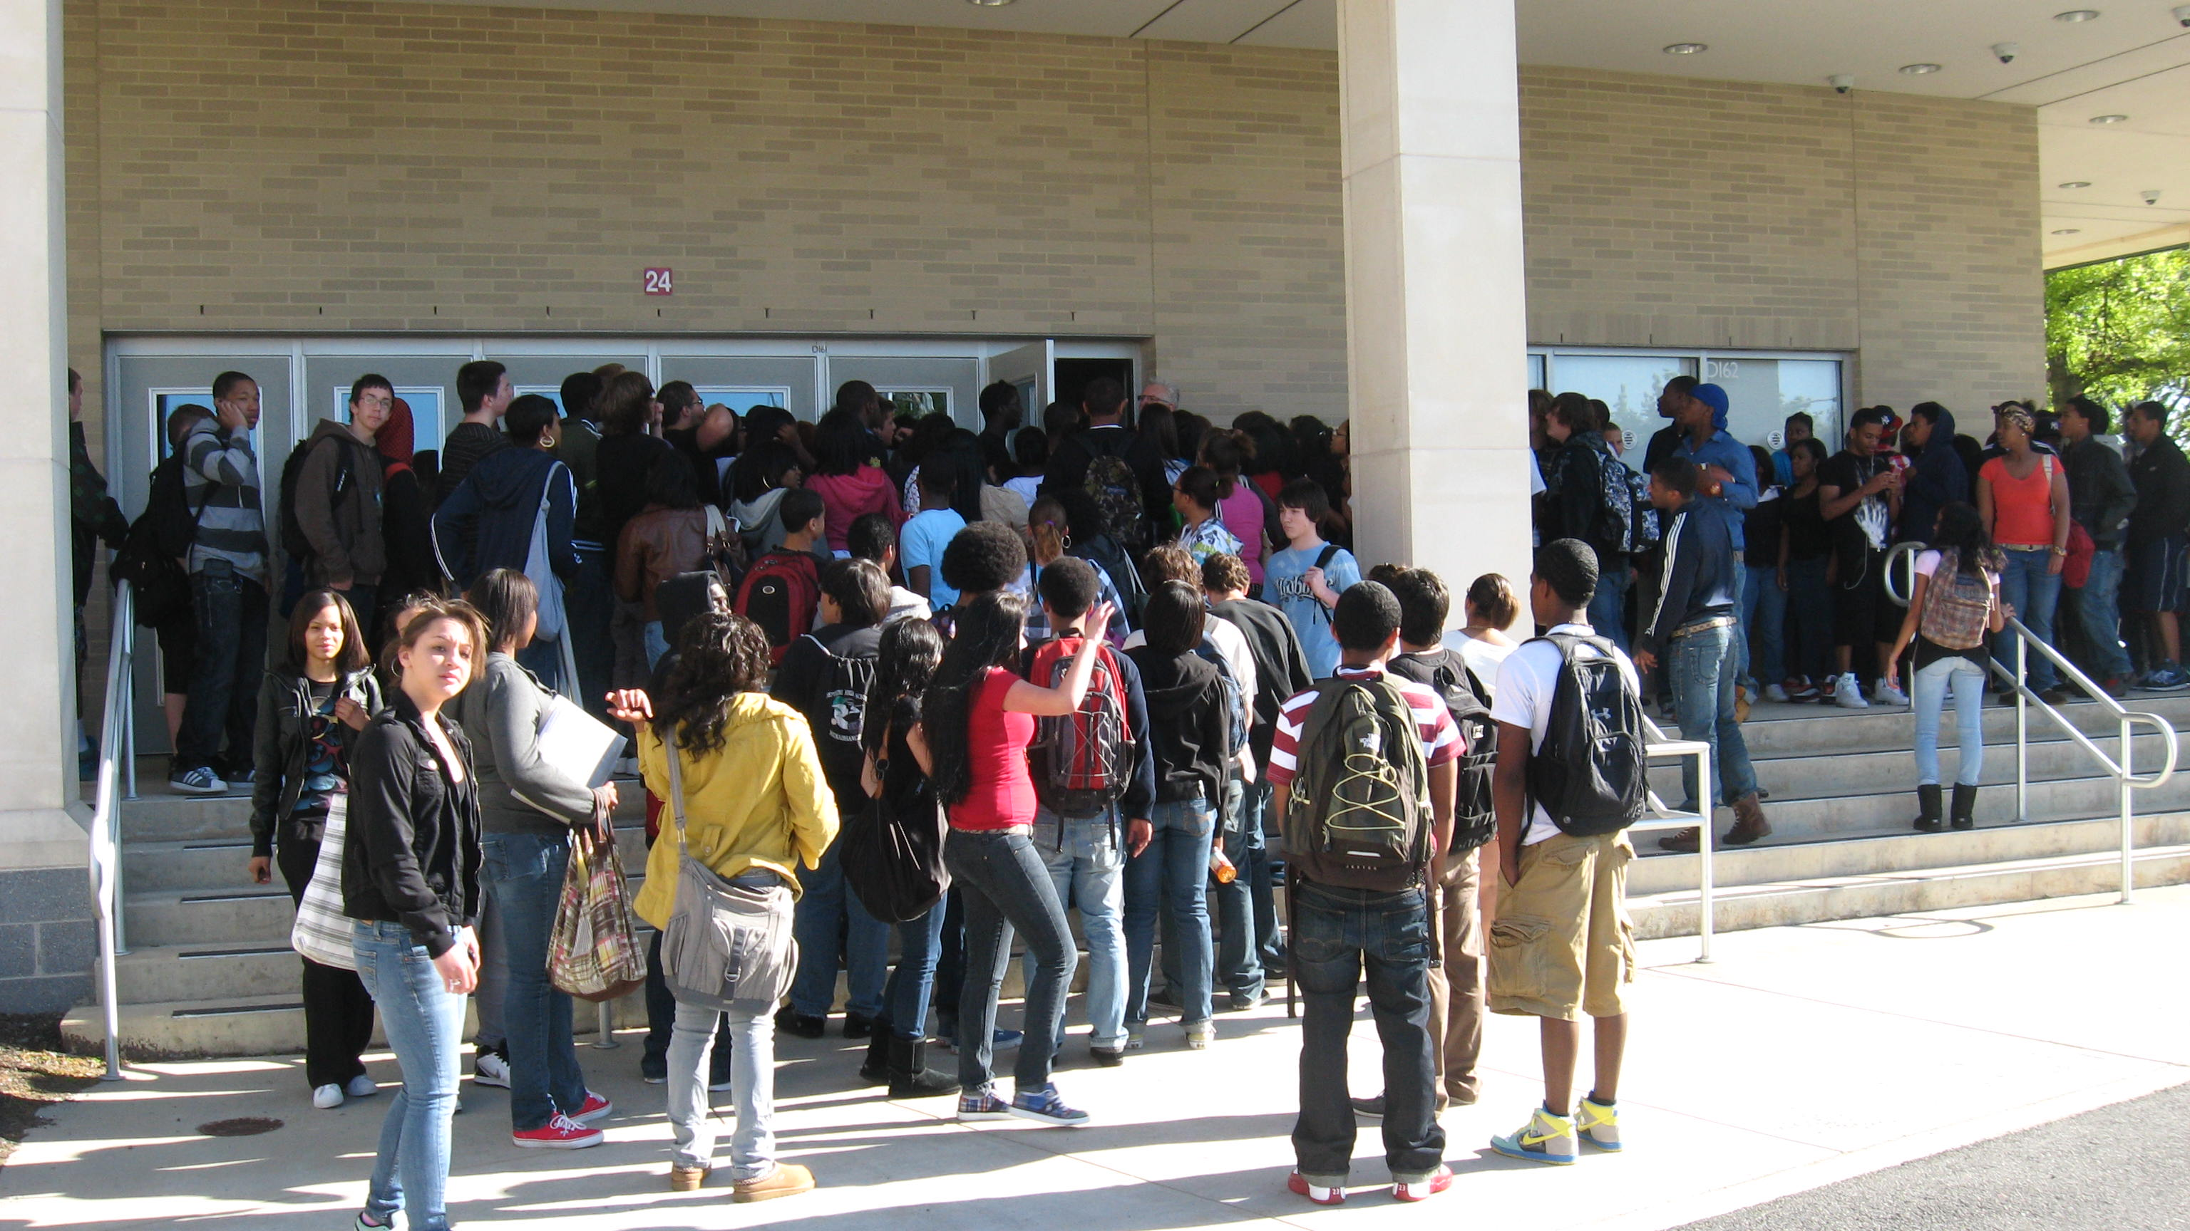
A DIFFICULT CHALLENGE: Returning to high school after an absence due to an emotional disorder

Slide 4
Public high schools as a safety net
17_84 7_84
Lack of Hospital Care
Lack of Aftercare Resources
Public High Schools
Inadequate Insurance Coverage
DCF Policies
Fragmented Service Systems
Lack of Juvenile Justice Treatment Resources
Limitations of Special Education Funding
Notes:
Public high schools have become the safety net provider for youth with serious emotional disorders

Slide 5
Psychiatric illness in adolescence results in poor school performance
CONSEQUENCES OF SED INCLUDE:
lower reading achievement
increased school absenteeism
increased likelihood of grade retention
increased involvement in the juvenile justice system
lower earnings
ABOUT
of high school students living with a mental illness drop out of school. This is the highest dropout rate of any disability group.
50%
A Children’s Health Fund Monograph June, 2010 Roy Grant MAArturo Brito MD, MPH.
.
Department of Education, Twenty-third annual report to Congress on the implementation of the Individuals with Disabilities Education Act, Washington, D.C., 2001.
(c) 2015 BCMHC

Slide 6
Program History
2000
Need for transition support identified:
6% of students were out of school
School guidance staff were taxed to the limit by small number of acutely ill students
BRUT was created by BCMHC and BHS
BRYT replicated for the first time
Received APA Gold Achievement Award
37 high schools across MA have replicated the BRYT program model
2004
2006
2014
2015

Slide 7
BRYT: a school-based program that helps students transition back to school
Program objective: To provide customized, short-term clinical and academic support to enable high-need students to successfully re-enter school after a significant absence.

Slide 8
BRYT serves youth with a wide variety of emotional disorders and medical conditions

Slide 9
Four Key Elements of the BRYT Transition Model
A room in the school open and staffed every day, every period
Two staff
A transition Plan
Clinical, academic, and family support plus care coordination

Slide 10
Impact of BRYT is both academic and behavioral
ACADEMIC
BEHAVIORAL
Helps student succeed in school and avoid dropping out, school avoidance, or repeating a year
92% of students successfully complete the academic year
Enables other school staff to better serve the entire school population
School functioning improvement on standardized measures
Students are helped to engage in treatment, and learn self-care skills
Insure access to behavioral care and prevent re-hospitalization (relapse rate <10%)
Significant improved in standardized clinical measures
Families report decreased stress and anxiety
Source: Bridgespan interviews, site visits

Slide 11
Average School Attendance Rates, Before and After Program Admittance

Slide 12
Changes in Well-Being Over Time
CAFAS Scores Among Participants with a Mental Health Diagnosis (N=147)
*Lower scores indicate better functioning; all differences are statistically significant at p < .05.

Slide 13
Concentrating in one geographic area offers many benefits
Focusing in one geographic area offers key benefits
Analogues demonstrate the value in concentrating
Allows for local momentum including growth by word of mouth, development of local champions, and evolution of supportive local policies that can accelerate later national growth
“It’s often easier for programs to expand statewide first before going national. It shows that the program has momentum and can succeed in diverse places within a state. A lot of programs have done this.” –Center for School Mental Health University of Maryland
Minimizes overhead program costs because only one headquarters / central office needed
Youth Villages initially started out heavily concentrated in Memphis, resulting in:
Being local default provider in TN
Pricing power and strong local reputation that drives referrals and financial sustainability
Platform for demonstrating strong, consistent results
Over ~30 years, Youth Villages has grown from 1 state to 11 and DC.
FWV’s Coaching Boys into Men campaign started as a national initiative, but as they continue to strategically grow the curriculum, they have recognized the value in concentrating geographically
“We’re now going smaller, more regionally based to try to go deeper. You really have to focus first” – CBIM staff
Source: TBG analysis; interview with Futures Without Violence; Bridgespan work with Youth Villages

Slide 14
BRYT’s current pattern of growth through large high schools is a strong platform for the next five years
Growth Priorities
There are 115 large high schools in ma
LARGE SCHOOLS OFFER THE MOST EFFICIENT PATH to growth
School Type | No. of 9-12th grade students | Avg. no. of students | No. of schools
Large | 1000+ | 1,443 | 115
Medium | 500-999 | 729 | 108
Small | 2-499 | 246 | 173
Total |  | 726 | 396
Note: 2013-14 data. Includes all schools with >1 9-12th grade students. Includes charters and technical schools. High school used to represent both high schools and secondary schools.
Source: MA DOE Massachusetts School and District Profiles; 2013-14 Enrollment By Grade Report (School)

Slide 15
Today, BRYT programs are in 37 schools in Massachusetts
This represents 14% of high schools in Massachusetts, a total of 40,000 students
Annually, each serves an average of 34 students -- 2.6% of the student body annually
About 800 students will be served this year
Most programs are funded completely by the school district

Slide 16
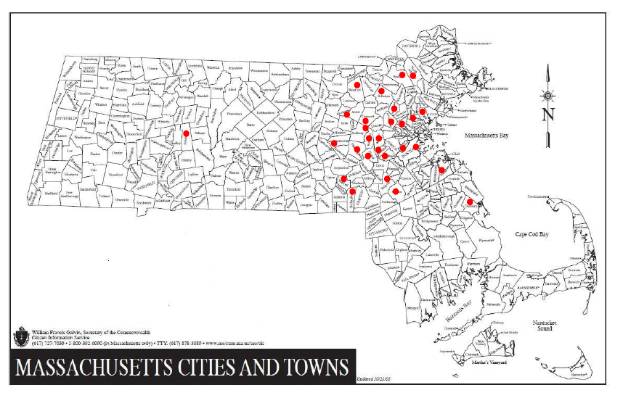
Current BRYT sites

Slide 17
Growth in BRYT 2003-2014

