Slide 1



Performance Measurement Demystified
October 21, 2015

Slide 2
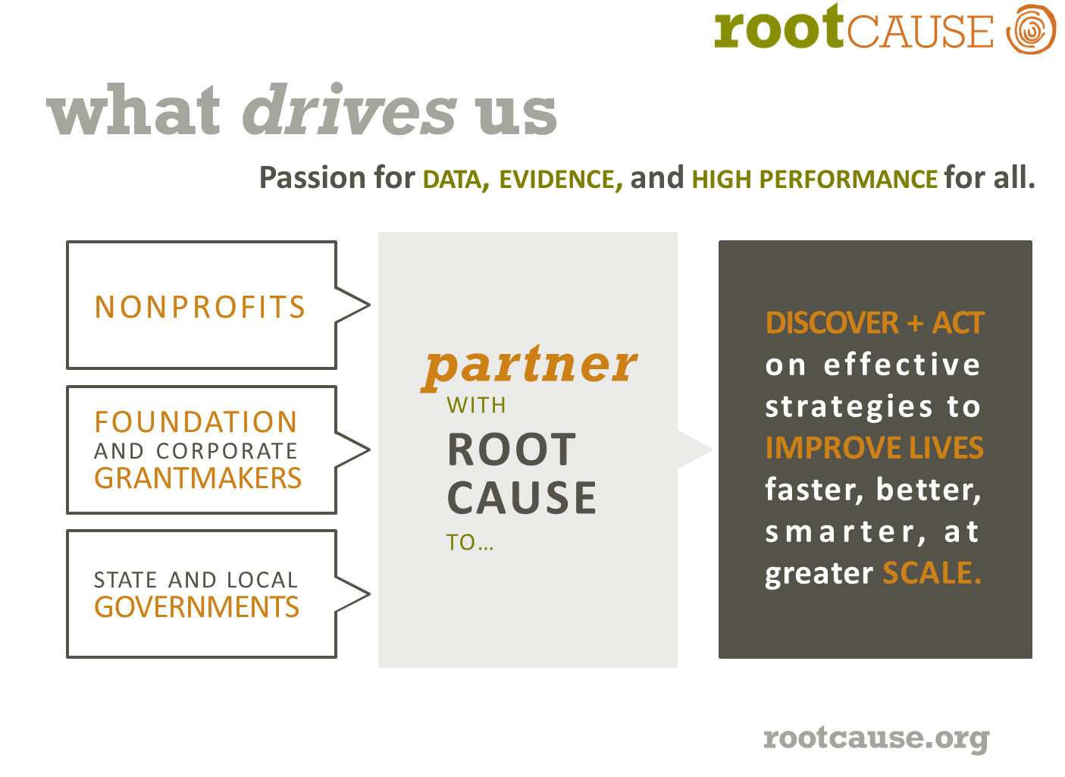

Slide 3
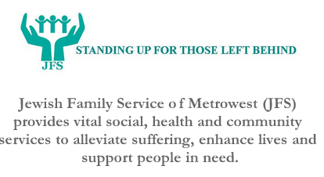


Slide 4
JFS Theory of Change
The Community/ Social Problem
Children, families and elders in both the Jewish and broader communities are in significant distress, facing critical life challenges without sufficient options or resources.
Immigrants and their Families
Intended Impact
The lives of individuals and families improve, given the tools to meet life’s obstacles and manage through crises, to attain stabilization and, in the long run, to achieve self-sufficiency and/or optimal functioning.
Family Assistance
Crisis response and fulfillment of basic needs
Longer-term life strategies and deeper engagement
Community-building and local leadership development in the Jewish community
Elder and Family Caregiver Services

Slide 5
Total US Philanthropy
1985
2011
$163B
$298B

Slide 6
# of Foundations with $440M+ Assets
1985
2011
36
132

Slide 7
Americans Living in Poverty
1985
2013
14%
16%

Slide 8
Health Care Spending as % of GDP
1985
2011
10%
18%
Commonwealth Fund rating of US Health Care Quality 2011:
Last among industrialized nations surveyed
Notes:
http://hspm.sph.sc.edu/COURSES/Econ/Classes/nhe06/

Slide 9
In 40 years, spending has doubled while achievement has not
AVERAGE US PER-PUPIL EXPENDITURES AVERAGE SCALE SCORES ON NATIONAL ASESSMENT OF EDUCATIONAL PROGRESS (NAEP). SPENDING DATA IN CONSTANT 2011-12 US DOLLARS.
Source: National Center for Education Statistics http://nces.ed.gov/nationsreportcard/lttdata
50
#ReimaginED2015

Slide 10
Black-White Achievement Gap

Slide 11


Slide 12
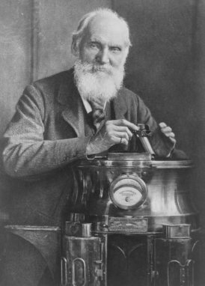
What cannot be measured cannot be improved
Lord Kelvin

Slide 13
high performance improves lives
The framework that guides our theory of change.
Organizational Health
Internal capacity:
Financial sustainability
Strategy and planning
Team and governance
Performance measurement of
internal benchmarks
Programmatic Health
Clear impact:
Program decisions based on data/evidence
Performance measurement
of improvements to lives of people served
High Performance
Working more effectively
and making better progress towards your mission
in a culture and framework of continuous improvement

Slide 14
The Effectiveness Continuum
Apparent
Systematically Collects Data
Intended outcomes specified
Demonstrated
Independent evaluator
Results compared to similar group not in program
Proven
Statistically significant sample
Comparison to randomly selected control group
Outcomes tracked
Internal evaluation resources
Notes:
Edna McConnell Clark Foundation: Three Levels of Quality and Effectiveness

Slide 15
Overview: Stages of Evidence Framework
Effectiveness
High
Low
Strong
Well–supported Evidence with Implementation Guidance
Evidence of Harm
Well-supported Evidence
Unsupported Evidence
Strength of Research
Promising Evidence
Emerging Evidence
Undeter-mined Evidence
Weak
Adapted from: Understanding Evidence: A Guide to the Continuum of Evidence and Effectiveness, CDC
Notes:
This is the framework we are working from. You’ve seen this before
The goal of this work is to identify the “best” evidence that exists for each strategy. Best is not meant to imply any value judgement at all. Instead it shows you the state of the field. I can’t emphasize enough that the state of the research in the social sector is immature – meaning there simply are not a lot of interventions that have been studied to the level to get to the well-supported stage of evidence.
In the social sector we operate in a place mostly here (gesture to promising to undetermined).
There are no really great estimates about how many RCT level studies have been conducted on social interventions. One I recently read is somewhere between 1000 and 2000. When you compare that to 350,000 therapeutic RCTs that’s not many.
This mapping is about helping you understand the reality of the evidence in the areas in which you are working.
As grantmakers its important to know what evidence is out there so that you can both use evidence where it does exist AND help develop the evidence base where it is not as strong.

Slide 16
The Performance Measurement Cycle
Mission & Vision of Success
ACTIVITIES AND OPERATIONS
Implement decisions to improve activities and operations
improve
measure
evaluate
Track performance using selected indicators
Periodically assess effectiveness with rigorous research methodology
Extract knowledge from the data, identify opportunities
for improvement, and make data-driven decisions
learn
report
Communicate performance internally and externally

Slide 17
Theory of Change Framework
Activities/
Interventions
Outcomes
Social Problem
Short-term
(<1 year)
Medium-term
(1-3 years)
Intended Impact
Longer-term
(>3 years)
Strategies
Outcomes Indicators
Process Indicators

Slide 18
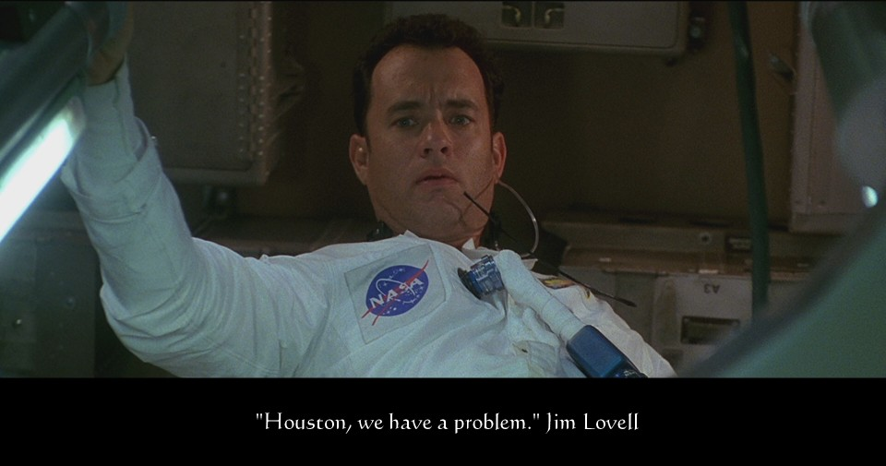
1. Define The Problem You’re Solving

Slide 19
2. Get Intended Impact Right
Closing the achievement gap between majority and minority students is the civil rights struggle of this generation. Efforts to reform schools may ultimately succeed in closing the gap, but for today's children, "ultimately" is unacceptable. SEO will close the achievement gap today—for 600 students in New York City and San Francisco this year. We will grow this number by 150 students annually.
What
How Much
For Whom
By When
…close the achievement gap …
…grow number by 150 students
students in New York City and San Francisco
this year…

Slide 20
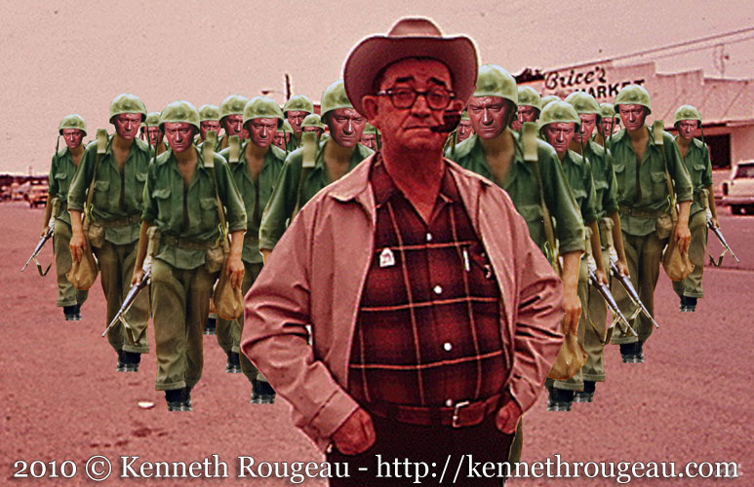
3. You and What Army?

Slide 21
4. Make The Data Actionable
What are the assumptions that underpin your program model?
How are you going to test them?
How will you change your model based on what you learn from your tests?

Slide 22
Theory of Change Case Study
Process and Outcome Tests
Co-development with citizens of technologies by public offices
Citizens increase participation and feedback
Social Problem:
Lack of gov’t accessibility, transparency and responsiveness
Interventions that introduce and model technology usage for public service offices
Intended Impact:
Citizens are going to engage and gov’t is going to respond
Adoption and spread of new technologies by public offices
Public offices are more responsive to citizen input
Process Tests
Outcome Tests

Slide 23
Process Test Scenario
Pilot
Will citizens actually upload content?
Uploads meet expectations
Advance to next stage of development
Scale
Sustain
Advance to next stage of development
Revise App
Repeat test
App dropped
Uploads below expectations
Convene user groups
Advance to next stage of development
PR/Marketing
Repeat test
App dropped

Slide 24
Outcome Test Scenario
Can citizen content change gov’t behavior?
Pothole fixes at or above expectations
Advance to next stage of development
Drop app
Advance to next stage of development
Review training and communication with agency staff
Repeat test
Pothole fixes below expectations
Drop app
Review quality of data
Repeat test
Advance to next stage of development

Slide 25
Sample Theory of Change: CollegeSpring
Community/ Social Problem
Low-income minority students are under-represented in 4-year colleges. Barriers to college include the SAT and navigating the college admissions process.
Strategies
SAT Prep
College Readiness Instruction
Mentoring
Activities
40 hours of classes
Diagnostic tests
1:1 feedback
Seminars
Essay Review
College targeting
Match students with recent program grads
Outcomes and Indicators
Process Indicators | Short-term (<1 year) | Medium-term (1-3 years) | Long-term (3+ years)
# of SAT prep classes # of diagnostic tests administered | # or % of students completing the program % of students who are more confident as a result of the program % or absolute increases in SAT diagnostic scores (in-program) | % or absolute increases in SAT scores % of students applying to 4-year colleges % of students accepted to 4-year colleges % retention of partners | % of students showing college persistence over 1-2 years % of students successfully graduating from college
Intended Impact
Students from low-income backgrounds are able to confidently pursue and graduate with 4-year college degrees.

Slide 26
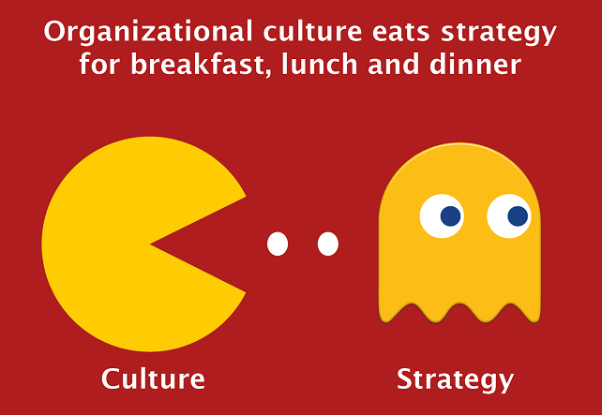

Slide 27
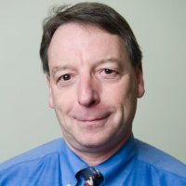
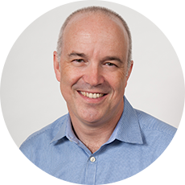
Stephen M. Pratt, Root Cause
Partner & Director of Advisory Services web rootcause.org email spratt@rootcause.org twitter @RootCause @ImpactCatalysts linkedin /stephenmpratt phone 617.394.8126
Thank you. Please stay in touch.
Marc Jacobs, JFS of Metrowest
Chief Executive Officer
web jfsmw.org
email mjacobs@jfsmw.org
phone 508.875.3100 x140

