Slide 1


Slide 2

Why Use Social Media?
Build trust, affinity, authority
Engage directly with supporters and encourage word-of-mouth marketing
Demonstrate impact
Crowdsource ideas and feedback
Community building is never a waste of time.

Slide 3
Why Use Social Media?
43% of social networking site users say that they have decided to learn more about a political or social issue because of something they read about on a social networking site.
18% of social networking site users say that they have decided to take action involving a political or social issue because of something they read on those sites.
  Resource: http://www.pewinternet.org/2013/04/25/civic-engagement-in-the-digital-age-2/

Slide 4

Website = Your Marketing Hub

Slide 5
Speak The Language
The platforms are different, and each has its own audience, users and unique culture.
Take some time to understand the channels:
140 characters and hashtags on Twitter
Pin videos directly from Vimeo and YouTube to Pinterest.
Directly upload or link on Tumblr and Facebook.
The intro to the video should reflect the channel.

Slide 6
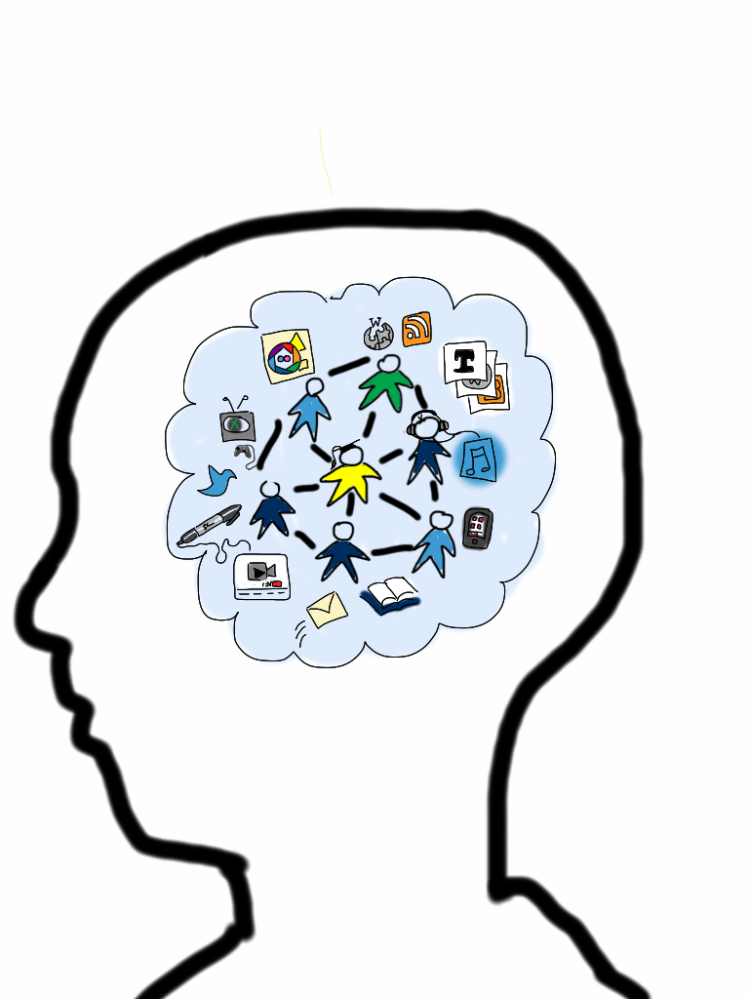
Get Those Shares
Psychological reasons why people share online videos:
Emotional response
Motivation

Slide 7

Video Promotion Checklist
Website
Blog
Email newsletter
Online Ambassadors (GaggleAmp, Thunderclap)
Partner with other orgs
Influential bloggers
Local celebrities

Slide 8
Social Media Specifics
Upload to YouTube and/or Vimeo
Link to Google+
Add to LinkedIn – personal profiles & company page
Add to Facebook
Schedule tweets
More channels!
Tumblr
Pinterest
Instagram (3-15 seconds)
Vine (6 seconds)
Sulia
Quora
Netsquared

Slide 9
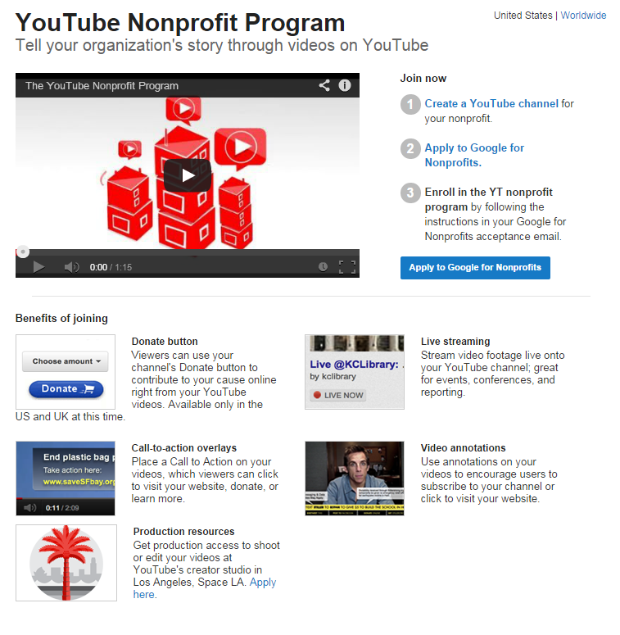

Slide 10
Wording Your Posts
Chicken Little or Little Engine That Could?
Avoid: Latest statistics on elder abuse are just heartbreaking—what if this were your grandmother? http:// samplelink
Advance: Seniors are mistreated more often than we think. Some states made a difference with this commonsense approach: http://samplelink
Resource: https://nonprofitquarterly.org/management/24746-reframing-issues-in-the-digital-age-using-social-media-strategically.html

Slide 11
Wording Your Posts
Enough About You, Let’s Talk About Me
Less: Our very own @executivedirector offered insight into our #issue on this exciting panel: http://samplelink
More: This (http://samplelink) gave us lots 2 think abt. @executivedirector: “We need the talents of all to be available to our communities.”
Resource: https://nonprofitquarterly.org/management/24746-reframing-issues-in-the-digital-age-using-social-media-strategically.html

Slide 12
Wording Your Posts
Taking Too Much For Granted?
Avoid: @studyauthor’s new report shows that atmospheric CO2 concentration reaches 401 PPM: http://samplelink
Advance: Use of fossil fuels for energy causes rampant CO2 to build up, trapping heat worldwide. Learn more from @ studyauthor: http://samplelink
Resource: https://nonprofitquarterly.org/management/24746-reframing-issues-in-the-digital-age-using-social-media-strategically.html

Slide 13

Food For Thought
“If you imagine your social media posts as a set of mini-lessons for people who know little or nothing about your issue, how would you change your approach to them?”
Resource: https://nonprofitquarterly.org/management/24746-reframing-issues-in-the-digital-age-using-social-media-strategically.html

Slide 14
Measurement
How will you know that you are successful?
How will you measure the impact of your video?
Bit.ly, Google Analytics, YouTube Analytics
Tie benchmarks to your goals
Focus on shares, not views
Use the data to track and inform future campaigns

Slide 15
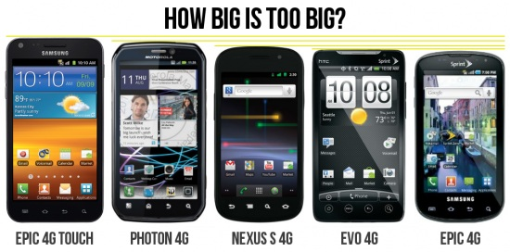
Importance of Mobile
40% of YouTube’s traffic now comes from mobile.
15% of all online video hours globally are viewed on tablets and smartphones.
Resource: http://www.businessinsider.com/mobile-video-statistics-and-growth-2013-12

Slide 16
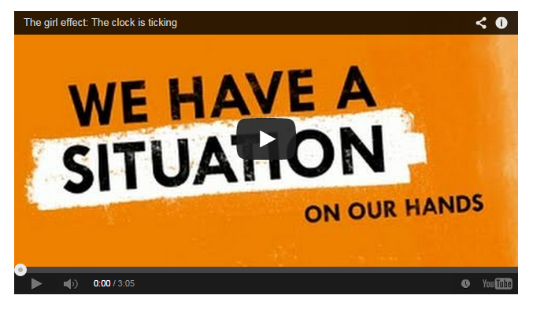
In Conclusion…
For nonprofits especially, using video is KEY to connecting with supporters!

Slide 17

In Conclusion…
Be authentic & credible.
Get over your fear.
Figure out ways to measure your success.

Slide 18
Resources
The Starter Guide to Nonprofit Video Storytelling (free download): http://www.startstorytelling.com/
DoGooder Awards: http://www.youtube.com/user/nonprofitvideoawards
TechSoup Digital Storytelling Challenge: http://www.techsoup.org/community/community-initiatives/techsoup-digital-storytelling

Slide 19
Questions? Feedback?
Julia Campbell:
  julia@jcsocialmarketing.com
  978-578-1328
  www.jcsocialmarketing.com
Rachel Jellinek:
  rachel@reflectionfilmsonline.com
  617-680-2019 cell
  781-646-3252 office
  www.reflectionfilmsonline.com

